Slide 1
Emotion Works
Week 4

Slide 2
Watch
Watch this clip - My Big Shouting Day
There are lots of things that makes Bella shout! How many can you remember?
Is there anything that makes Bella shout that makes you cross too?
https://www.youtube.com/watch?v=dnS7PllYi44

Slide 3
Think
Think back to the work you did on week one about emotion words. What makes you;
SAD?
HAPPY?
ANGRY?
WORRIED?
We call the things that make us feel our emotions “triggers”.
Last week you had a think about all the emotions you have felt lately.
We all show our emotions in different ways, for example when Mrs Kinnear is grumpy she can be a bit snappy with eyebrows that look like this
What colour is Lucy’s hair when she is:

Slide 4
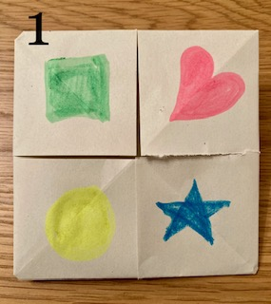
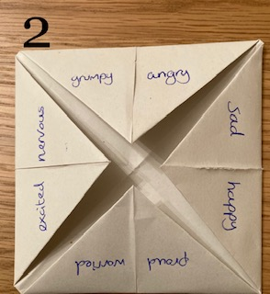
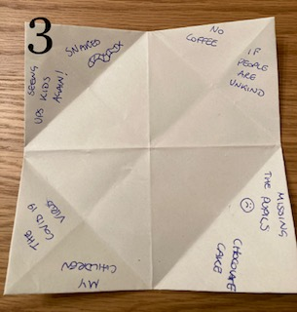
Create
Create an Emotions Trigger-Teller based on how you are feeling right now. You might need to get a grown-up or a big brother/sister to help!
Here is a link to help you - https://www.youtube.com/watch?v=TZauQZzXXc4
On the outside you can pick a colour.
On the inside write an emotion.
Under the flap write your trigger!
Challenge! Play with a member of your family and see if they can guess your triggers!
WAGOLL

Slide 5
Share
If you would like to share your picture or video of your Emotions Trigger-Teller we would love to see them! Share in your class blog or tweet @TEAMUphallPS

