Slide 1

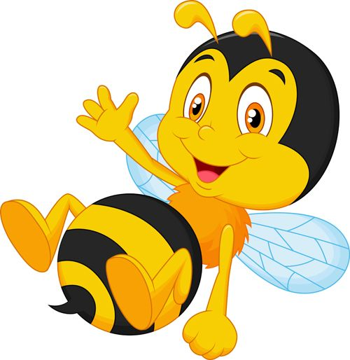
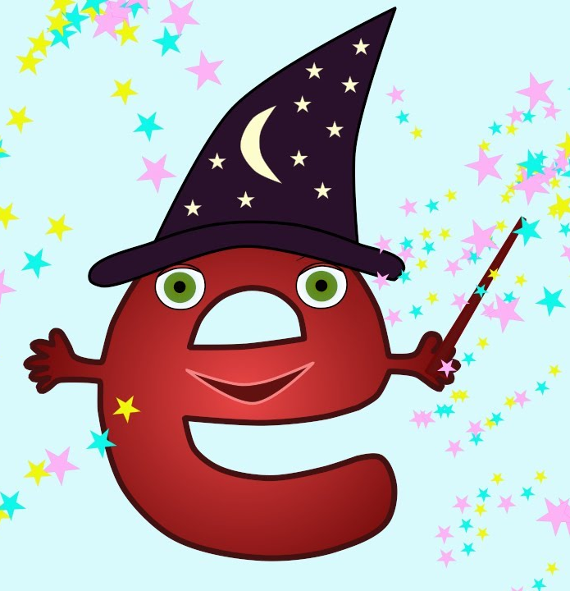


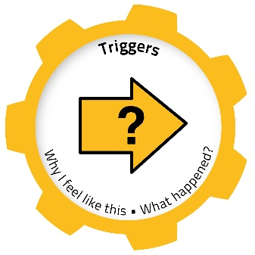
Welcome to week 11 of home learning. Thank you for your commitment so far and well done for all the
blog comments, tweets and photos of your work you have e-mailed. You are all STARS!
This week, we would like you to choose as many activities from the board as you can.
We are all busy in school, tidying, moving, and sorting. We look forward to seeing some of you on Friday (reports)!
SUMMER
Mindful Monday Phonics Please look at Miss Anderson’s Phonics lessons and practice magic ‘e’ (i_e). (Monday and Tuesday) | Terrific Tuesday Plan a summer party You might wish to create invitations, posters to advertise, a shopping list, and recipes for food you prepare. https://www.twinkl.co.uk/resource/t-tp-6279-planning-a-party-activity-sheet | Wellness Wednesday Food for your summer party When preparing for your party, calculate costs of party food, drink and decorations then measure ingredients when baking/cooking. How much will you spend and how will you measure the ingredients? https://www.twinkl.co.uk/resource/t-n-5425-how-many-grams-activity-sheet
Thoughtful Thursday Social distancing at your party When preparing for your party, measure 2m distances so your family can socially distance in your garden. What could you use to measure 2m? (Toys, feet, garden chairs, paper plates etc.) 2m away song: https://www.youtube.com/watch?v=3nQgTywKmvQ |  | Fun Fact Friday Entertainment At your party, make sure your family have fun. You could play a game together (read the instructions), make up a new game (teach the rules), perform a song or dance, share a talent, hold a fancy dress competition or tell each other stories. https://www.twinkl.co.uk/resource/t-im-605-ks2-summer-fun-in-the-holidays-in-the-garden-activity-pack
Emotion works - Yellow cog Please look at Mrs Kinnear’s Emotion Works slides about emotional triggers. | Blue Peter 6 Badges of Summer Challenge https://www.bbc.co.uk/ newsround/52893942 | Make your own….choose… Bunting, party hats, costume. Ice-lollies, juice, cakes, sandwiches.
type
type
type
SUMMER BBQ/PICNIC/GALA/PARTY
WEEK 11
type
type
type

