Slide 2
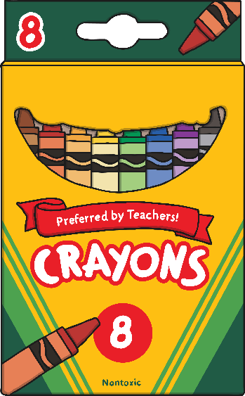
…a packet of crayons?
g
kg
ton

Slide 3
Correct! Well done!

Slide 4
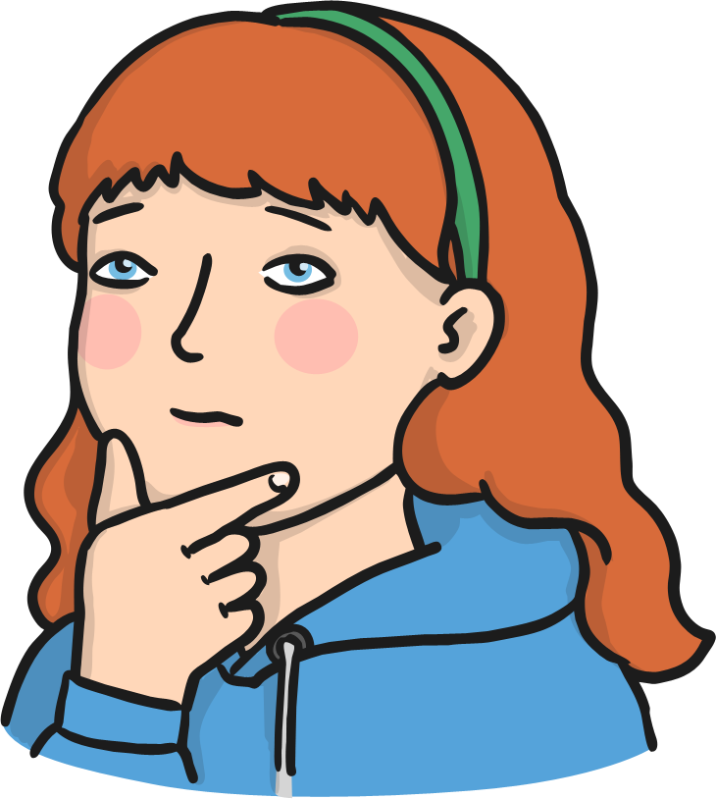
Oh no! Try again!

Slide 5
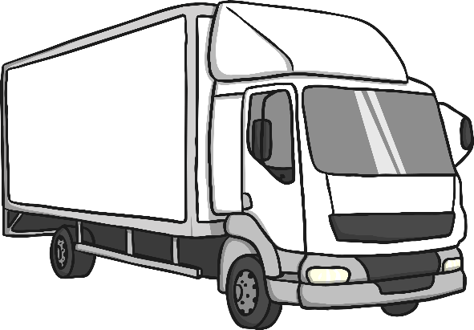
…a lorry?
g
kg
ton

Slide 6
Correct! Well done!

Slide 7
Oh no! Try again!

Slide 8
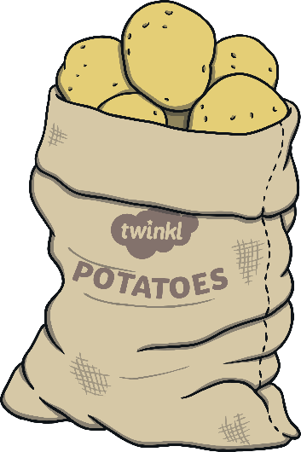
…a bag of potatoes?
g
kg
ton

Slide 9
Correct! Well done!

Slide 10
Oh no! Try again!

Slide 11
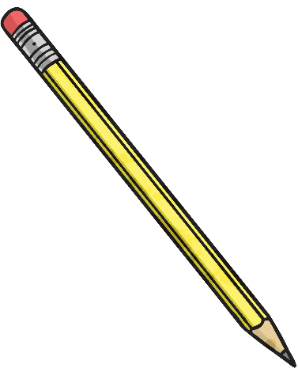
…a pencil?
g
kg
ton

Slide 12
Correct! Well done!

Slide 13
Oh no! Try again!

Slide 14
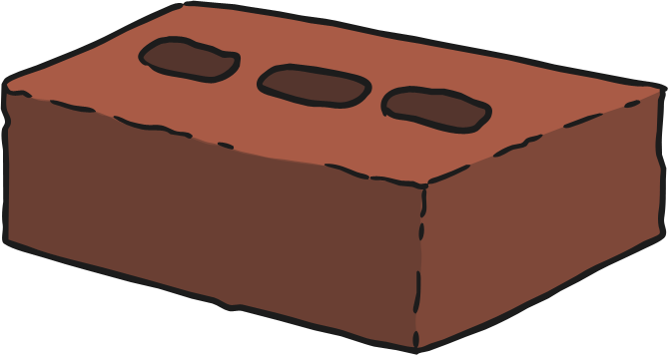
…a brick?
g
kg
ton

Slide 15
Correct! Well done!

Slide 16
Oh no! Try again!

Slide 17
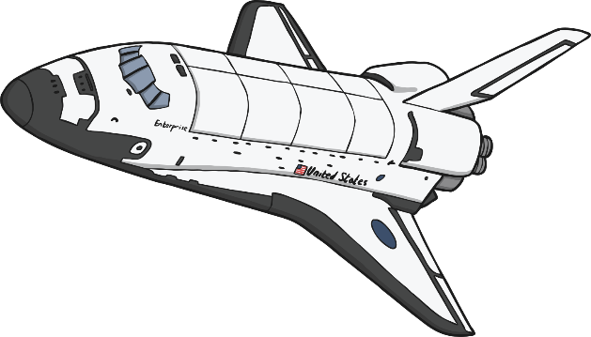
…a space shuttle?
g
kg
ton

Slide 18
Correct! Well done!

Slide 19
Oh no! Try again!

Slide 20
…a letter?
g
kg
ton

Slide 21
Correct! Well done!

Slide 22
Oh no! Try again!

Slide 23
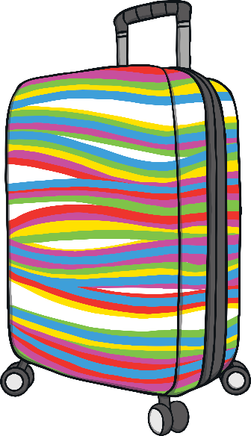
…a packed suitcase?
g
kg
ton

Slide 24
Correct! Well done!

Slide 25
Oh no! Try again!

Slide 26
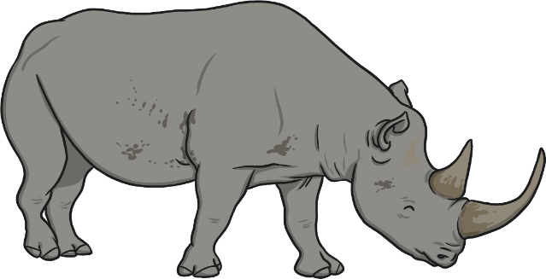
…a rhinoceros?
g
kg
ton

Slide 27
Correct! Well done!

Slide 28
Oh no! Try again!

Slide 29
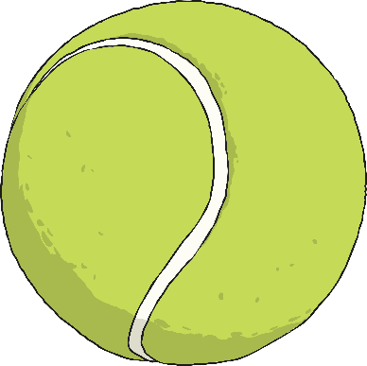
…a tennis ball?
g
kg
ton

Slide 30
Correct! Well done!

Slide 31
Oh no! Try again!

