Slide 2
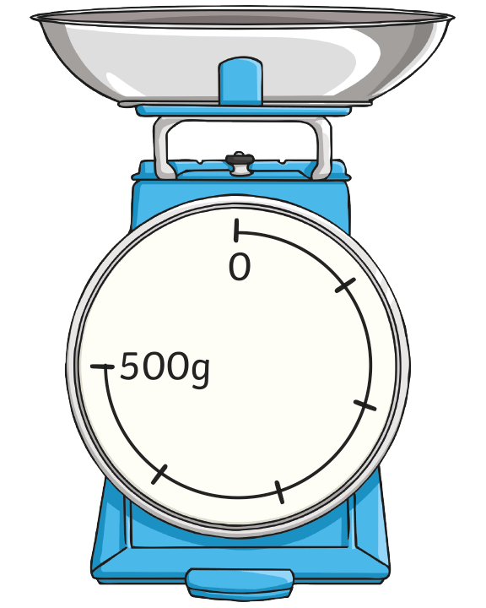
Measure Mass Using Grams or Kilograms
Diving
Intervals on Scales
What is each interval worth?
What mass is shown on these scales?
Show where 200g would be on these scales.

Slide 3
Measure Mass Using Grams or Kilograms
Diving
Intervals on Scales
What is each interval worth?
There are 5 intervals between 0 and 500. 500 ÷ 5 = 100. Each interval is worth 100g.
What mass is shown on these scales?
The pointer is after the fourth interval. Each interval is 100g. The pointer shows 4 × 100g, or 400g.
Show where 200g would be on these scales.
Each interval is worth 100g. 200 ÷ 100 = 2, so 200g would be after the second interval.

Slide 4
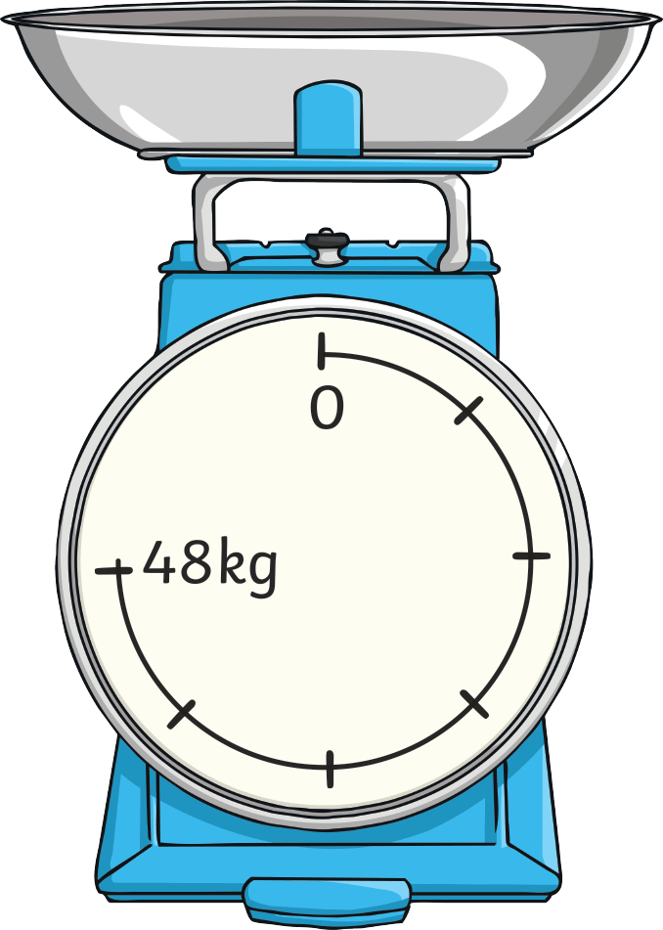
Measure Mass Using Grams or Kilograms
Diving
Intervals on Scales
What is each interval worth?
What mass is shown on these scales?
Show where 32kg would be on these scales.

Slide 5
Measure Mass Using Grams or Kilograms
Diving
Intervals on Scales
What is each interval worth?
There are 6 intervals between 0 and 48. 48 ÷ 6 = 8. Each interval is worth 8kg.
What mass is shown on these scales?
The pointer is after the third interval.
Each interval is 8kg. The pointer shows 3 × 8kg, or 24kg.
Show where 32kg would be on these scales.
Each interval is 8kg. 32 ÷ 8 = 4, so the pointer would be after the fourth interval.

Slide 6
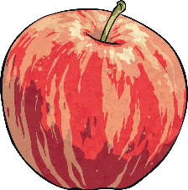
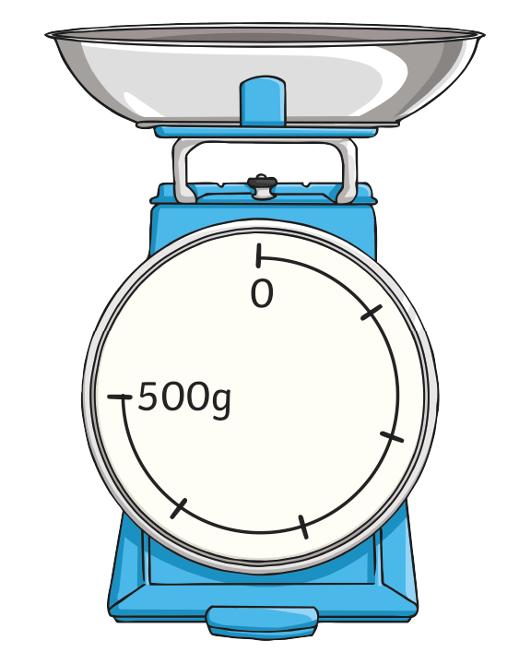
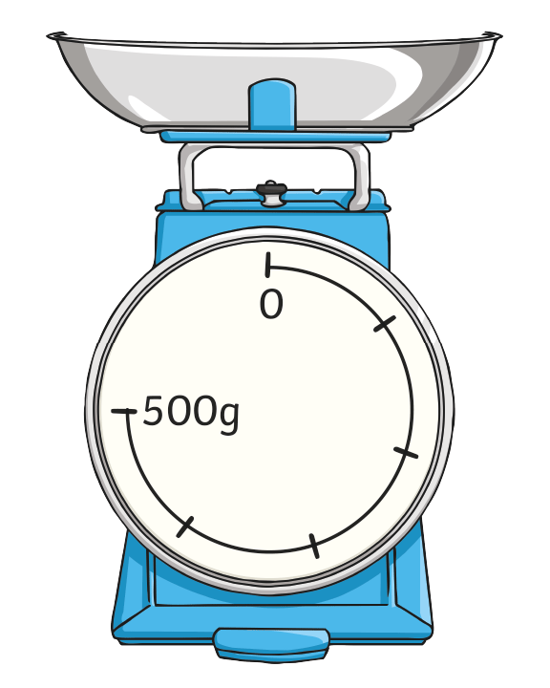
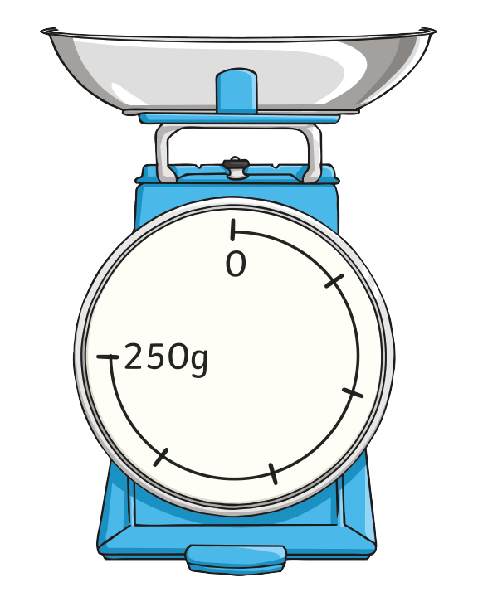
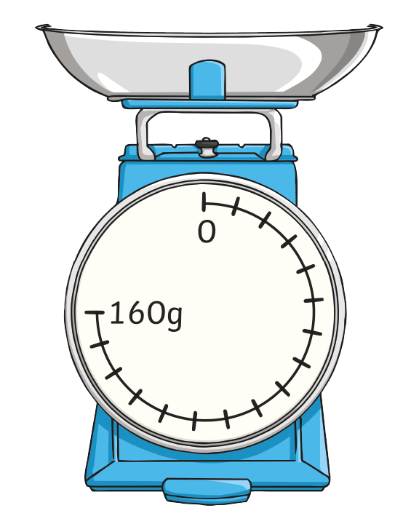
Measure Mass Using Grams or Kilograms
Deeper
Odd One Out
One set of scales shows a different mass. Which one is it?

Slide 7
Measure Mass Using Grams or Kilograms
Deeper
Odd One Out
One set of scales shows a different mass. Which one is it?
Each interval is worth 100g.
The scale shows 125g.
Each interval is worth 50g.
The scale shows 125g.
Each interval is worth 10g.
The scale shows 120g.
The third set of scales shows a different mass.

Slide 8
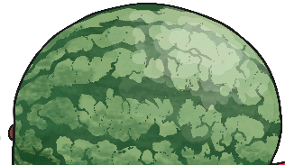
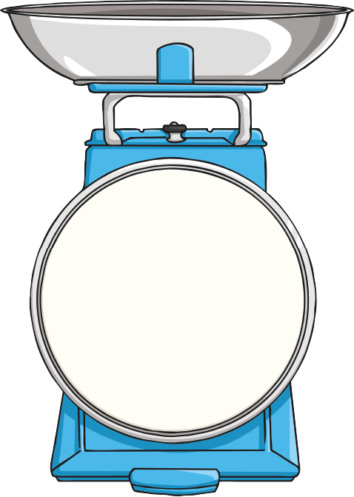
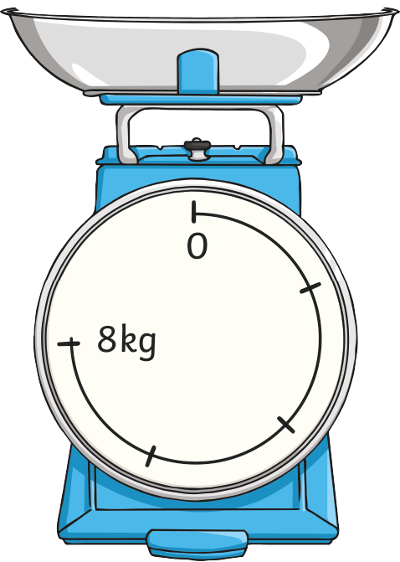
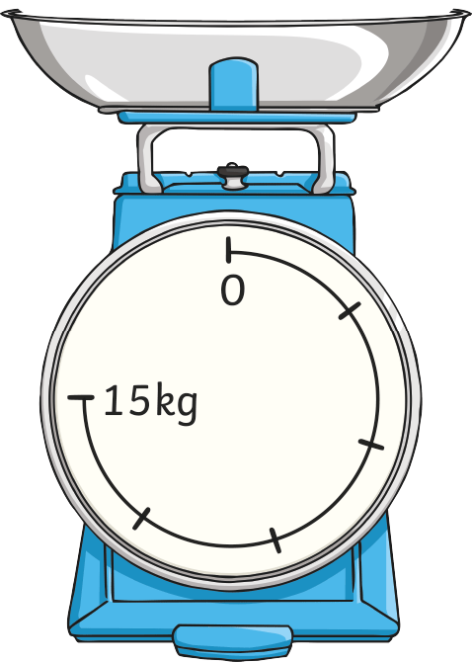
Measure Mass Using Grams or Kilograms
Deeper
Odd One Out
One set of scales shows a different mass. Which one is it?

Slide 9
Measure Mass Using Grams or Kilograms
Deeper
Odd One Out
One set of scales shows a different mass. Which one is it?
Each interval is worth 2kg.
The scale shows 3kg.
Each interval is worth 3kg.
The scale shows 2kg.
Each interval is worth 3kg.
The scale shows 2kg.
The first set of scales shows a different mass.

