Slide 1
Literacy Monday 15th June
L.I. to spell and read words using magic e
S.C. I can spell and read words with the magic e
I can spell and read words with the long i_e sound.

Slide 2
We already know the igh sound. Can you do the action of the man in the vowel house listening? Today we are learning that you can say igh in another way. i_e

Slide 3
Magic e
We call this the Magic e!
The e at the end of the word works magic on the vowel in the word. It make the vowel say its name not its sound!
The vowels are a e i o u

Slide 4
Let’s make magic!
Get your magic e wand ready!

Slide 5
Watch the links below about magic e
https://www.youtube.com/watch?v=5HNpJFVEjFU
https://www.youtube.com/watch?v=JrGmIGB__54
https://www.youtube.com/watch?v=bZhl6YcrxZQ
https://www.youtube.com/watch?v=4-swf3Gy_40
https://www.youtube.com/watch?v=v7UmfJQjgbE

Slide 6
Warm Up Game!
Say what the i_e word is in each picture and try to spell it in your jotter?
Let’s have a go!

Slide 7
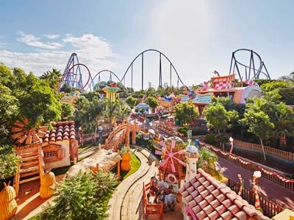

Slide 8
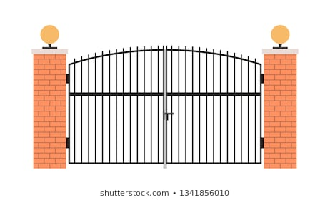
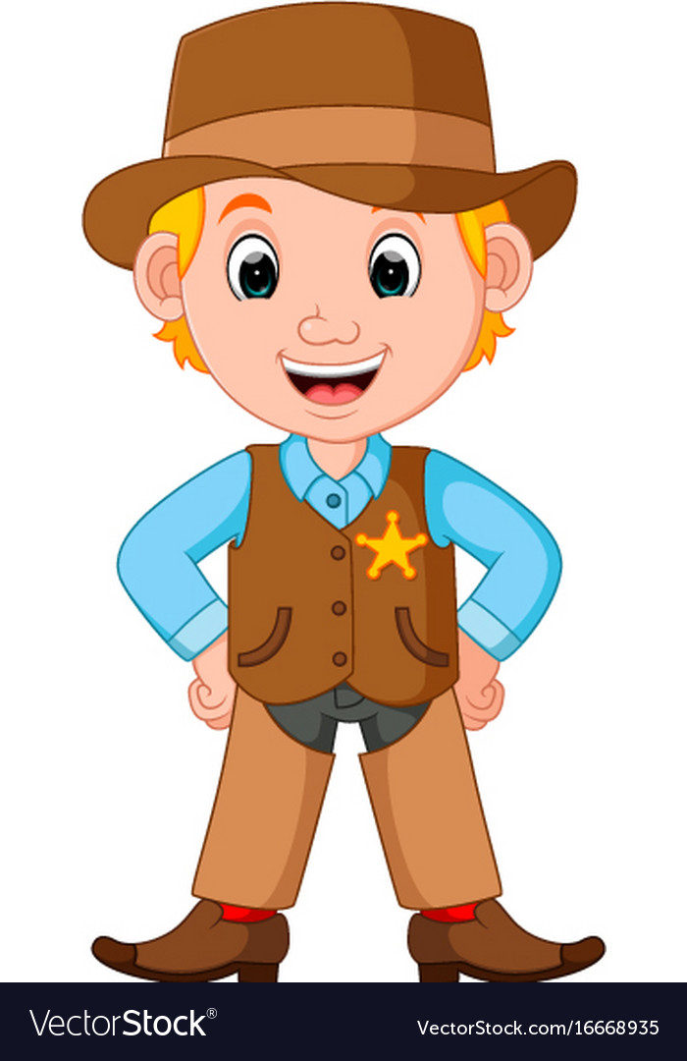
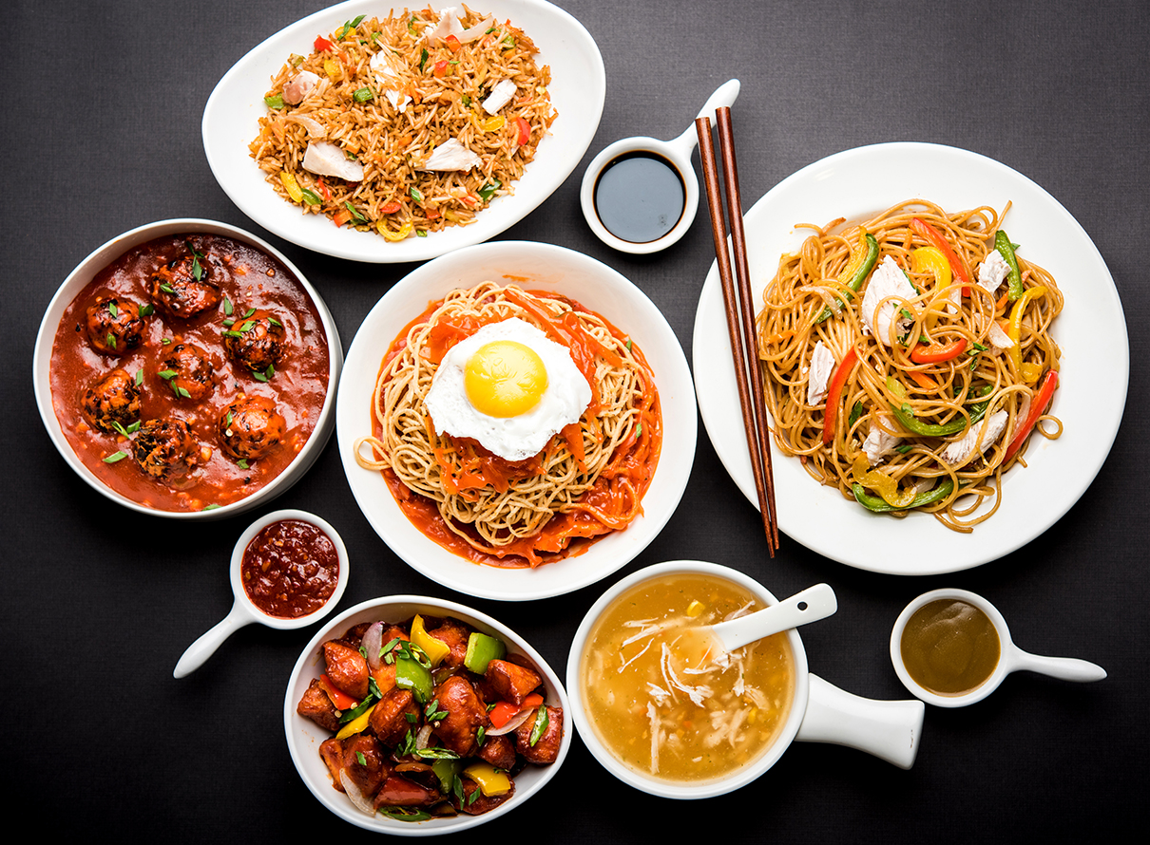
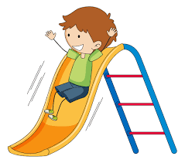
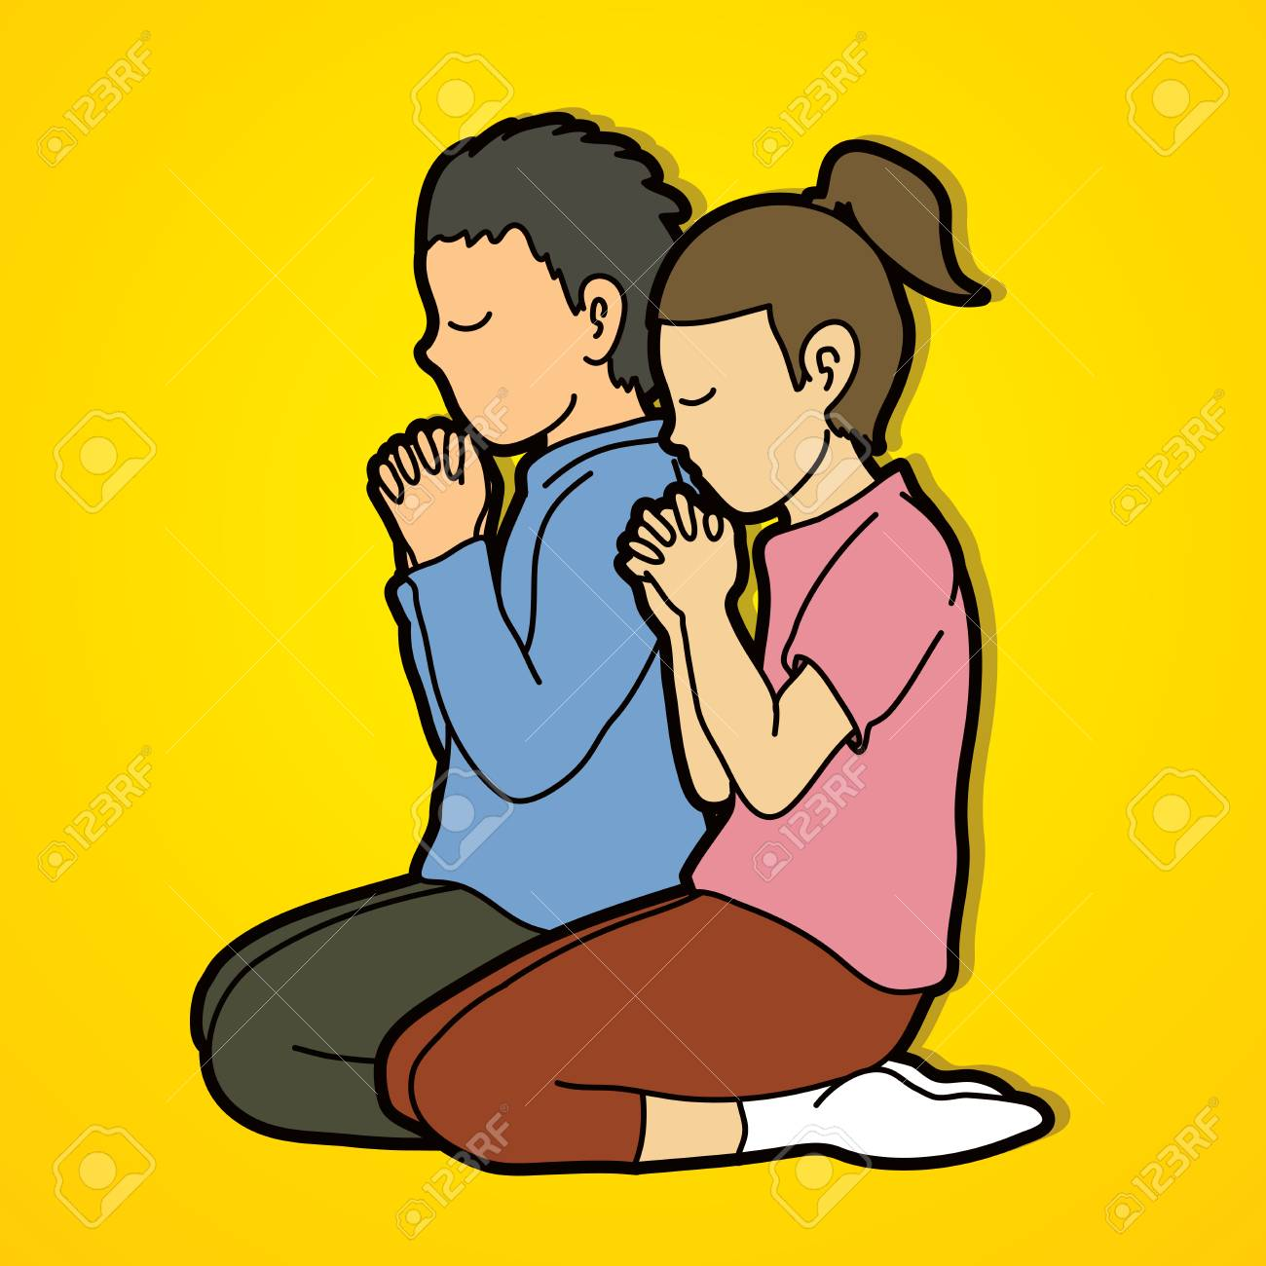

Slide 9
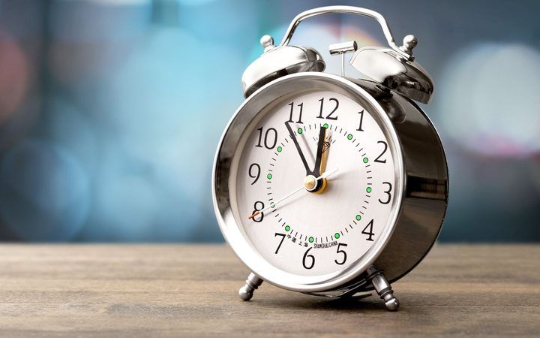
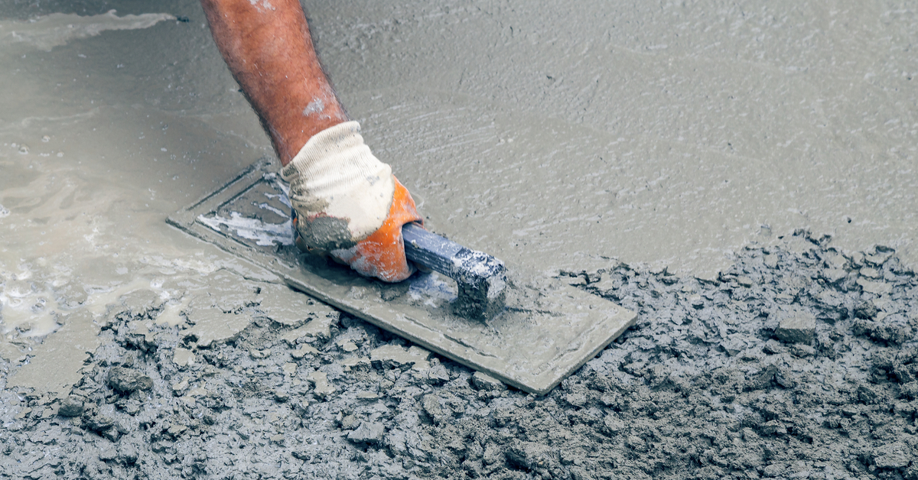
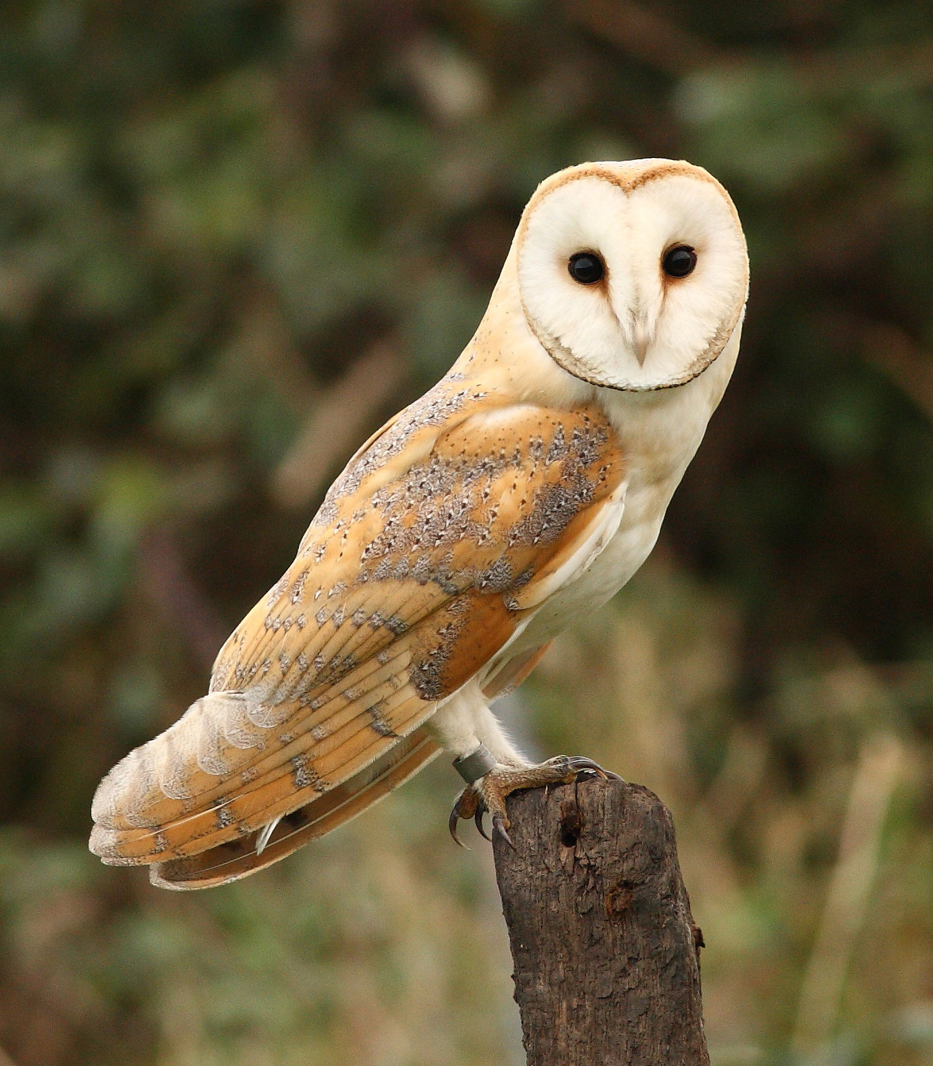
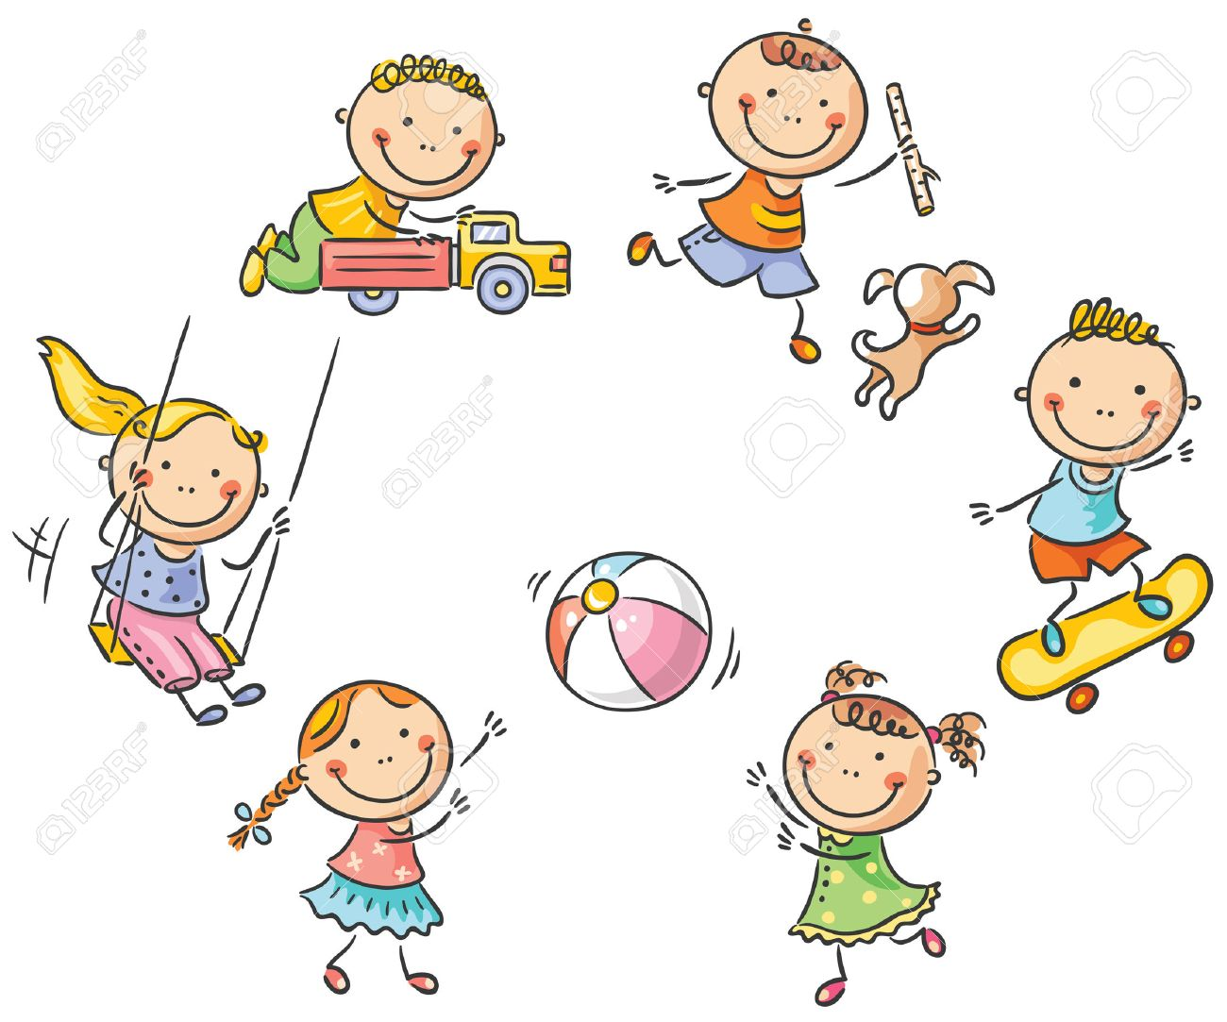

Slide 10
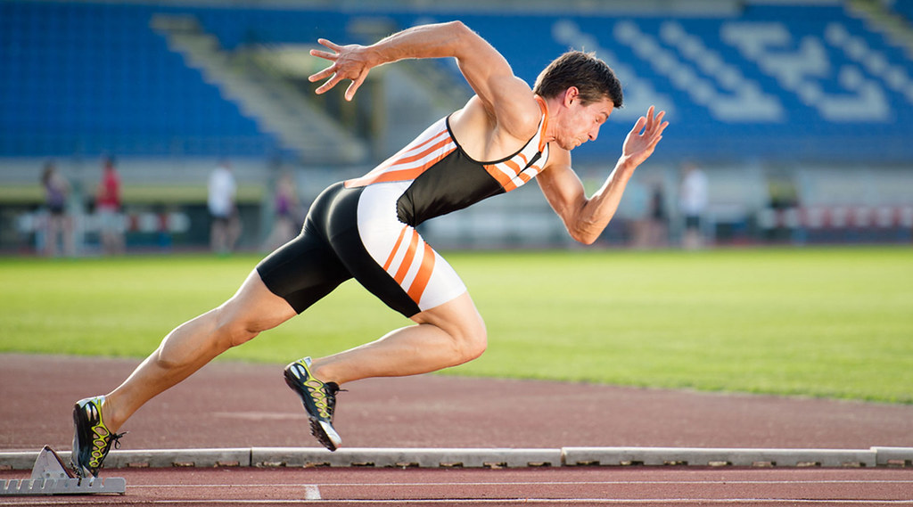
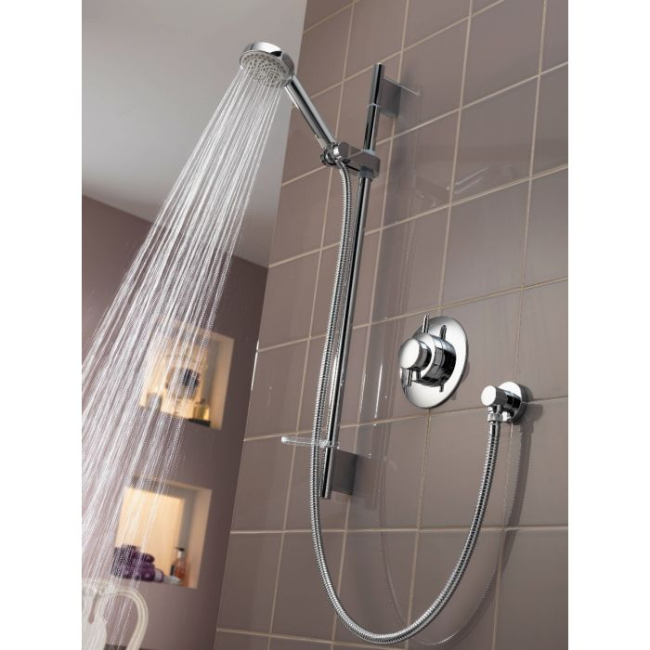
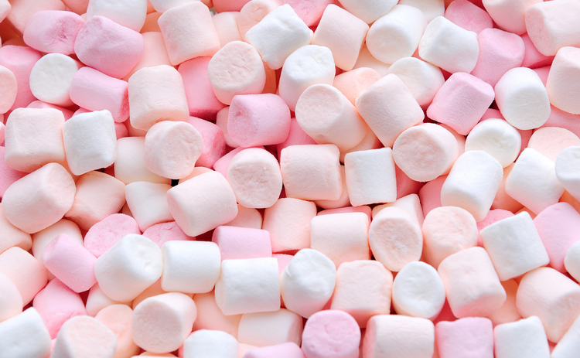

Slide 11
Reading i_e words Read each word out loud Draw a picture for each word and colour it in.
1. bike 2. ride
3. wide 4. time

Slide 12
Part 2
L.I. to write a sentence with an i_e word
S.C. I can use the descriptive bubble to make
sentences more interesting.

Slide 13
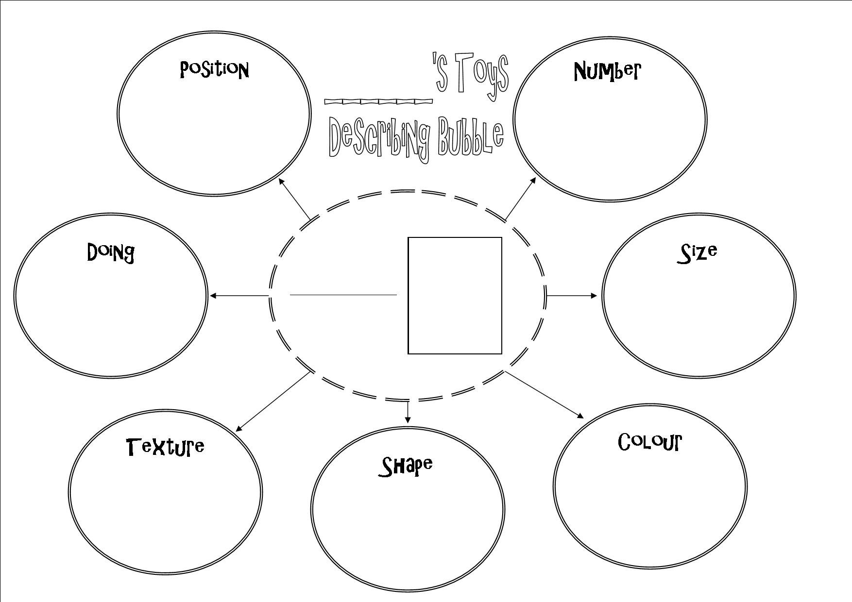
Up Level
The man was riding his bike down the hill.
This sentence is boring. Let’s up level it using the descriptive bubble!

Slide 14
The man was riding his bike down the hill.
First what are the nouns? (The name of things)
The man was riding his bike down the hill.
These are the things I can describe.
The tall man was riding his blue bike down the steep hill.
Now its more interesting!

Slide 15
Up level again!!!
I can up level it again by saying how the verb happened.
Can you find the verbs?
The tall man was riding his blue bike down the steep hill.
So I can improve it by adding an adverb. I can say how the man was riding the bike.
The tall man was riding his blue bike down the steep hill quickly.

Slide 16
Your Turn!
Write a sentence for each i_e word.
Make sure you use your basic writing targets.
Capital letters finger spaces full stops
Try to up level your sentences using the descriptive bubble.
1. bike 2. ride
3. wide 4. time

Slide 17
Assessment Time
How did you get on? Choose one way.
Tell me how you feel it went by leaving
a comment on the blog.
Draw one of the self assessment methods below next to your work.
Traffic light Fist of 5
1 – I struggled
Red – not there yet 2 – I found some difficult
Orange – getting there 3 – I think I’m getting it
Green – got it! 4 – I’m doing well
5 – I have got it!

Slide 18
Plenary

