Slide 1
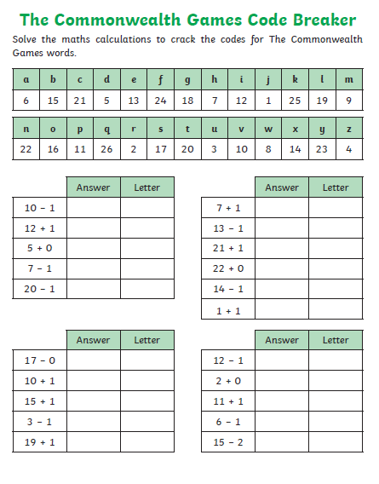
Maths:
Commonwealth Games Code Breaker - Mild
As we have done in previous weeks, solve the sum, write the answer then find the matching letter for your answer. You can answer the questions in your jotter, on paper or tell someone your answers. Let me know what sporting words you find.
If you have a printer, you could print out this slide or use the pdf link.

Slide 2
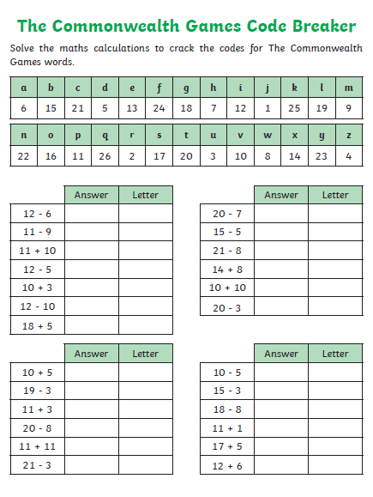
Maths:
Commonwealth Games Code breaker - Spicy
As we have done in previous weeks, solve the sum, write the answer then find the matching letter for your answer. You can answer the questions in your jotter, on paper or tell someone your answers. Let me know what sporting words you find.
If you have a printer, you could print out this slide or use the pdf link.

Slide 3
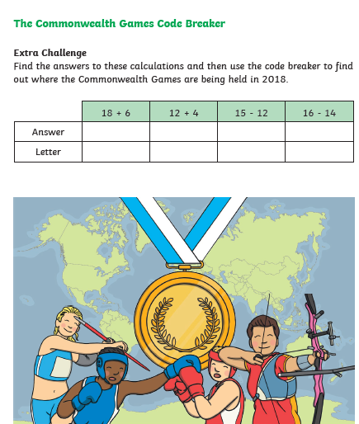
Maths:
Commonwealth Games Code Breaker - Hot
Once you have completed the Spicy challenge, try this extra hot challenge. You can answer the questions in your jotter, on paper or tell someone your answers. Let me know your answer (perhaps you remember but try the sum anyway).
If you have a printer, you could print out this slide or use the pdf link.

