Slide 1
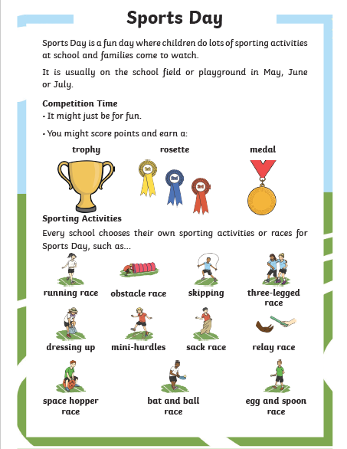
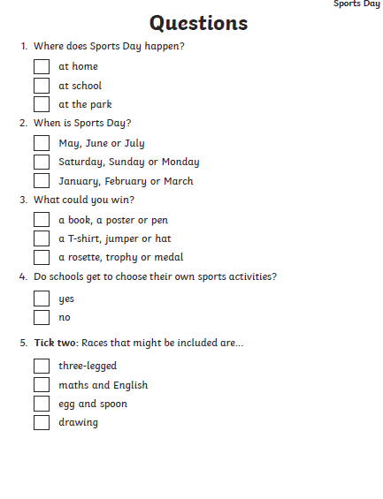
Literacy - MILD
Reading passage about Sports Day
Answer the questions in your jotter, on paper or tell someone your answers. Let me know how you get on.
If you have a printer, you could print out this slide or use the pdf link.

Slide 2
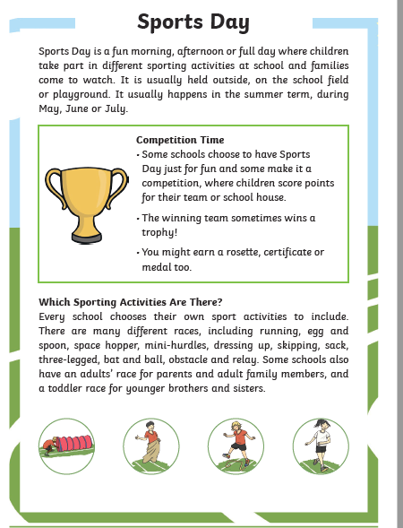
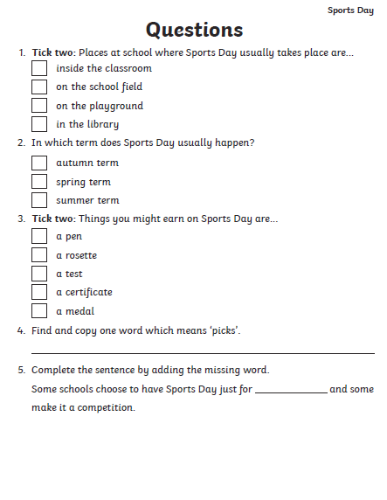
Literacy - SPICY
Reading passage about Sports Day
Answer the questions in your jotter, on paper or tell someone your answers. Let me know how you get on.
If you have a printer, you could print out this slide or use the pdf link.

Slide 3
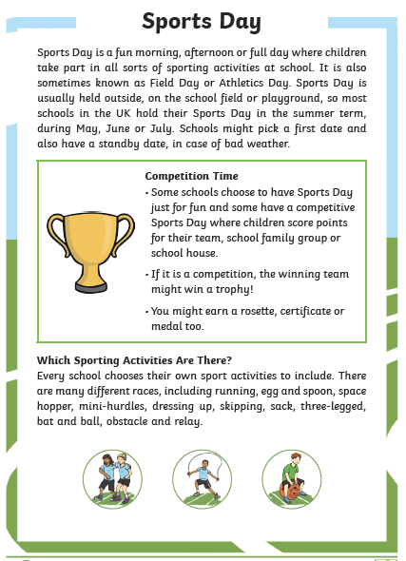
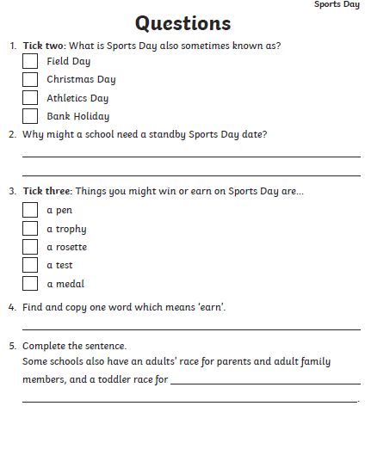
Literacy - HOT
Reading passage about Sports Day
Answer the questions in your jotter, on paper or tell someone your answers. Let me know how you get on.
If you have a printer, you could print out this slide or use the pdf link.

