Slide 1
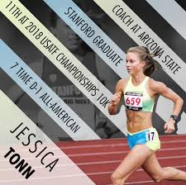
Literacy – Creating an information poster for an athlete
Using all the skills you have learned so far, I would like you to:
1. Choose an athlete you admire (Scottish or any other nationality).
2. Find out at least 3 facts about your athlete.
3. Use headings to organise the facts.
4. Design and create an information poster for your athlete.
5. Your poster must have a title, image(s) and at least 3 facts.
Use the lesson from yesterday on Andy Murray and Sir Chris Hoy to think about examples of facts.
Where will you find this information? You may need help form a trusted adult to use the internet, look in a magazine, search for your athlete on a Smart tv or maybe you have sport annuals at home?
https://www.alarms.org/kidrex/

