Slide 1
Emotion Works
Week 3

Slide 2
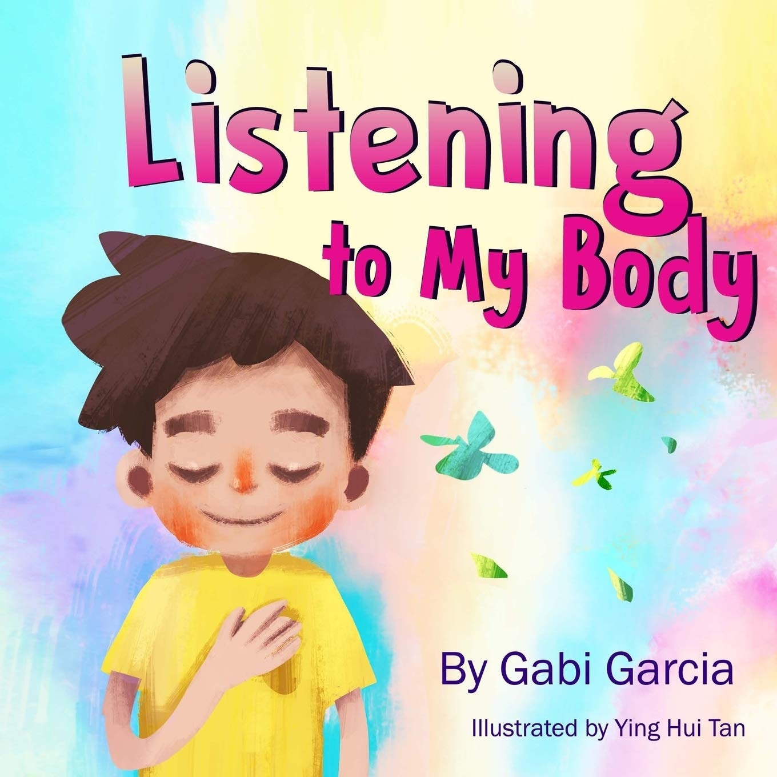
Watch
Listen to the story. As you listen you have some activities to try out with an adult. You can pause the story to practise them!
https://www.youtube.com/watch?v=NlV00-BUvIo&t=9s

Slide 3
Think
We feel a lot of sensations in our body when we are feeling our emotions.
How does your body feel when you are
SAD?
HAPPY?
ANGRY?
WORRIED?
We all feel our emotions in different ways, and knowing how our body feels can help us when we want to change how we are feeling.
Last week you had a think about all the emotions you have felt lately.
We all show our emotions in different ways, for example when Mrs Kinnear is grumpy she can be a bit snappy with eyebrows that look like this
What colour is Lucy’s hair when she is:

Slide 4
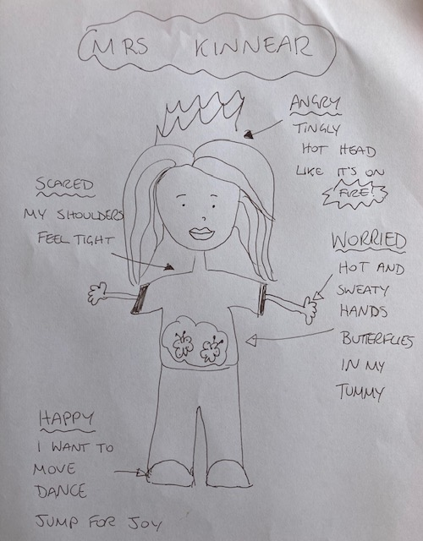
Create
Draw a picture of yourself that shows you from head to toe.
Label your drawing to show what emotions feel like in your body. Here’s a picture to help you!
This is how some
emotions feel in my body.
Are any the same as you?
What’s different?
Challenge! Can you think about ways to make yourself feel better if you don’t like the body sensation?

Slide 5
Share
If you would like to share your picture of your body sensations we would love to see them! Share in your class blog or tweet @TEAMUphallPS

