Slide 2
Introducing u
Learning Intentions
To develop automatic sound letter recognition
To develop explicit awareness that u is a short vowel sound
To blend u in words with selected familiar sounds
To understand how to form the letter correctly
Success Criteria
I can say the sound to match the letter shape.
I know that u is a short vowel sound.
I can blend this sound with other sounds.
I can write this letter.

Slide 3

under the umbrellas
u

Slide 4
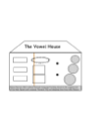
u

Slide 5
u in the middle
s
l
i
d
e
Can you
the sounds together to say the word ?

Slide 6
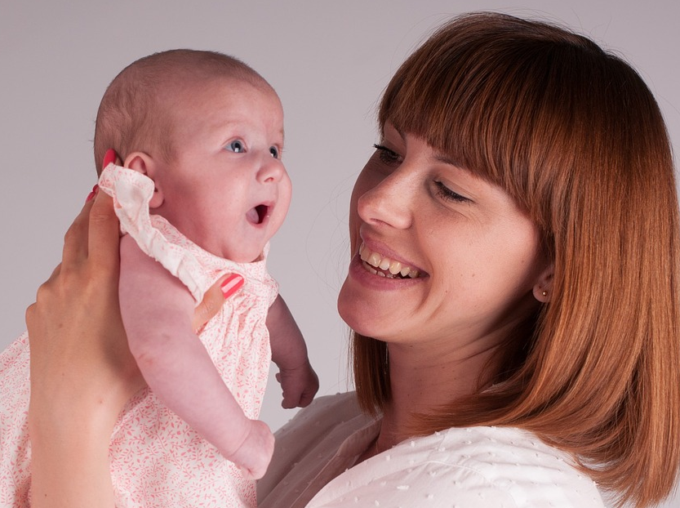
m
u
m

Slide 7

c
u
t

Slide 8
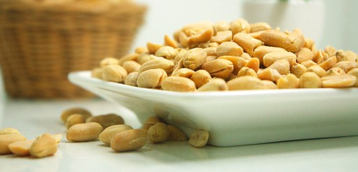
n
u
t

Slide 9

c
u
p

Slide 10
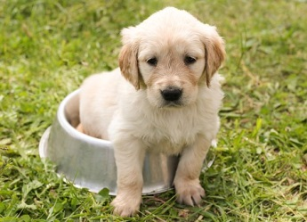
p
u
p

Slide 11
s
u
n

Slide 12

b
u
s

Slide 13
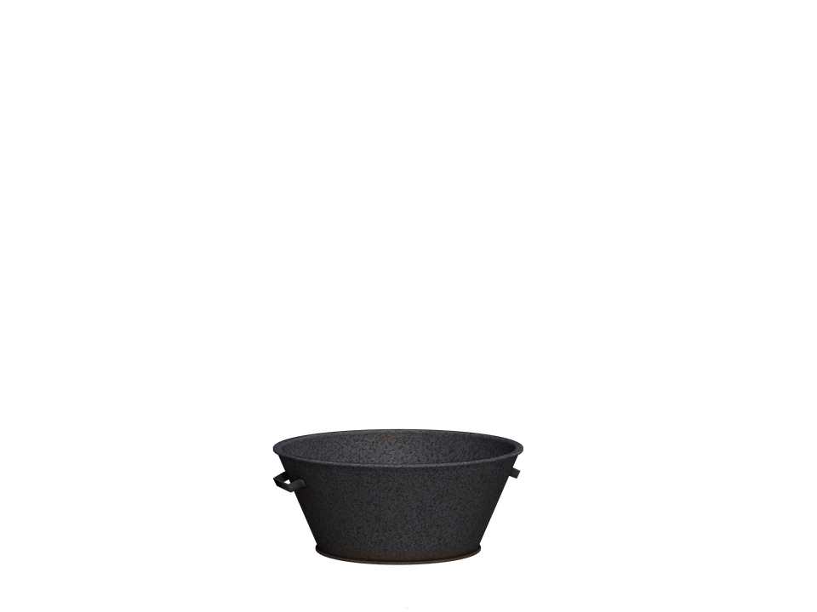
t
u
b

Slide 14
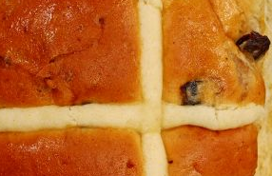
Hot cross ....
b
u
n

Slide 15

f
u
n
scran

Slide 16
Can you remember any words with u in them?

