Slide 1
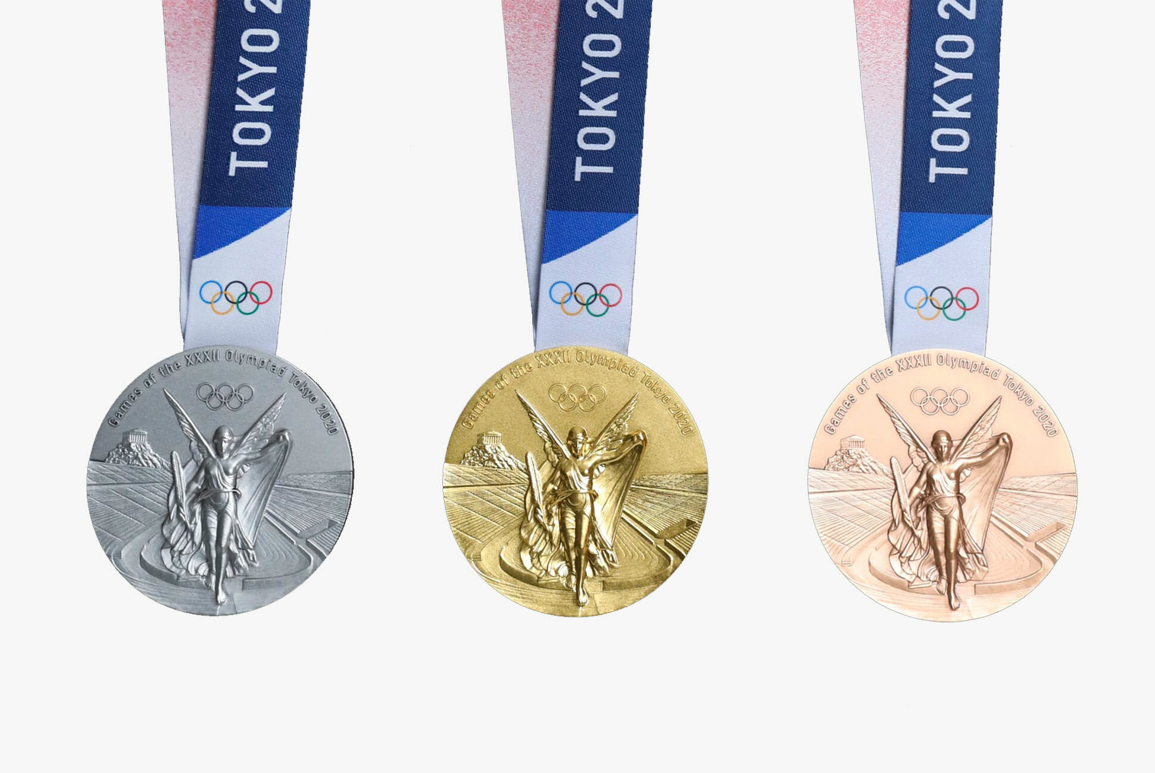
WEEK 10 – SPORTS WEEK

Slide 2
Sir Chris Hoy
Sir Chris Hoy, who originates from Edinburgh, is Scotland’s most successful Olympian. He has competed in cycling sprint events in four Olympic Games and has won the following medals:
London 2012 - 2 golds
Beijing 2008 - 3 golds
Athens 2004 - 1 gold
Sydney 2000 - 1 silver
Sir Chris retired from competitive cycling in 2013. He is the first Briton since 1908 to win three gold medals in a single Olympic Games, and the most successful Olympic male cyclist of all time.

Slide 3
Task 1: Chris Hoy
L.I: To understand a text
SC: I can find key words, phrases or facts about athletes.
E-form:
https://forms.office.com/Pages/ResponsePage.aspx?id=oyzTzM4Wj0KVQTctawUZKVWPOp5BW2hJnapxBMJasGVUOExXWDk3N1VFWE1ZWjZYMlVNVE9GV0FHTS4u

Slide 4
Andy Murray
Andy Murray, who originates from Dunblane near Stirling, has been playing tennis since he was a boy. He is the 2012 US Open Champion, the 2013 Wimbledon Champion and the reigning Olympic Singles Champion. Andy competed in the London 2012 Olympics and won Gold at the Men’s Tennis Singles and Silver at the Mixed Doubles with his team mate, Laura Robson. He is also 2016 Wimbledon Champion.

Slide 5
Task 1: Andy Murray
L.I: To understand a text
SC: I can demonstrate I understand questions about athletes.
E-form:
https://forms.office.com/Pages/ResponsePage.aspx?id=oyzTzM4Wj0KVQTctawUZKVWPOp5BW2hJnapxBMJasGVUMDU2SlRTTEhCQ1JMVkRQSkI1SE9QR1FDNC4u

Slide 6
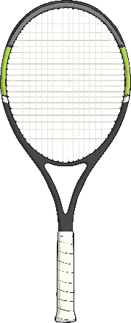
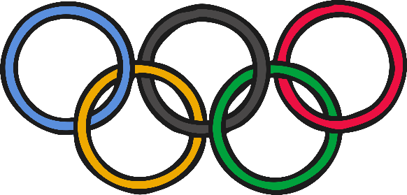
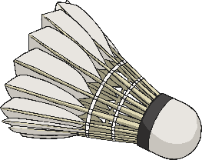
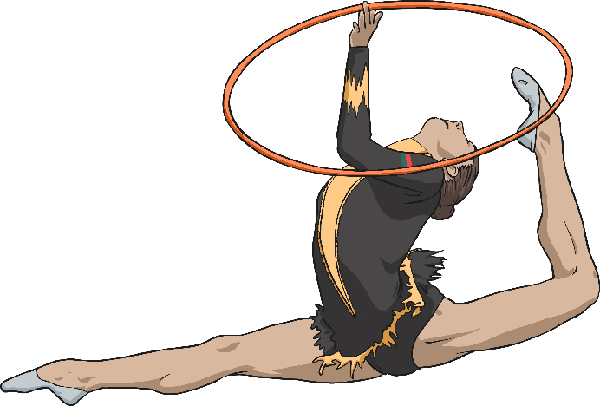
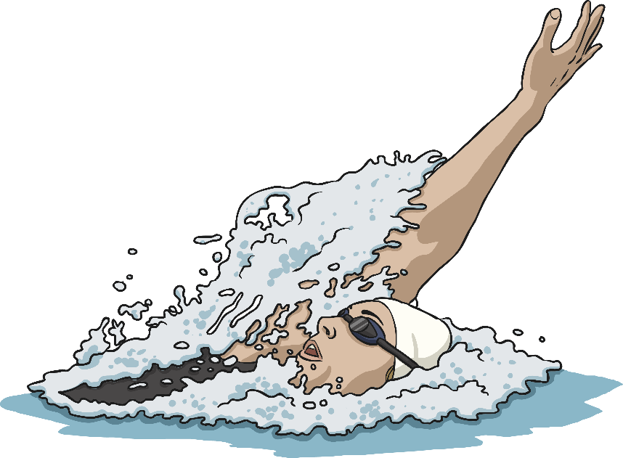
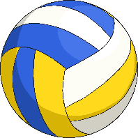
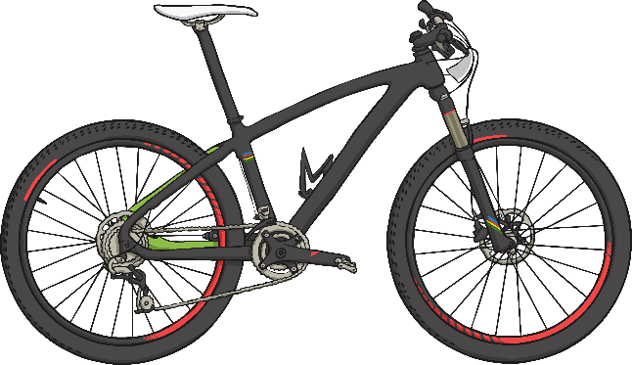
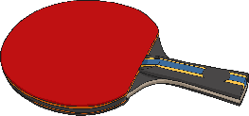
Scottish Olympians
Which other Scottish Olympians can you find out about?

