Slide 1
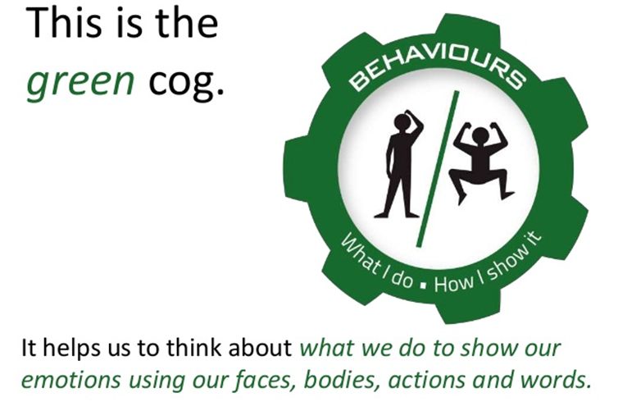
Emotion Works
Week 2

Slide 2
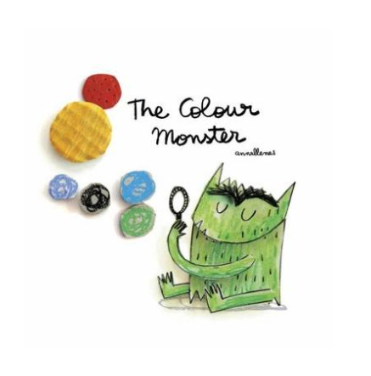
Watch
https://www.youtube.com/watch?v=Ih0iu80u04Y&t=68s

Slide 3
Think
Last week you did some work about all the emotions you have felt lately.
We all show our emotions in different ways, for example when Mrs Kinnear is grumpy she can be a bit snappy with eyebrows that look like this:
How does the monster show his emotions when he feels;
SAD?
HAPPY?
ANGRY?
FEARFUL?
CALM?
How do you show these emotions? Think about your facial expressions and behaviour and share them with a grown up!
Last week you had a think about all the emotions you have felt lately.
We all show our emotions in different ways, for example when Mrs Kinnear is grumpy she can be a bit snappy with eyebrows that look like this
What colour is Lucy’s hair when she is:

Slide 4
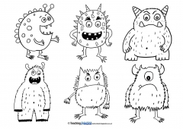
Create
Create your own Colour Monster
You can pick one or more of the emotions to make your own. Remember to label your picture with the emotion your monsters shows.
Challenge! Can you write a short story about how your character behaves?

Slide 5
Share
If you would like to share your Colour Monsters we would love to see them! Share in your class blog or tweet @TEAMUphallPS

