Slide 1
I can read the “ o “ sound
I can blend the “o” sound

Slide 2
o
Can you name things that start with o?

Slide 3
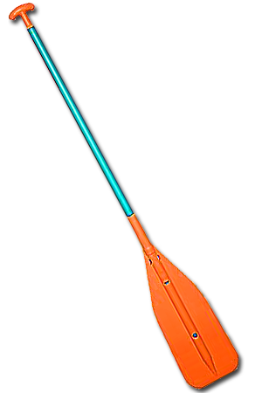
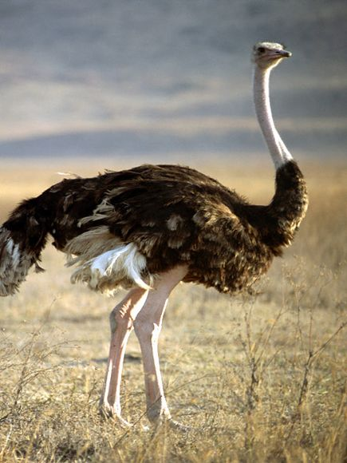

Slide 4
Success Criteria
s
l
i
d
e
I can
two sounds together.
Press back arrow to repeat the ‘sliding together’ slides

Slide 5
Can you slide two sounds together?
o
n

Slide 6
on

Slide 7
Can you slide two sounds together?
o
p

Slide 8
op

Slide 9
Can you slide two sounds together?
o
t

Slide 10
ot

Slide 11
Success Criteria
s
l
i
I can
two sounds together
in a different way!
d
e
Press back arrow to repeat the ‘sliding together’ slides

Slide 12
Can you slide two sounds together?
p
o

Slide 13
Can you slide two sounds together?
s
o

Slide 14
Can you slide two sounds together?
m
o

Slide 15
o in the middle
s
l
i
d
e
Can you
three sounds together to say the word ?
Press and wait for a second for word to slide across. – there is a slight delay!
Press back arrow to repeat the ‘sliding together’ slides

Slide 16
m
o
p

Slide 17
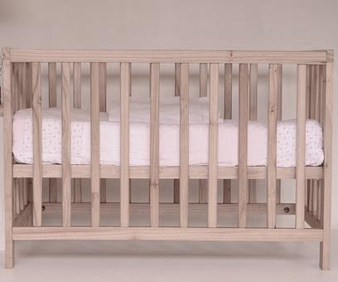
c
o
t

Slide 18
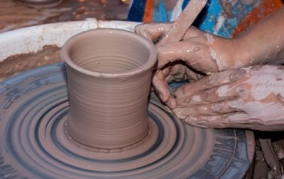
p
o
t

Slide 19
s
o
ck

Slide 20
p
o
p

Slide 21
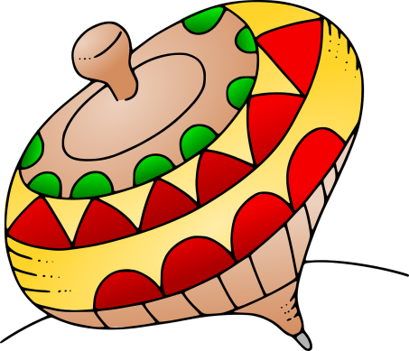
t
o
p

Slide 22
t
o
p
s

