Slide 1
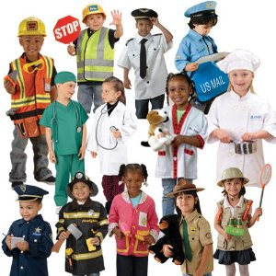
Guess the Community Helper

Slide 2
You come to me if you are sick or hurt. I will make you feel better. Who am I?

Slide 3
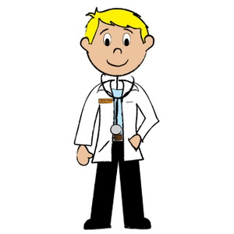
doctor

Slide 4
I help you keep your teeth healthy. I teach you good dental habits. I help you prevent cavities. Who am I?

Slide 5
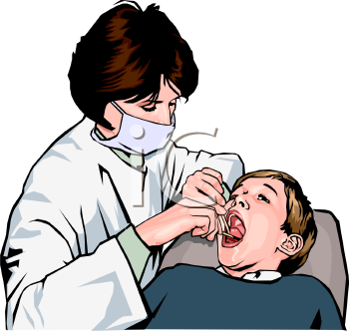
dentist

Slide 6
I help keep you safe. My car has a red light on it. I put dangerous people in jail. Who am I?

Slide 7
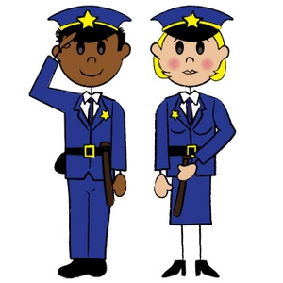
police officer

Slide 8
I am in your school. I help you to have fun and learn new things. Who am I?

Slide 9
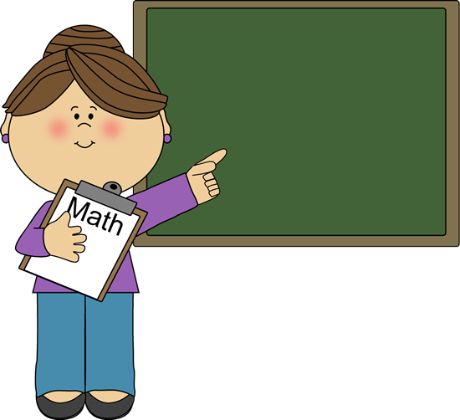
teacher

Slide 10
I will help you when you are in trouble. I put out fires and rescue people from burning buildings. Who am I?

Slide 11
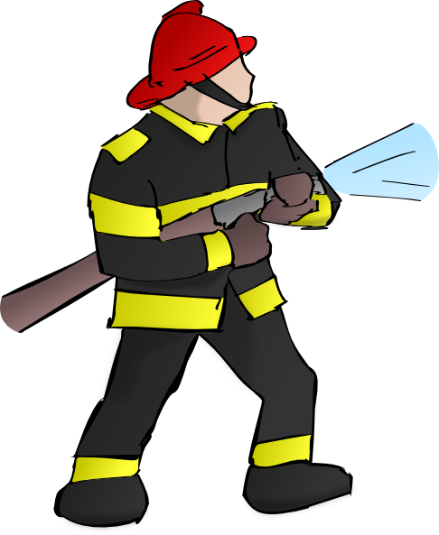
fire fighter

Slide 12
I grow the fruits and vegetables you eat. Sometimes I drive a tractor. Who am I?

Slide 13
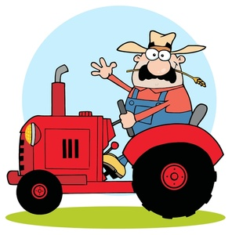
farmer

Slide 14
I fix broken sinks and toilets. Who am I?

Slide 15
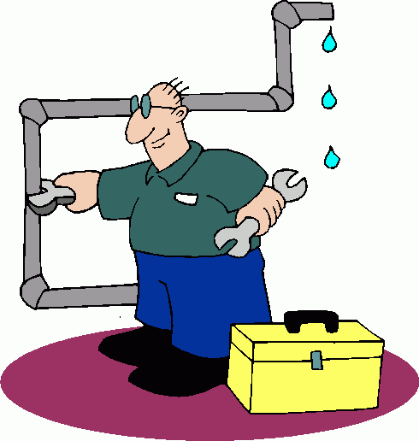
plumber

Slide 16
I build houses, schools, and hotels. I use hammers and nails. I wear a hard hat to protect my head from falling objects. Who am I?

Slide 17
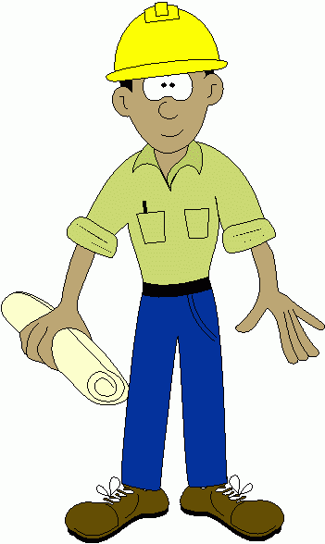
construction worker

Slide 18
You bring your cat or dog to me if he or she is sick or hurt. Who am I?

Slide 19
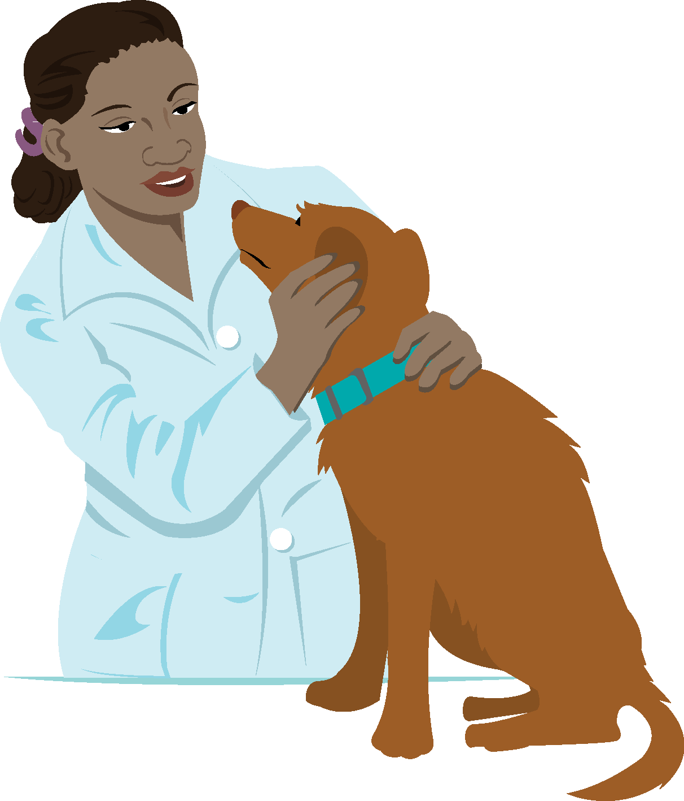
veterinarian

Slide 20
I empty rubbish from the bins. I drive a really big and loud lorry. Who am I?

Slide 21
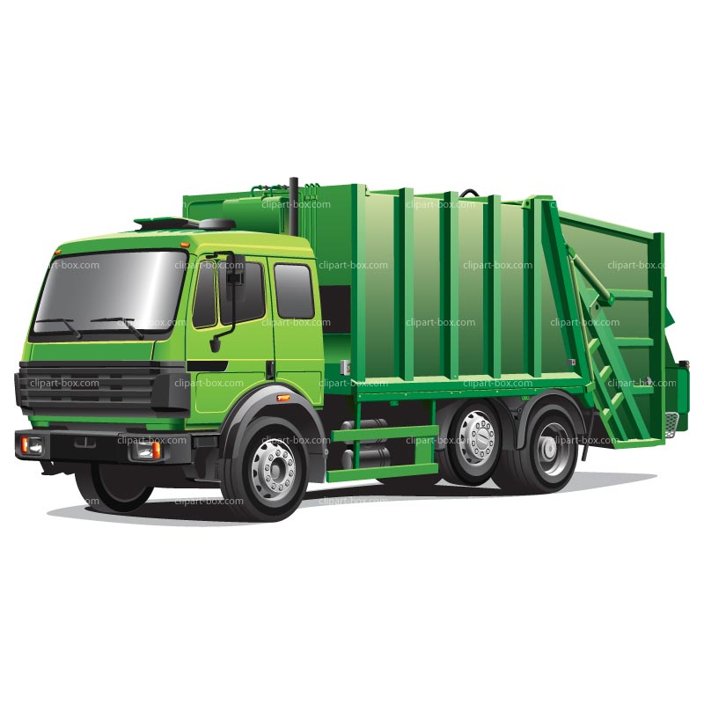
rubbish collector (or bin man/woman)

Slide 22
I travel to space and study the solar system. Who am I?

Slide 23
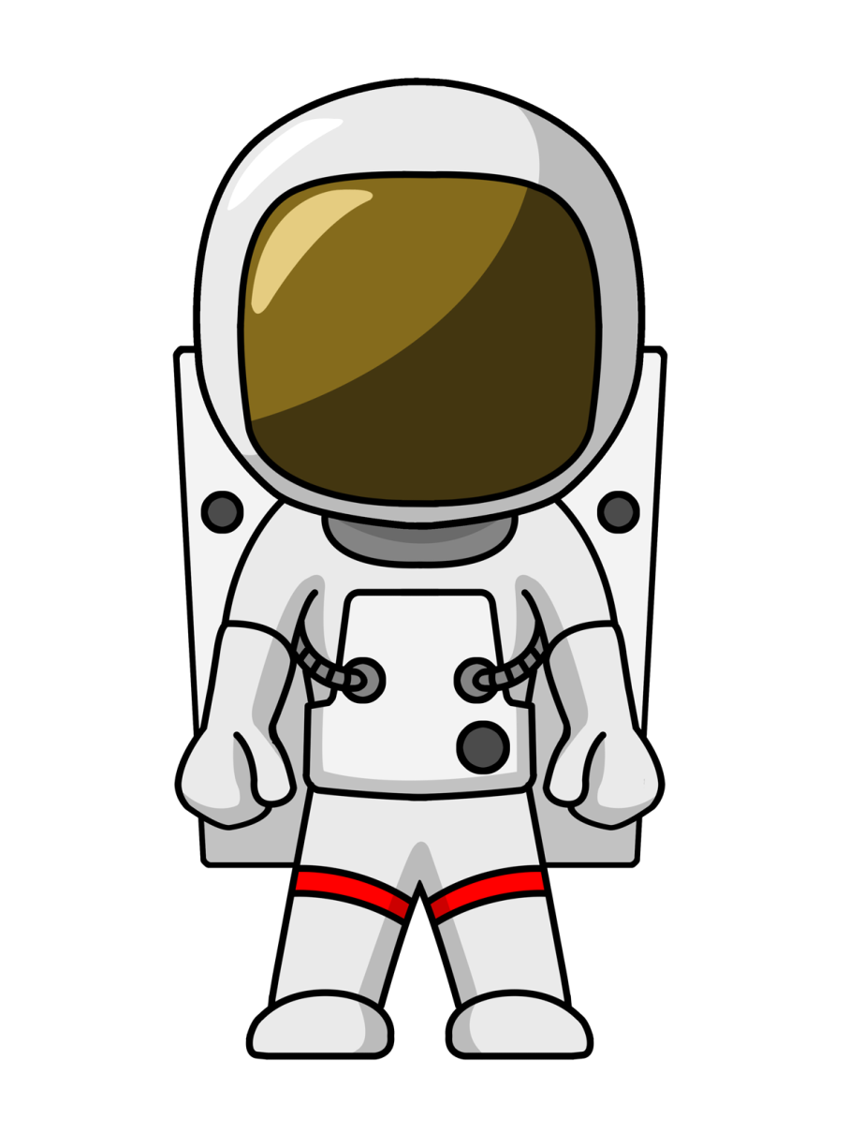
astronaut

