Slide 1
Reading Books P2
Oxford Owls
Online Books

Slide 2
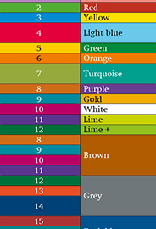
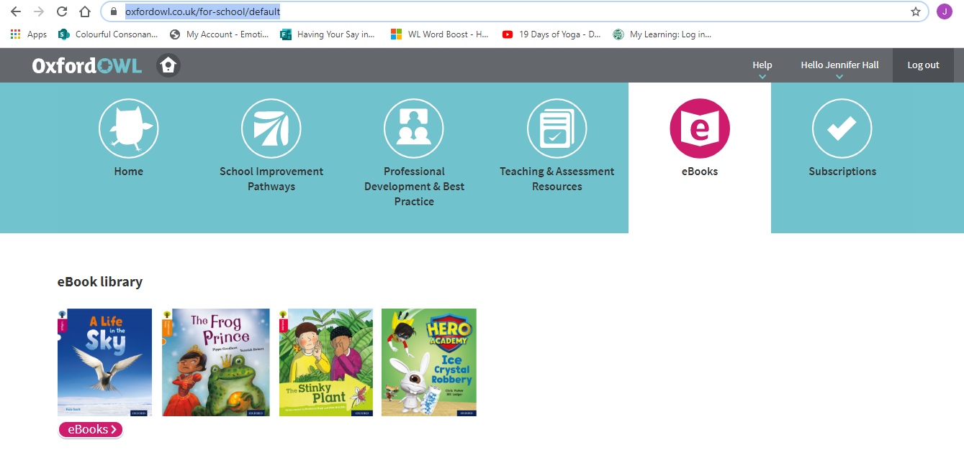
How to access it: 1. Go on to Oxford Reading Owl- they have free online e-books! https://www.oxfordowl.co.uk/ 2. Go to ‘My class log in’ Username: p2-miss swift Password: Uphall 3. To figure out your reading level- if you have your reading book at home look on the back to see what colour it is or what stage it says. If you are unsure of your stage you can email the school and we will tell you what level. 4. Click on e-books, select your level. 5. Read the book and answer the comprehension questions on the front page and do the activities at the top of the book. You can mark this yourself! ☺ .

