Slide 1
Introducing e https://www.youtube.com/watch?v=rWyKmM-PqJY listen to the “e” sound
© Alison Paterson, Colourful Consonants and the Vowel HouseEarly Literacy Initiative
Re-edited September 2017
Illustrations courtesy of pixabay.com and openclipart.org

Slide 2
e
Success criteria
I can say the correct sound when I see the letter.
I can blend and spell some words with this sound.

Slide 3
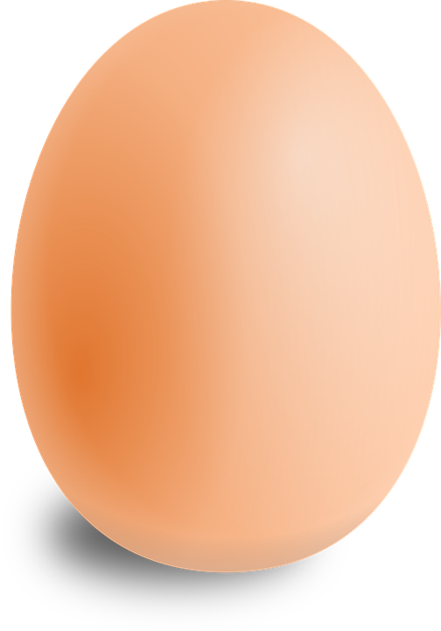
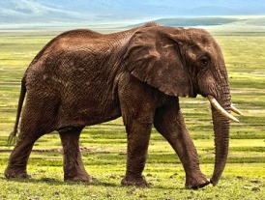
All these words begin with e

Slide 4
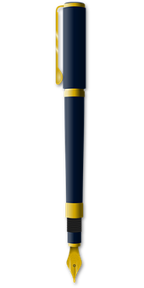
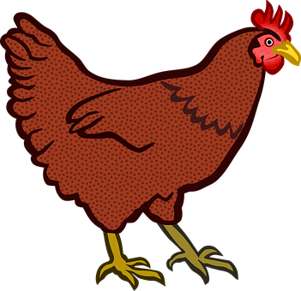
All these words have e in the middle.

Slide 5
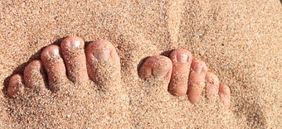
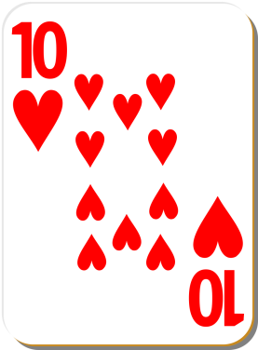
All these words have e in the middle.
10

Slide 6
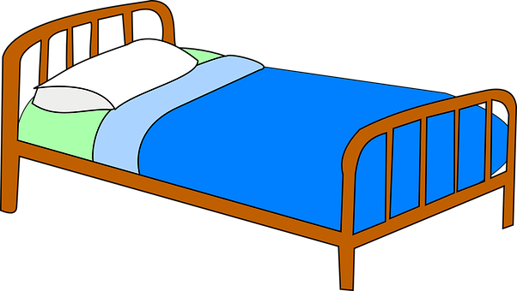
All these words have e in the middle.

Slide 7
e in the middle
s
l
i
d
e
Can you
the sounds together to say the word ?

Slide 8
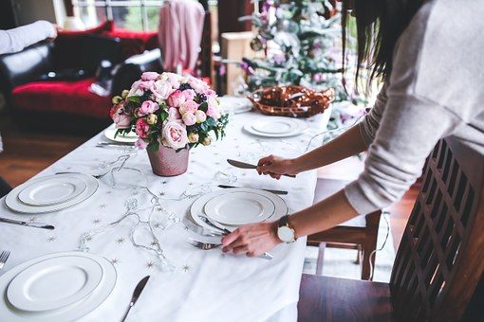
s
e
t

Slide 9
n
e
t

Slide 10
n
e
ck

Slide 11
m
e
n

Slide 12
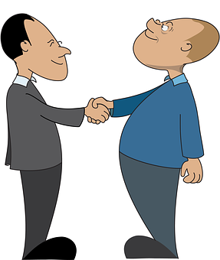
m
e
t

Slide 13
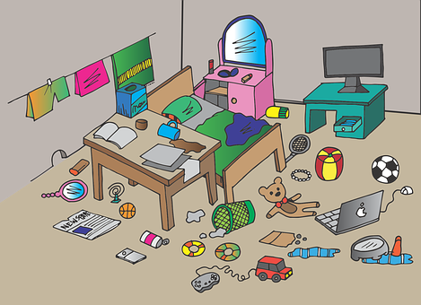
m
e
ss

Slide 14
10
t
e
n

Slide 15
p
e
n

Slide 16
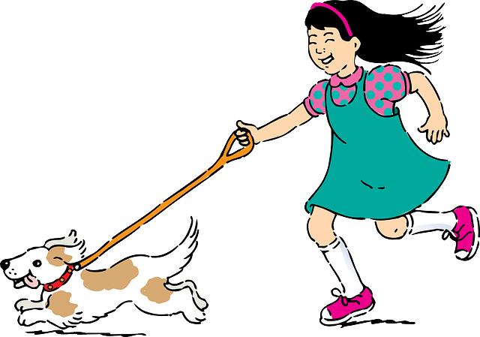
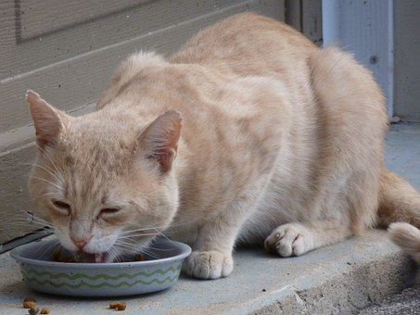
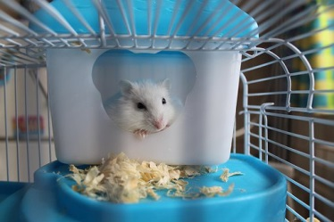
p
e
t

Slide 17
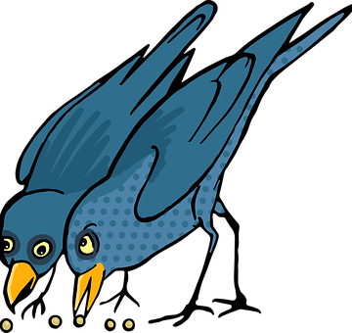
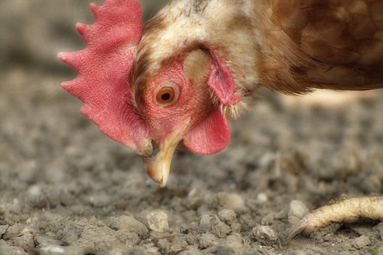
p
e
ck

Slide 18
e n d

Slide 19
Can you name any words with an “e” sound in them?
Can you name any words that start with an “e” sound.

