Slide 1
h

Slide 2
Introducing h
Success Criteria
I can say the sound to match the letter shape.
I know that h is a back sound.
I can blend this sound with other sounds to say a word I recognise.
I can write this letter to spell words
© Alison Paterson Colourful Consonants and Vowel House Early Literacy Initiative Jan 18 edit

Slide 3
h
h for horse
h
h

Slide 4
Can you say these words?
They all begin with
h

Slide 5
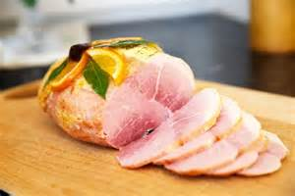
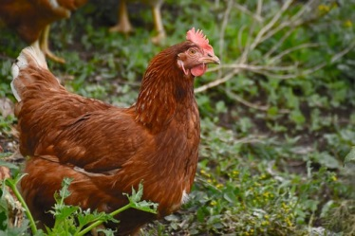
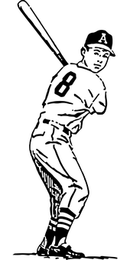
h

Slide 6
Can you spot the difference?
h
n

Slide 7
h at the beginning
s
l
i
d
e
Can you
the sounds together to say the word ?

Slide 8
h
a
t

Slide 9
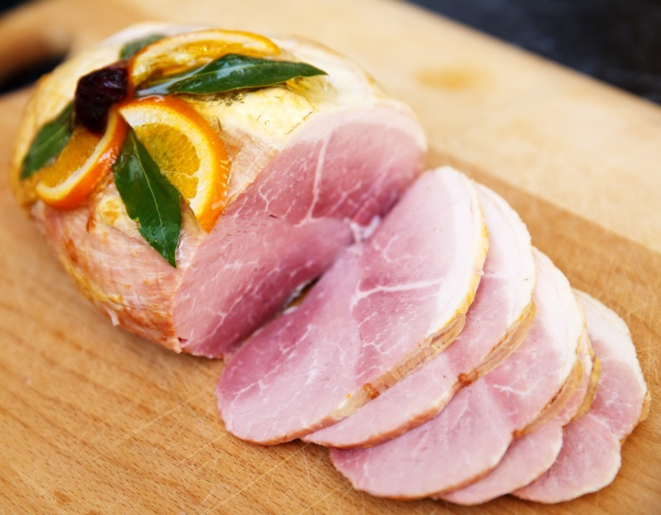
h
a
m

Slide 10
h
e
n

Slide 11
h
i
t

Slide 12
h
i
p
Scran

Slide 13
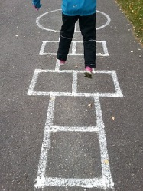
h
o
p

Slide 14
h
o
t

Slide 15
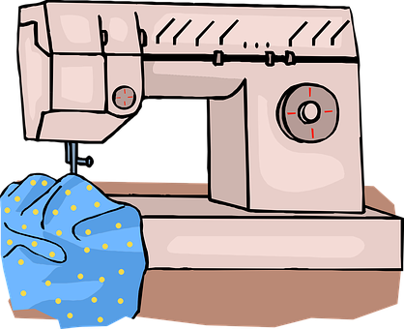
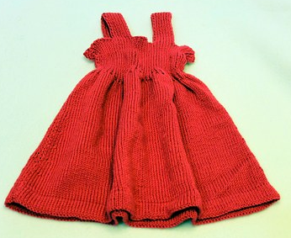
h
e
m

Slide 16
Can you read all the words?
ham
him
hem
hit
hat
hot
hip
hop
hap

Slide 17
Now tell someone as many “h” words as you can remember.
Challenge: write some of them down

