Slide 1
b
I can read and recognise the b sound
I can read three-letter words containing the b sound

Slide 2
Can you remember any words starting with b?

Slide 3
The next slides show words beginning with b. Can you blend the letters to read the words? You can use arm blending -

Slide 4
b
s
l
i
d
e
OR you can
the sounds together to say the word

Slide 5
What does it say?
b-a-t

Slide 6
b
a
t

Slide 7
b
a
ck

Slide 8
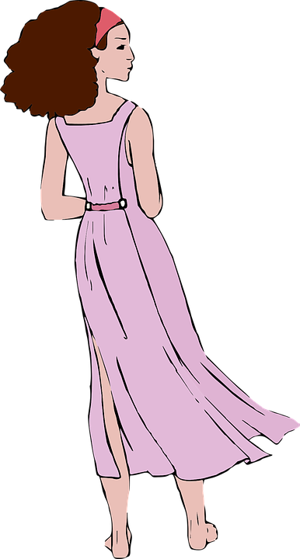
b
a
ck

Slide 9
b
a
t

Slide 10
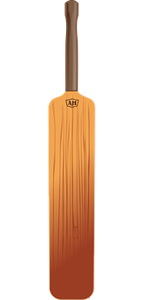
b
a
t

Slide 11
b
i
b

Slide 12
b
i
b

Slide 13
b
i
n

Slide 14
b
i
n

Slide 15
b
i
t

Slide 16
Challenge:
Can you read words that have b at the end?

Slide 17
s
o
b

Slide 18
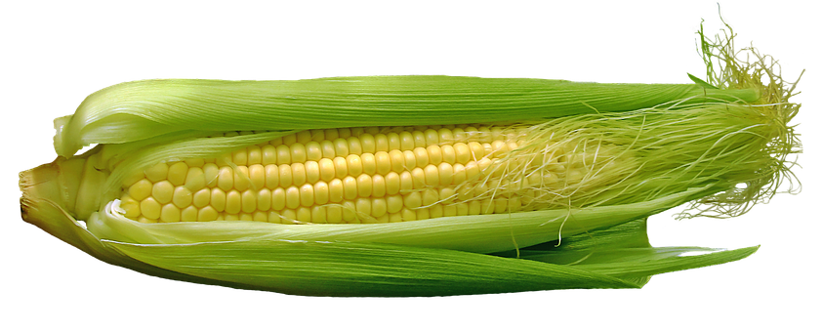
c
o
b

Slide 19
f
o
b

Slide 20
n
i
b

Slide 21
Do you know what all these words mean?

Slide 22
Say as many words beginning with b.
Can you make any of them on your word mat?

