Slide 1
Spelling/ Phonics/ Reading Activity Carousel Monday 20th - Thursday 23rd and do one of these activities each day. Use your jotter to record your answers! Recommended time: 30 mins

Slide 2
1. Spelling Activity
Here are the spellings for this week…
(Children will know which spellings they normally do)
k/sk spellings: Kent, kept, king, kiss, skid, skill, skin, skip, sky
mp spellings: limp, limpet, dump, jump, lump, plump
More oa spellings: throat, approach, coach, poach, foal, goal, groan, loan, moan, boast, coast, roast, toast
(you have now completed level 4 spellings so we will now go on to some ‘common exception words’) believe, bicycle, breath, breathe, build, busy, business
Click on the link below to find different ways of practising your spellings!
https://www.thoughtco.com/ways-to-practice-spelling-words-2086716

Slide 3
2. Reading activity Following on from our reading lesson on Monday… Find examples of bold, italic, underlined and CAPITAL LETTER print in your books at home. Discuss with an adult or write in your jotter why you think the author has used this type of print where they have. .

Slide 4
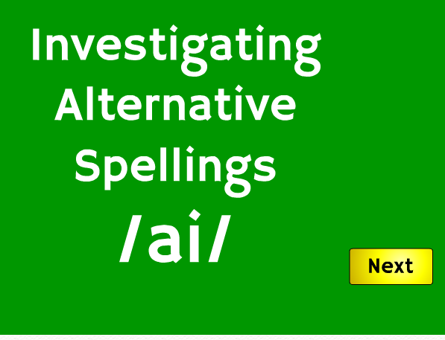
3. Phonics activity The sound family we are looking at this week is the ay, a_e, ai, ae sound family. They sound the same but are spelt differently. Check out this video clip https://www.youtube.com/watch?v=m-uLFJp5ZtI Play this phonics game to investigate the long ai sound! https://www.phonicsplay.co.uk/aiAltSpellings.html Username:march20 password: home

Slide 5
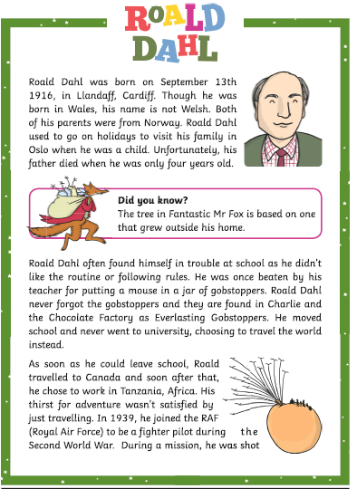
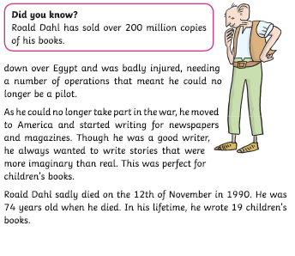
4. Reading comprehension Read this…

Slide 6
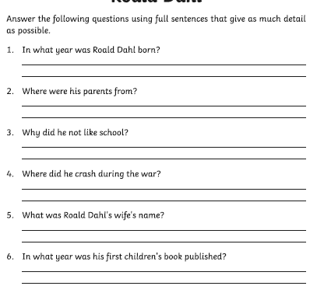
4. Reading activity- answer these!

