Slide 1
Grammar
LI. To identify verbs in the past tense
SC.I can recognise verbs in the past tense
I can write sentences using the past tense

Slide 2
Warm Up
Watch the video and join in with the actions.
https://www.youtube.com/watch?v=j3EYciNco58&t=1s

Slide 3
drive
Verbs
A verb is a doing word/an action.
eat
run
cut
read
swim
play

Slide 4
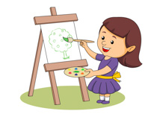
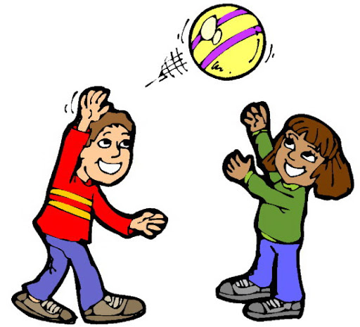
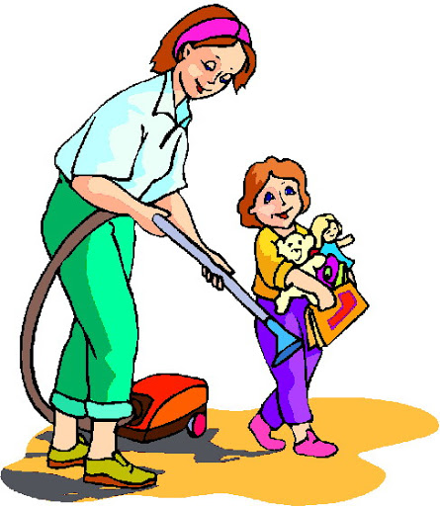
Verbs in the Past
The words in the pictures are doing words. They are called verbs.
They tell us what people, animals and things did in the past. The past is something that has already happened. It could have happened 10 minutes ago, one hour, this morning, Yesterday, last week, last year or a very long time ago.
helped

Slide 5
Can you copy these sentences into your jotter and underline the verbs?
Birds fly in the sky.
I walk to school in the morning because I like to keep fit.
I like to swim in the sea.
The farmer feeds the animals.

Slide 6
Can you now write your own sentences including verbs?
Challenge!
Can you up level your sentence by including a conjunction e.g. and, because, but, until?

