Slide 1
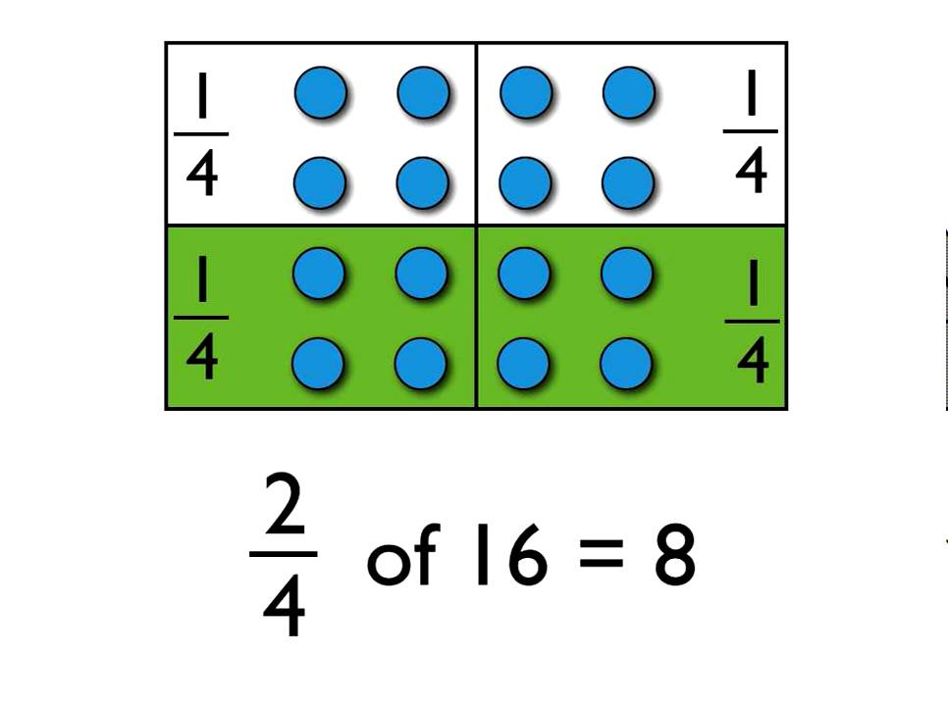
Identifying the fraction of an amount.

Slide 2
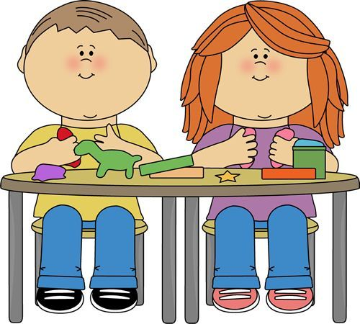
Getting organised
When you see the pencil symbol this means that you should record the answer to this question in your blue Numeracy jotter.
Resources: - whiteboard & pen - Numeracy jotter
When you see the whiteboard symbol this means that you might want to use your whiteboard/pen to help you with this activity.

Slide 3
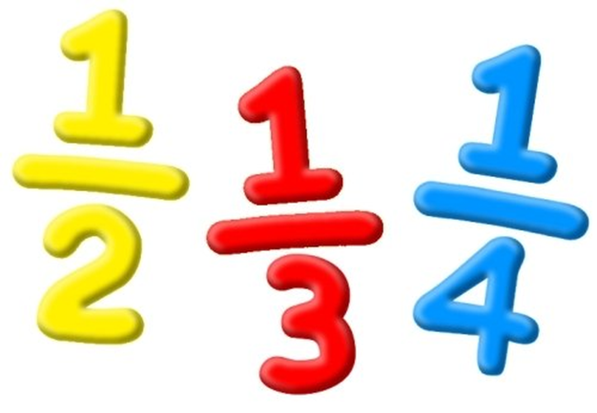
Fractions of an amount
Today we are going to explore finding the fraction of an amount.

Slide 4
Task 1
Question 1
Draw 12 counters on your whiteboard.
How would you find ¼ of these counters? (Record your answers in your jotter)
What operation would you use? Multiplication/ Division/ Addition/ Subtraction

Slide 5
Questions 2 & 3
Question 2
Question 3
Can you circle a quarter of the cars in a different way?
How do you know that you have found ¼?

Slide 6
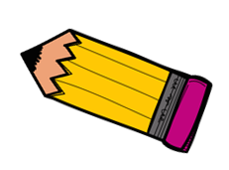
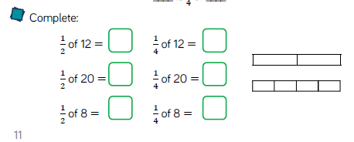
Some more for you try!

Slide 7
Let’s Recap and make sure we understand how to write fractions.
Watch: https://www.bbc.co.uk/bitesize/topics/z9sycdm/articles/zh3xxyc You might want to make some notes as you watch. ☺
This video introduced some important vocabulary: Numerator Denominator

Slide 8
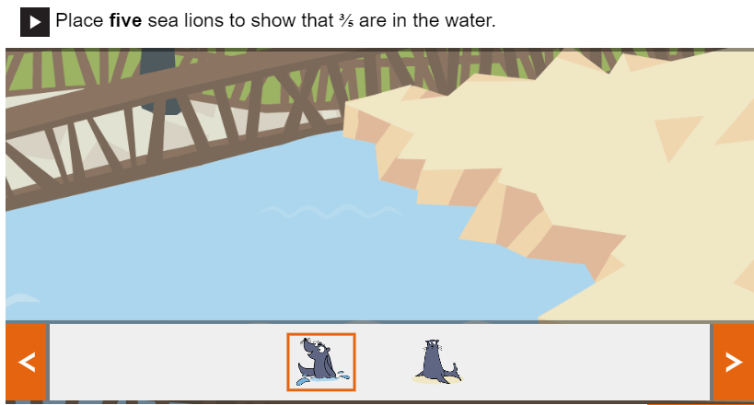
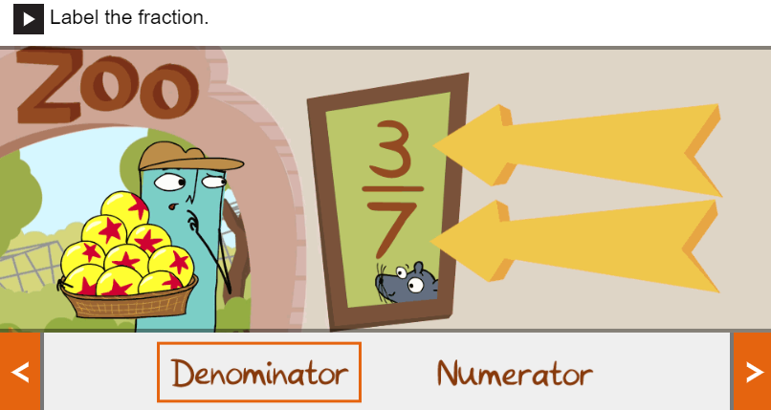
Reflection Activities
Complete this online tasks from the bitesize website:

