Slide 1
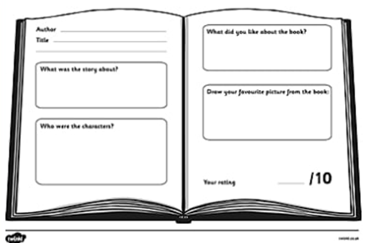
Literacy
Reading – Enjoyment,
You will need:
Your favourite book and the book review from your Home Learning booklet (or paper/a jotter).
Follow the lesson plan or skip to slide 8.

Slide 2
Literacy
Reading – Enjoyment, part 3 (of 3)
Learning Intention (LI):
to select and read texts which I enjoy and find interesting, and I can explain why I prefer certain texts and authors.
Success Criteria (SC):
I can sort books into categories.
I can choose my favourite book or author and explain my choice.
I can write a book review about my favourite book.

Slide 3
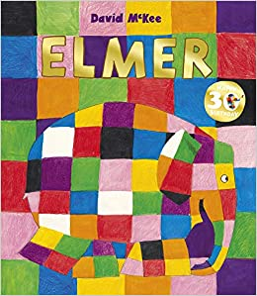
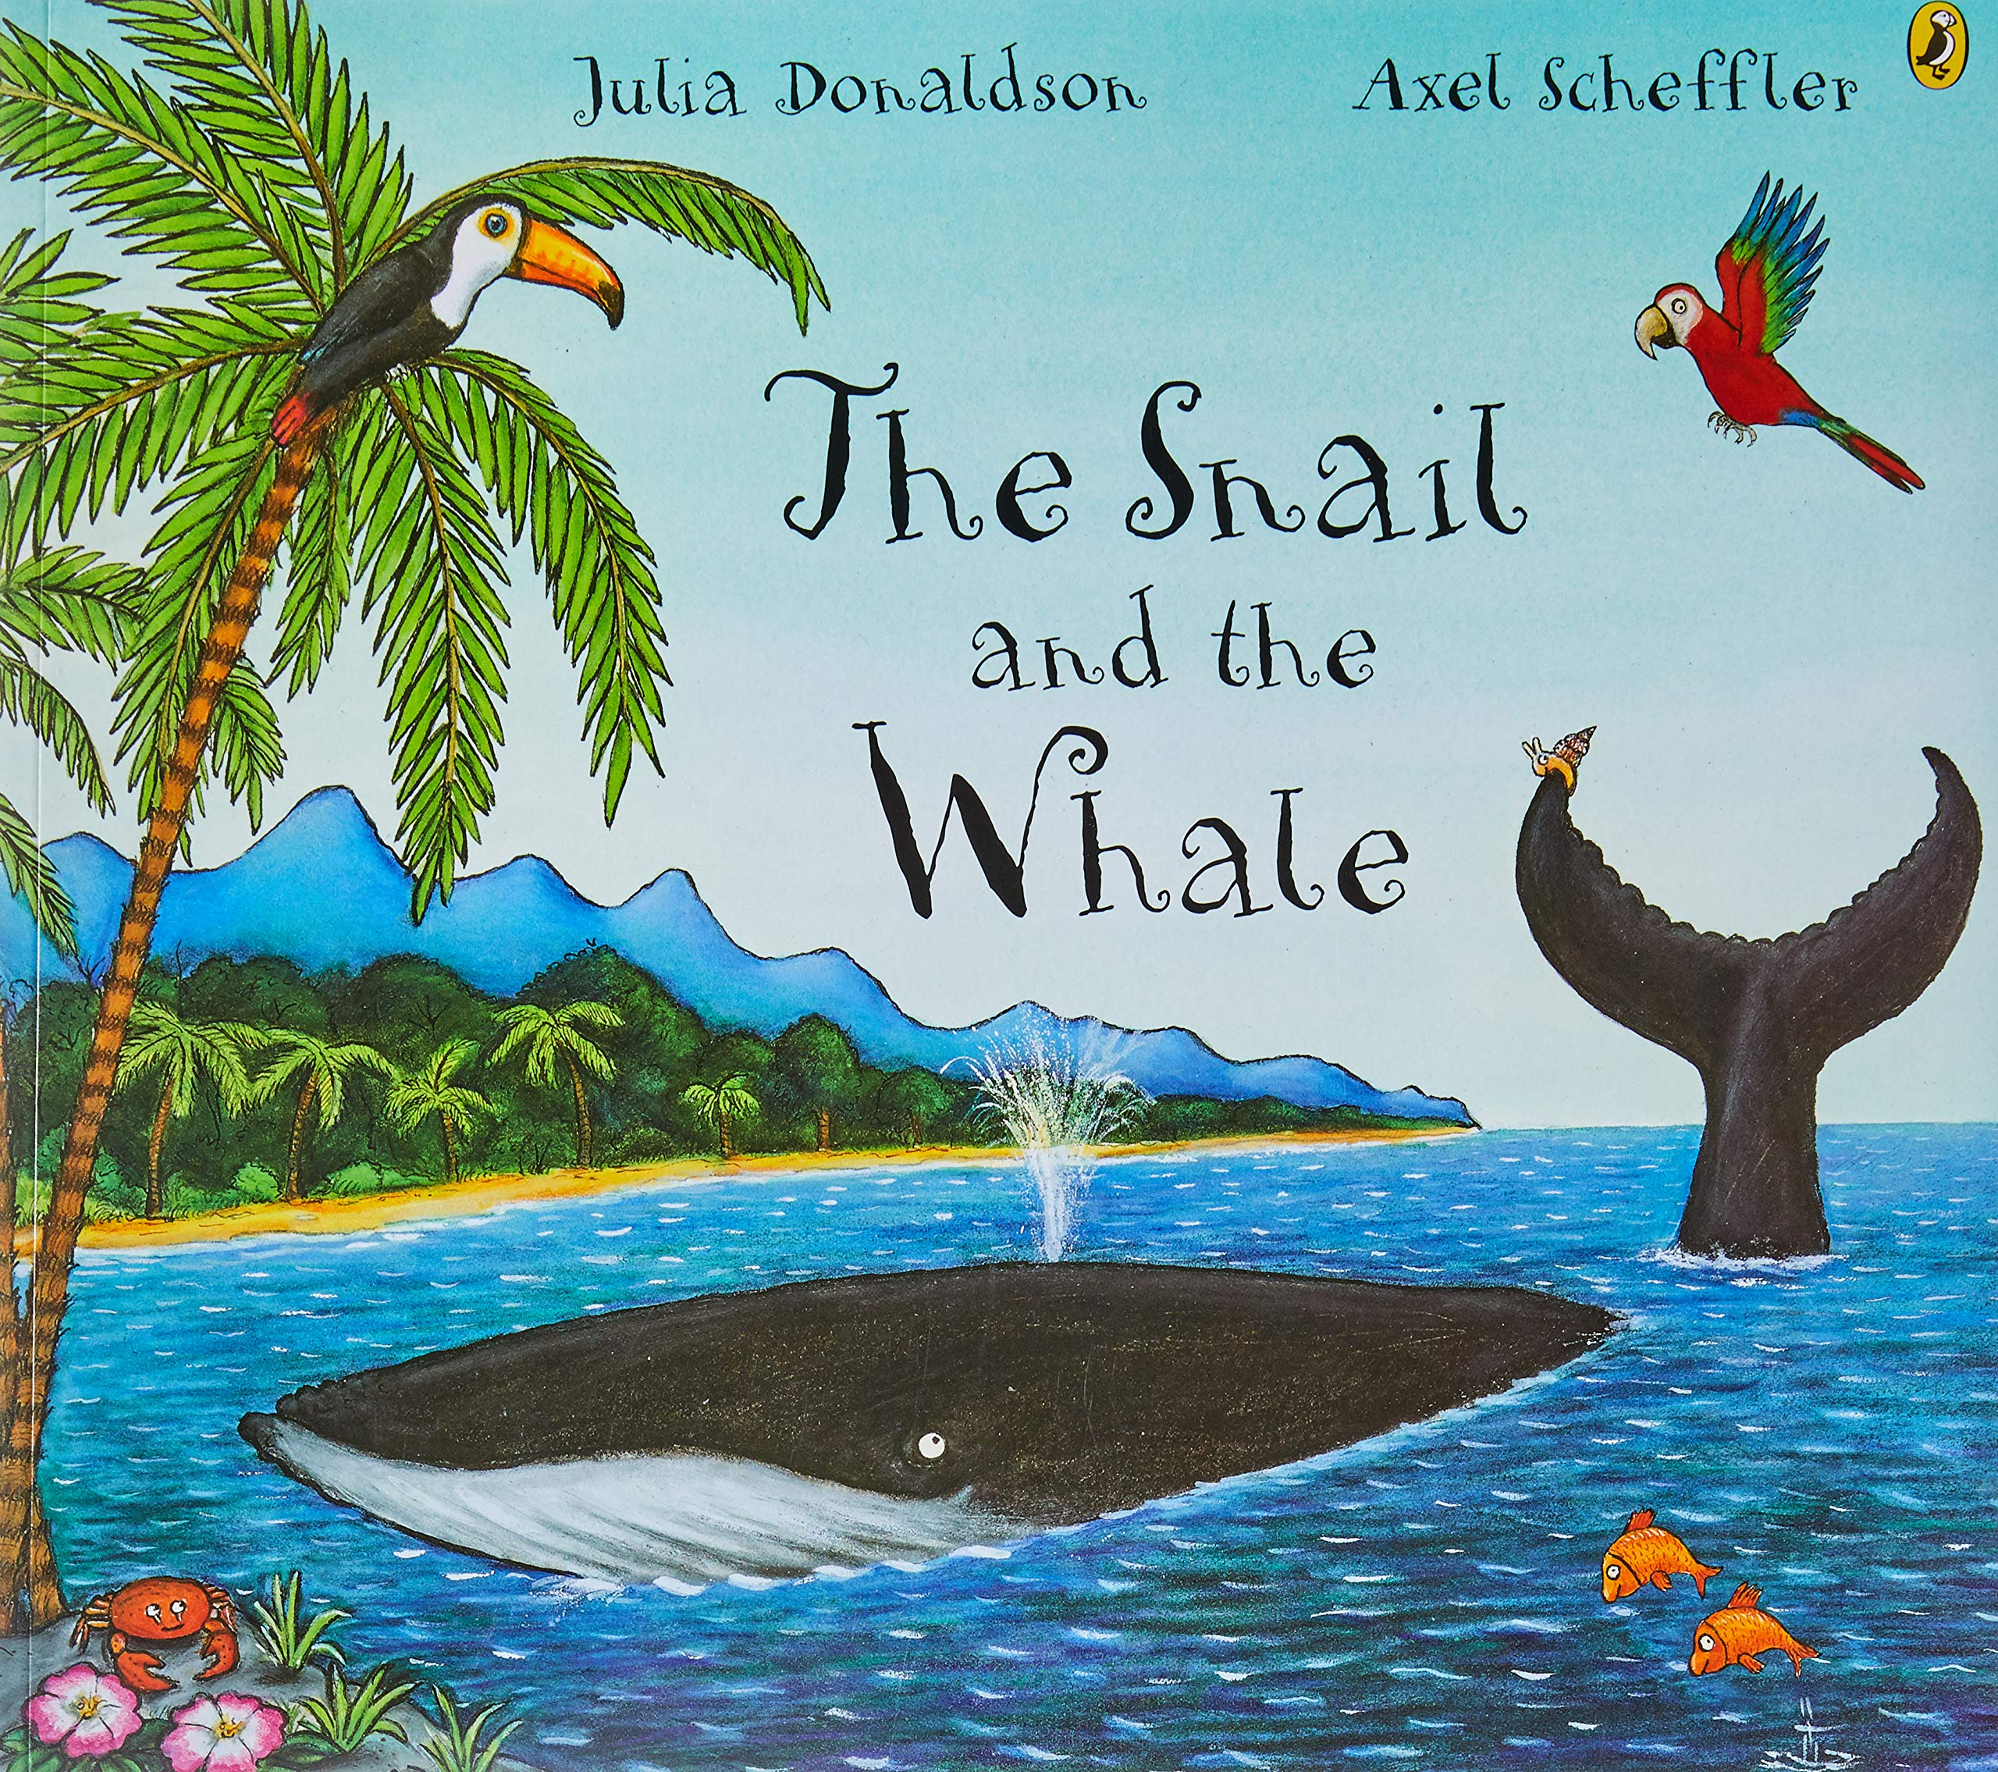
Warm Up – Guess the book from the book review…
1. The main character is a rainbow coloured elephant
who likes to make his friends laugh.
2. The main character is a brave snail who comes up with a clever plan.
3. The main character is a little girl with a big imagination.

Slide 4
Warm Up – Did you guess?
1. The main character is a rainbow coloured elephant
who likes to make his friends laugh.
2. The main character is a brave snail who comes up with a clever plan.
3. The main character is a little girl with a big imagination.

Slide 5
Warm Up – Examples with more detail.
The main character is a rainbow coloured elephant who likes to make his friends laugh.
It is set in a jungle.
It is my favourite book because Elmer is different to all the other elephants and is proud to be different.
9/10

Slide 6
Warm Up – Examples with more detail.
The main character is a brave snail who comes up with a clever plan.
It is set at sea.
It is my favourite book because they whale and snail travel to lots of places which are interesting to see.
9/10

Slide 7
Warm Up – Examples with more detail.
The main character is a little girl with a big imagination.
It is mainly set the a little girls house but also shows her memories.
It is my favourite book because I love the illustrations (drawings) and they make me feel happy.
10/10

Slide 8
OVER TO YOU…
Activity:
Find your absolute favourite book.
Use the book review from your Home Learning booklet and complete it as best you can. You could also use paper or a jotter. Or you could give a review by telling someone at home.
If possible, take a photo of your answer and post to the school Twitter page or leave a comment on the school blog.

Slide 9
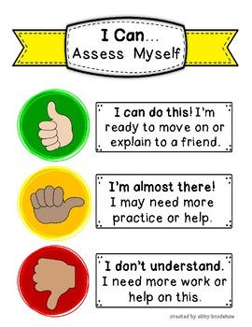
Assessment and Plenary
Think:
Did you mange to give your favourite book a review
(by writing it down or telling someone)?
Did you give your favourite book a score out of 10?
Next step:
Each time you read a book or hear a
story, pay attention to the author and
begin to form an opinion about which
authors you prefer.
Can you tell I like Julia Donaldson?

