Slide 1
Literacy
Writing – Writer’s Craft, part 3 (of 3)
You will need:
Sharp pencil, paper and someone
to help you read through the lesson.
Follow the lesson plan or skip to slide 6.

Slide 2
Literacy
Writing – Writer’s Craft, part 3 (of 3)
Learning Intention (LI):
to continue writing a story.
Success Criteria (SC):
I can continue the setting.
I can continue with the same characters.
I can continue with the same timings.

Slide 3
Warm Up – Story starter
Activity – Alan and Amy are still on holiday.
Read the text and answer the questions:
On the last night of their holiday, Alan and Amy crept out of their bed and, in the darkness, opened the curtains of
the caravan window…

Slide 4
Warm Up – What next?
Who are the characters?
Where are they?
What time of day is it?
What has happened so far?
Tell someone what you think might happen next.

Slide 5
Writer’s Craft
When we continue a story, we have to check it make sense.
Is the character a boy – he/him/his
Is the character a girl – she/her
Is it daytime or night time? Is it winter or spring?
Is it a scary story or a funny story?

Slide 6
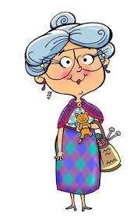
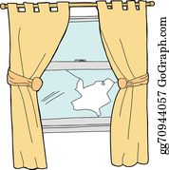
Writer’s Craft
Activity: Continue this story starter about Alan and Amy.
Option 1: Draw a picture to show what happens next.
Option 2: Draw a picture to show what happens next
and explain your answer to someone.
Option 3: Draw what happens next. Copy the starter
sentence and write what happens next. Explain your
answer to someone.
Ideas:

Slide 7
Assessment and Plenary
Think:
Did you mange to draw what might happen next with Alan and Amy?
Can you explain your answer to someone else?
Choose an assessment method and draw it beside your work. 1 – I struggled 4 – I’m doing well
Red – not there yet 2 – I found some difficult
Orange – getting there 3 – I think I’m getting it 5 – I have got it!
Green – got it!
Next step:
Do you still have your story cards from your Read, Write, Count bags? Look them out and practise telling stories.

