Slide 1
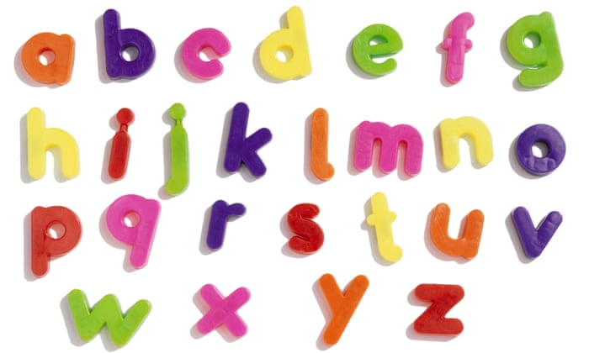
Alphabetical Order
L.I. to order words alphabetically.
S.C. I can sort the farm animal names into alphabetical order.

Slide 2
Watch the link below and practise singing the song
https://www.youtube.com/watch?v=yseWMJS8IHw

Slide 3
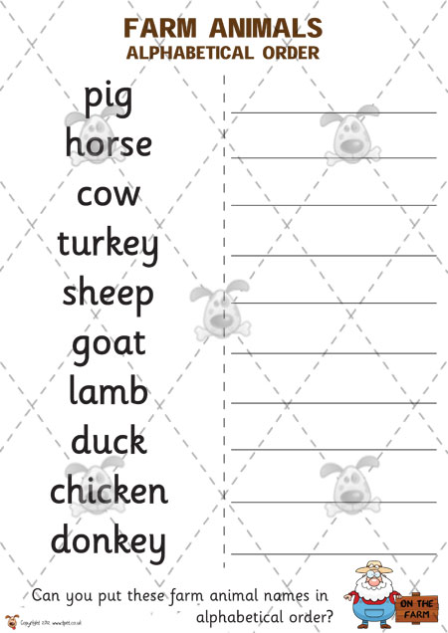

Slide 4
Assessment
How did you get on?

