Slide 1
Spelling/ Phonics/ Reading Activity Carousel Monday 30th - Thursday 2 and do one of these activities each day. Use your jotter to record your answers! Recommended time: 30 mins

Slide 2
1. Spelling Activity
Here are the spellings for this week…
(Children will know which spellings they normally do)
c/sc spellings: clap, click, clip, crisp, scab, scalp, scuff-
amp spellings: camp, cramp, damp, lamp, ramp, stamp, tramp
oa spellings: load, road, toad, loaf, cloak, oak, soak, boat, coat, float, goat, gloat, oat
(you have now completed level 4 spellings so we will now go on to some ‘common exception words’) accident, accidentally, actual, address, although, answer, appear, arrive
Click on the link below to find different ways of practising your spellings!
https://www.thoughtco.com/ways-to-practice-spelling-words-2086716

Slide 3
2. Reading activity Following on from our reading lesson on Monday. Read some of your book and get an adult to ask you some of these comprehension questions about what you have read. .

Slide 4
3. Phonics activity The sound family we are looking at this week is the oo, ew, u, ue and u_e family. They sound the same but are spelt differently. Check out this video clip https://www.youtube.com/watch?v=jNpqXXClrAA Play this phonics game to investigate the long oo sound! https://www.phonicsplay.co.uk/member-only/ooAltSpellings.html Username:march20 password: home

Slide 5
4. Reading activity
Read this…..

Slide 6
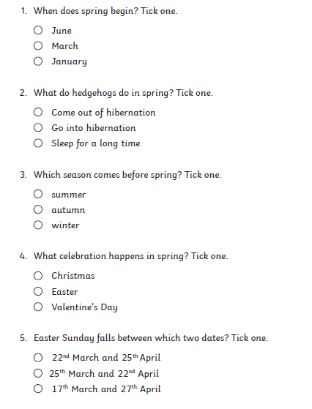
4. Reading activity
Answer these comprehension
questions!

