Slide 1
Reading lesson Monday 30th March Recommended time: 30 mins

Slide 2
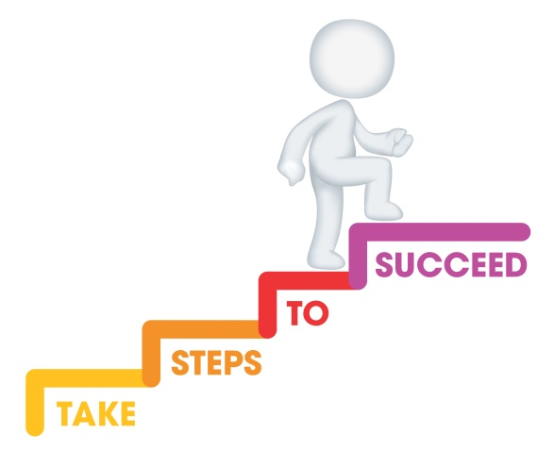
L.I. To answer comprehension questions.
Steps to success
I can read a section of text.
I can skim and scan to find the important information.
I can answer comprehension questions.
I can write my answers in full sentences.

Slide 3
Okay P3 remember we’ve done this before ‘comprehension’ to means to show you have understood what you have read! just common sense! e!

Slide 4
Remember I said you can find answers more quickly by using the skill of ‘skimming and scanning’- click on this video clip to remind yourself https://www.youtube.com/watch?v=F1wPYHa5nUg

Slide 5
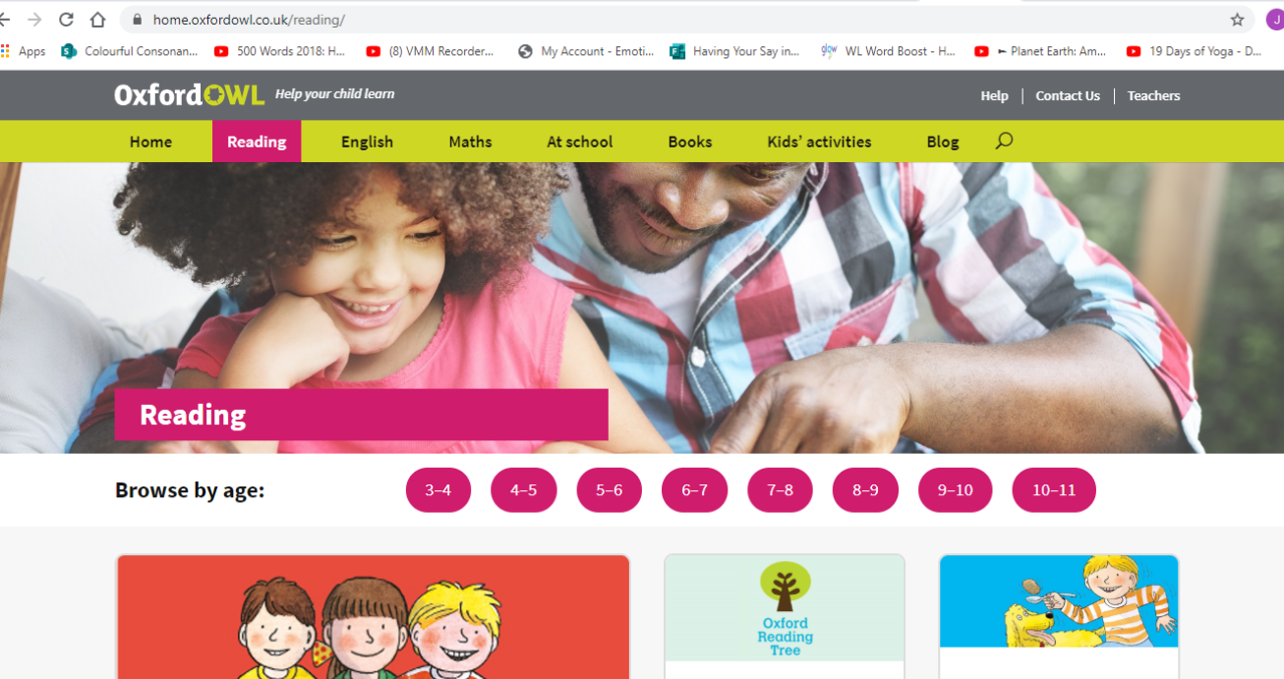
This is a really cool website where you can access e-books for free you just need to register... https://home.oxfordowl.co.uk/reading/

Slide 6
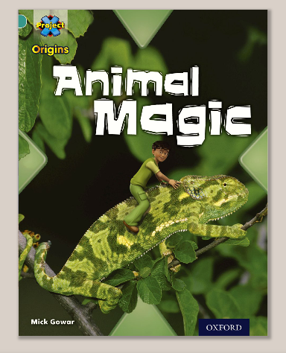
When you have register click on ‘free e-books’ and search ‘Animal Magic’.

Slide 7
Read the book and then play the activities above.

Slide 8
Now use your skimming and scanning to answer these comprehension questions. Write down your answer in a complete sentence… 1. What does the word ‘camouflage’ mean? The word camouflage means… 2. How does a ‘bark spider’ hide from it’s prey? A bark spider… 3. What type of animal is a chameleon? A chameleon is…

Slide 9
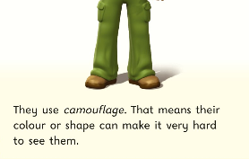
Answers! 1. What does the word ‘camouflage’ mean? The word camouflage means to change shape or colour which is usually used to hide or to hunt.

Slide 10
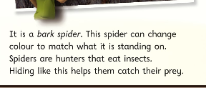
Answers! 2. How does a ‘bark spider’ hide from its prey? A bark spider hides from its prey by camouflaging into the colour of the bark of a tree.

Slide 11
Answers! 3. What type of animal is a chameleon? A chameleon is a type of lizard.

Slide 12
Let’s reflect on our learning! Do/can you now… …read a section of text? …skim and scan to find the important information? …answer comprehension questions? …write my answers in full sentences?
Not achieved the learning intention- I’ve answered ‘no’ to all of the above.
Go through the slides again.
Partly achieved the learning intention- I’ve answered ‘yes’ to some of the above
Goo job! We’ll keep practising.
Achieved the learning intention- I’ve answered ‘yes’ to all of the above.
Well done!

