Slide 1
Numeracy lesson. Monday 30th March

Slide 2
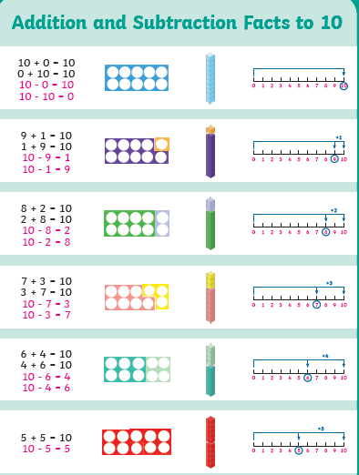
Mental Maths Recommended time 15 mins
Step 1: Make sure you can recall all your number bonds to ten but this time the related subtraction facts.

Slide 3
Mental Maths Recommended time 15 mins
Step 2 (if you can confidently do step 1): Change your number bonds to ten into number bonds to 100 by multiplying by ten but focus on the subtraction facts. Then recall these off by heart.
10-8=2 so 100-80=20
Extension: Can you work out a whole number family? i.e. 10+90=100 so 90+10=100
so 100-10=90 so 100-90=10

Slide 4
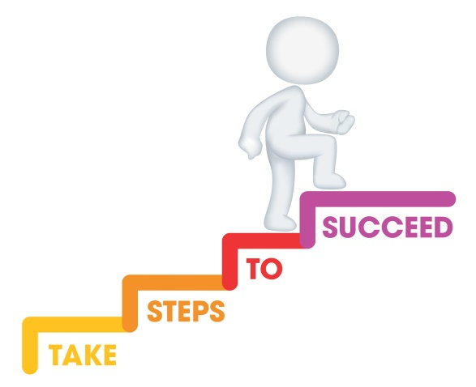
L.I. To subtract by drawing dienes. Recommended time approx 1 hour
Steps to success
I know how to represent a number using dienes.
I know how to draw the dienes.
I can subtract by drawing the dienes and crossing them out.

Slide 5
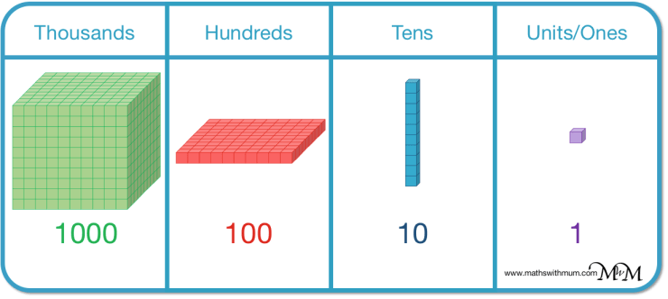
These are dienes.

Slide 6
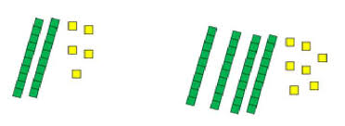
We can use dienes to represent numbers.
This represents 25 because 25 is made of 2 tens and 5 ones.
What number does this represent?

Slide 7
I can draw dienes like this

Slide 8
Now I can subtract numbers by drawing the dienes!
Firstly, draw the dienes
33
21

Slide 9
Now I can subtract numbers by drawing the dienes!
Then cross them out, in this case cross out 21, as we are subtracting 21!
33
21

Slide 10
Now I can subtract numbers by drawing the dienes!
Count up what is left!
33
21
12

Slide 11
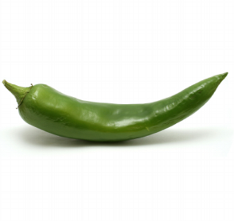
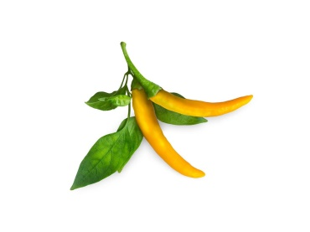
Your turn! In your jotter calculate the following by drawing the dienes. You choose which chilli challenge suits your level of understanding!
Hot
You are going to try subtracting with exchanges! Watch this video which helps explain it and shows you how to do this while still drawing the dienes.
https://www.youtube.com/watch?v=-JUxKogWhF8
(Skip to 1 min 29)
46-29=
72-47=
82-69=
71-58=
123-28=
234-128=
420-225=
568-459=
Mild
Spicy
23- 13=
45-24=
34-12=
49-23=
54-41=
89-27=
77- 15=
99-28=
98- 18=
78-24=
133- 31=
254-123=
358- 142=
428-122=
727- 321=
942-721=

Slide 12
Let’s reflect on our learning! Do you now… …know how to represent a number using dienes? …know how to draw the dienes? …know you can subtract by drawing the dienes and crossing them out?
Not achieved the learning intention- I’ve answered ‘no’ to all of the above.
Go through the slides again.
Partly achieved the learning intention- I’ve answered ‘yes’ to some of the above
Goo job! We’ll keep practising.
Achieved the learning intention- I’ve answered ‘yes’ to all of the above.
Well done!

