Slide 1
Numeracy
Multiplication
L.I To solve multiplication problems
S.C. I can make equal groups
I can count equal groups

Slide 2
Warm up
Orally practise counting forwards in 2s
Watch the counting by 5s to100 video. Singalong and join in with the actions.
https://www.youtube.com/watch?v=amxVL9KUmq8

Slide 3
Multiplication
Today we will learn how to solve multiplication problems using the grouping strategy!

Slide 4
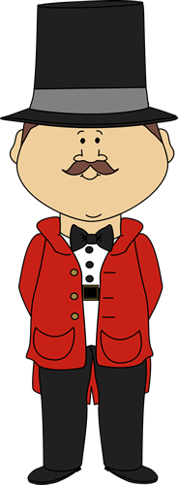
Let’s see all the words we need to use when solving multiplication problems.
groups of
Lot’s of
Times
multiply
Sets of

Slide 5
How do we solve multiplication problems using the grouping strategy?
Lets try and solve this …..
2 x 3 = ?
What is the first number?
2
We can draw 2 groups

Slide 6
Now what is the second number ?
3
So we can draw 3 objects in each group!
2x3=6
How many objects altogether? 6

Slide 7
Let’s try and solve this….
4 x 2 = ?
How many groups do we need to draw?
4
How many in each group?
2
How many altogether?
8
4 x 2 = 8

Slide 8
Daily tasks
Write the following sums in your jotter. Remember to draw groups to help you solve the multiplication.
There are Mild, Hot and Spicy ones to choose from. If you complete a set and find it easy try the next one!
If you get you stuck you can always draw your groups and use real objects to help you. For example you may use buttons, cheerios or bits of lego to put in the groups.

Slide 9
Mild
1. | 1 x 2 =
2. | 3 x 2=
3. | 2 x 2 =
4. | 4 x 2 =
5. | 2 x 4 =
6. | 2 x 5 =
7. | 1 x 2 =
8. | 5 x 2 =
9. | 2 x 4 =
10. | 6 x 2 =

Slide 10
Spicy
1. | 2 x 2 =
2. | 4 x 2 =
3. | 6 x 2 =
4. | 7 x 2 =
5. | 2 x 5 =
6. | 3 x 5 =
7. | 5 x 5 =
8. | 2 x 3 =
9. | 3 x 3 =
10. | 10 x 2 =

Slide 11
Hot
1. | 3 x 2 =
2. | 5 x 3 =
3. | 2 x 6 =
4. | 7 x 3 =
5. | 4 x 4 =
6. | 6 x 5 =
7. | 3 x 6 =
8. | 4 x 7 =
9. | 3 x 8 =
10. | 2 x 9 =

Slide 12
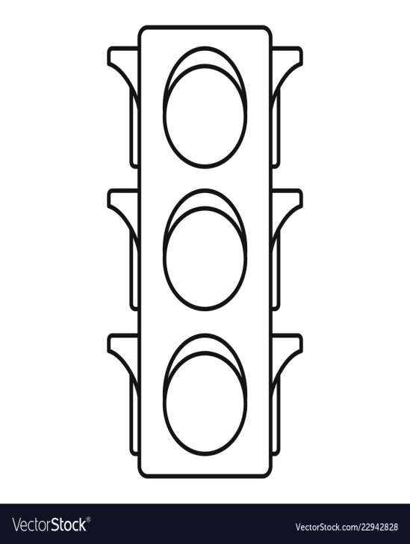
Assessment
How did you get on? Choose one way.
Tell me how you feel it went by leaving
a comment on the blog.
Draw one of the self assessment methods below next to your work.
Traffic light Fist of 5
1 – I struggled
Red – not there yet 2 – I found some difficult
Orange – getting there 3 – I think I’m getting it
Green – got it! 4 – I’m doing well
5 – I have got it!

Slide 13
Well Done Everyone!

