Slide 1
Literacy
Writing – Writer’s Craft, part 1 (of 3)
You will need:
Sharp pencil, paper and someone
to help you read through the lesson.
Follow the lesson plan or skip to slide 7.

Slide 2
Literacy
Writing – Writer’s Craft, part 1 (of 3)
Learning Intention (LI):
to continue writing a story.
Success Criteria (SC):
I can draw what might happen next.
I can match a picture to a starter sentence.
I can check my next sentence makes sense.

Slide 3
Warm Up – Story starter
Activity:
Match the images to the story starter:
1. One sunny day in July, Lucy went to the beach with
her family and something pinched her little toe.
2. It was a cold, dark evening in October and, as Ben was
walking home from school, something flew over his head.

Slide 4
Warm-up activity:
Did you guess correctly?
What would make sense as a second sentence?
1. One sunny day in July, Lucy went to the beach with
her family and something pinched her little toe.
She shouted on her mum and the crab crawled
back to the sea.
OR
He shouted on his dog and the seagull
flew away.
Can you explain your answer?

Slide 5
Warm-up activity:
Did you guess correctly?
What would make sense as a second sentence?
2. It was a cold, dark evening in October and, as Ben was
walking home from school, something flew over his head.
She thought it was a butterfly so she chased it into the
castle and found a princess.
OR
He hated bats so he ran all the way home, got into
bed and hid under the covers.
Can you explain your answer?

Slide 6
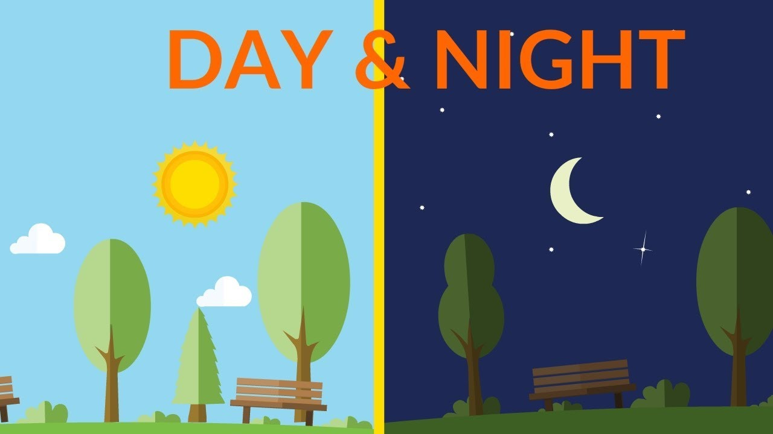
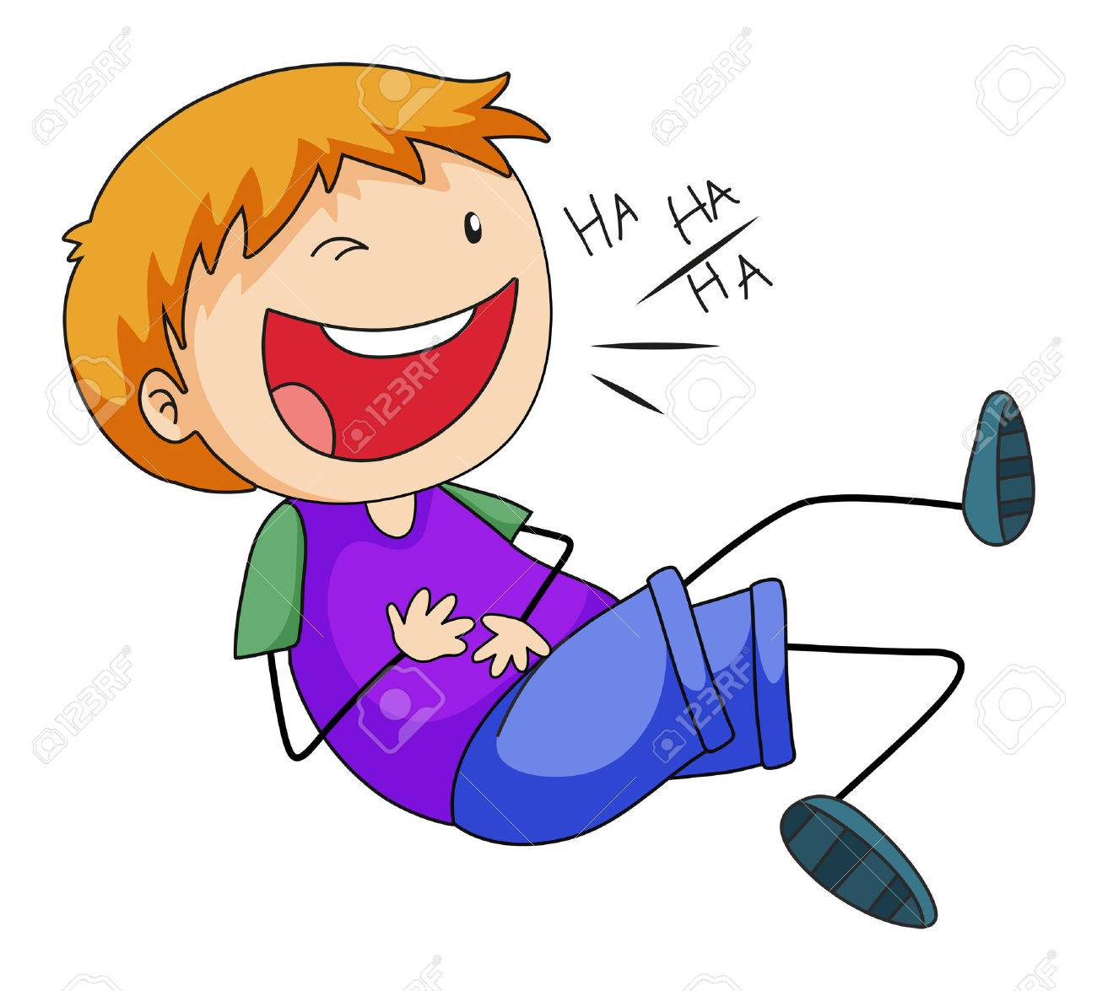
Writer’s Craft
When we continue a story, we have to check it make sense.
Is the character a boy – he/him/his
Is the character a girl – she/her
Is it daytime or night time? Is it winter or spring?
Is it a scary story or a funny story?

Slide 7
Writer’s Craft
Activity: Continue this story starter.
Option 1: Draw a picture to show what happens next.
Option 2: Draw a picture to show what happens next
and explain your answer to someone.
Option 3: Draw what happens next. Copy this
sentence and write what happens next. Explain your
answer to someone.
At breakfast time, Fluffy the dog stole
some sausages from Joe and hid them...

Slide 8
Assessment and Plenary
Think:
Did you choose the correct sentences for each story starter?
Did you mange to draw what might happen next with Fluffy and Joe?
Choose an assessment method and draw it beside your work. 1 – I struggled 4 – I’m doing well
Red – not there yet 2 – I found some difficult
Orange – getting there 3 – I think I’m getting it 5 – I have got it!
Green – got it!
Next step:
Next time you read a story, pause before turning the page and guess what the next sentence might say.

