Slide 1
Literacy
L.I. to spell words using our phonics sounds
S.C. I can spell ay words.

Slide 2
We already know the ai sound. Today we are learning that you can say ai in another way. ay

Slide 3
Watch the links below
https://www.youtube.com/watch?v=ROKNNvuGpEo
https://www.youtube.com/watch?v=YZg3fVSx8a8
https://www.youtube.com/watch?v=BGrIyCT7nK0
https://www.youtube.com/watch?v=eoy1JXYPn6w

Slide 4
Warm Up Game!
Say what the ay word is in each picture and try to spell it in your jotter?
Let’s have a go!

Slide 5
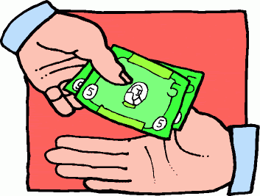
Clue:
When you go to the shop you give the person money.

Slide 6
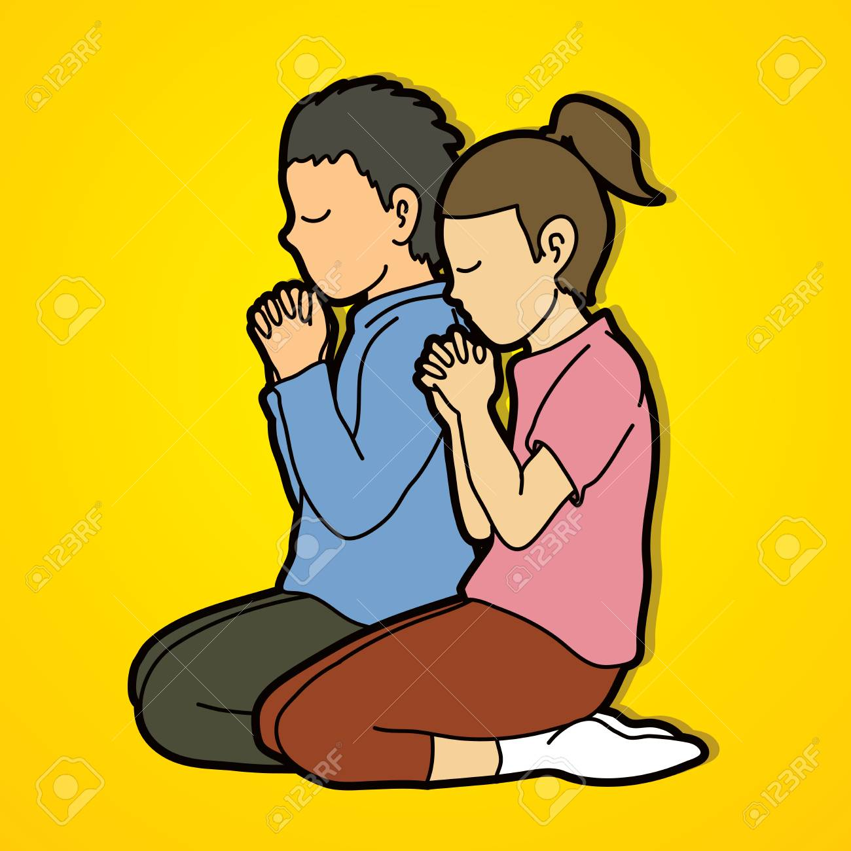

Slide 7
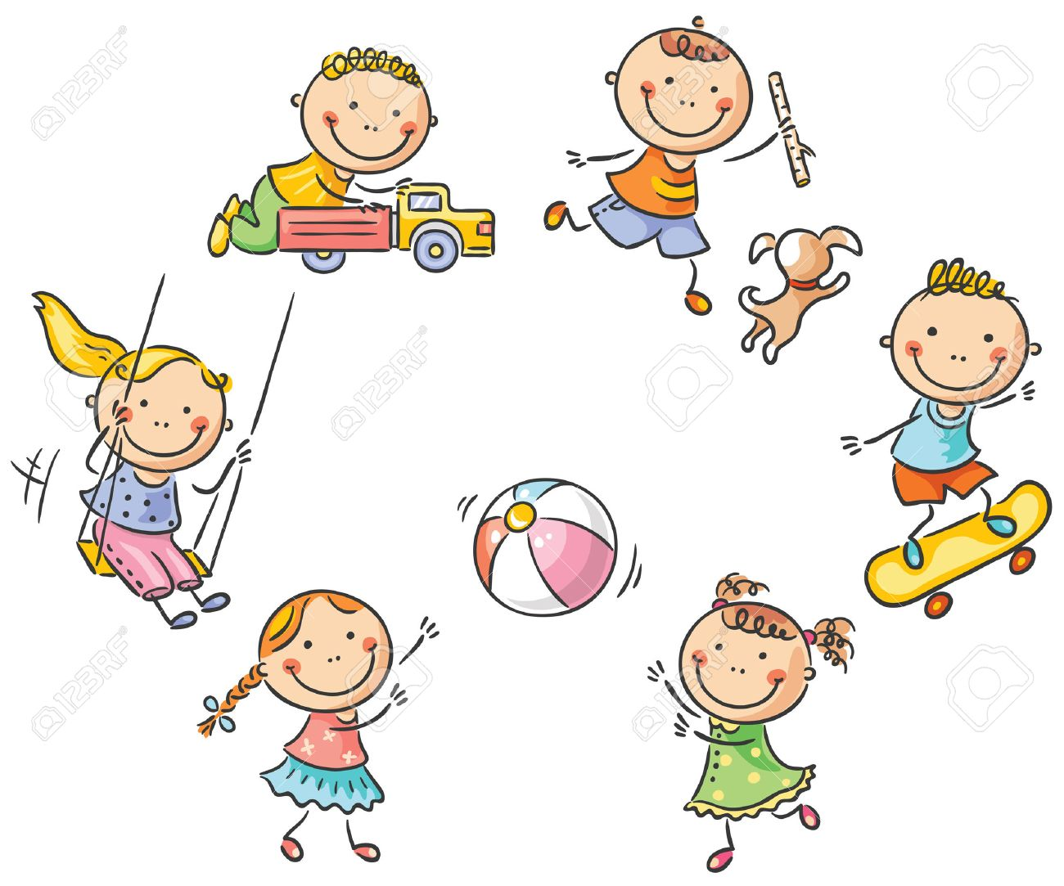

Slide 8
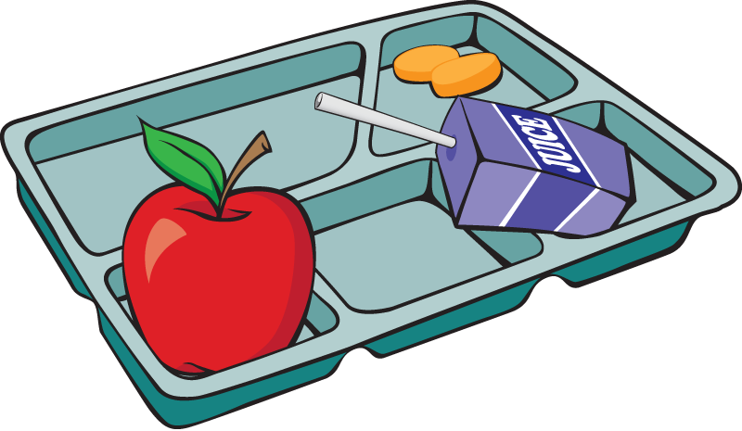

Slide 9
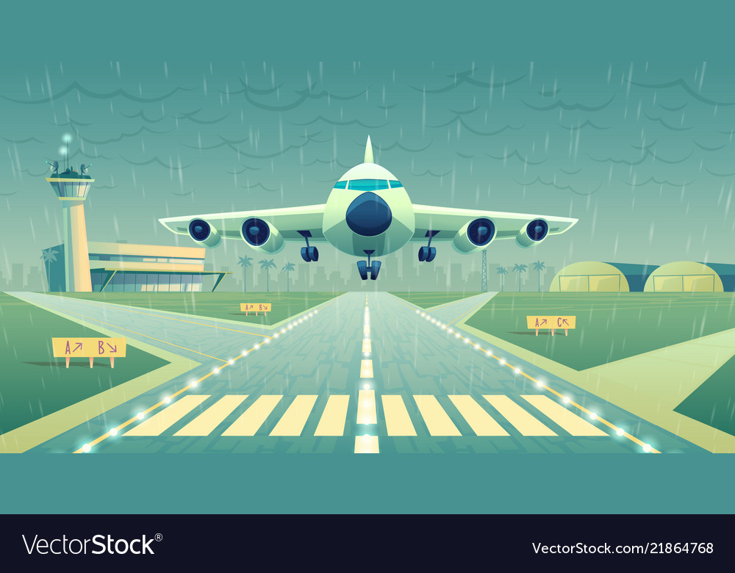

Slide 10
Reading ay words Read each word out loud Draw a picture for each word and colour it in.
1. say 2. today
3. clay 4. hay

Slide 11
Part 2
L.I. to write a sentence with an ay word
S.C. I can use the descriptive bubble to make
sentences more interesting.

Slide 12
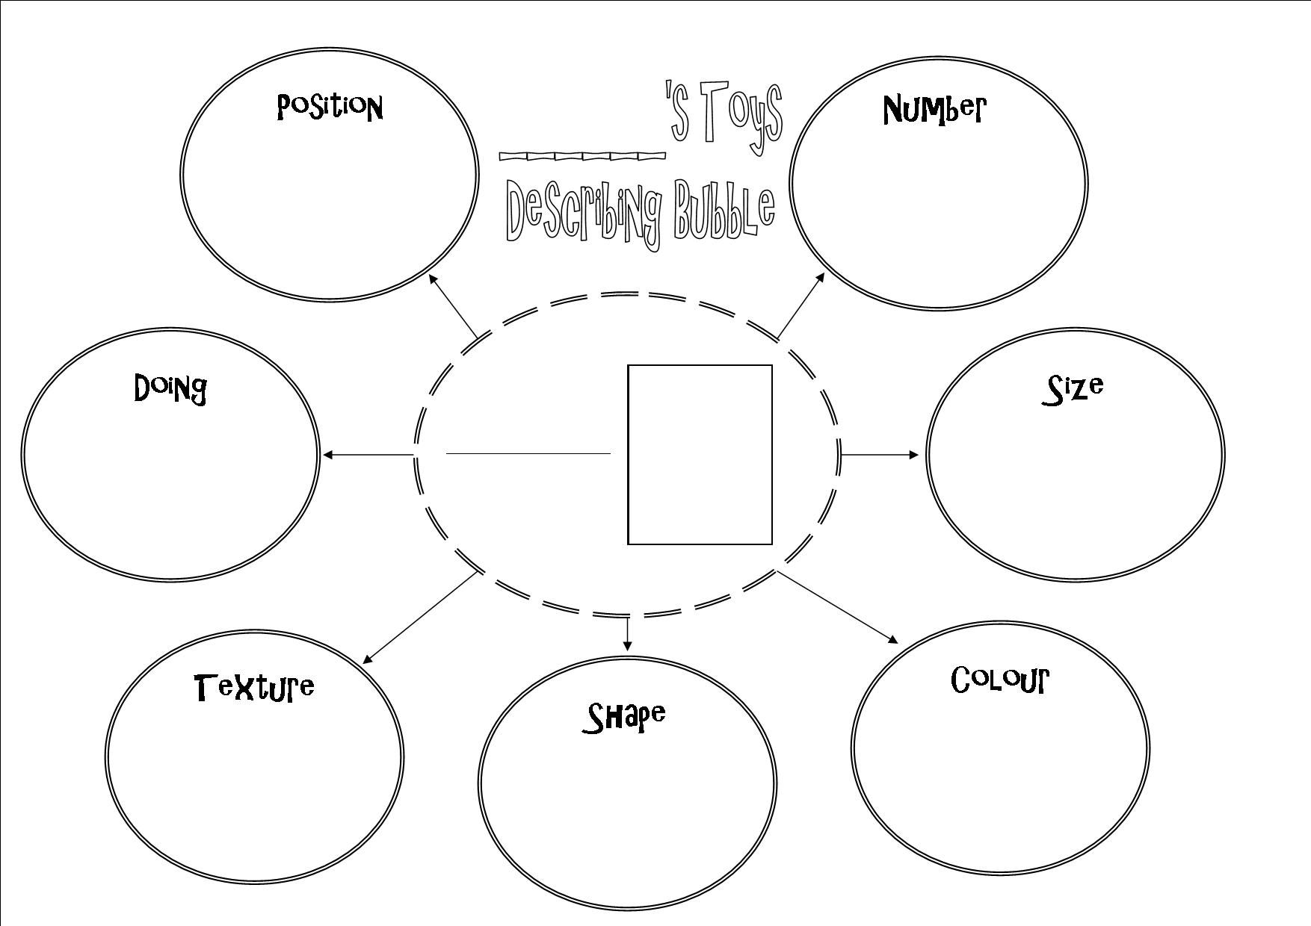
Up Level
May will pray at church.
This sentence is boring. Let’s up level it using the descriptive bubble!

Slide 13
May will pray at church.
First what are the nouns? (The name of things)
May will pray at church.
These are the things I can describe.
Happy May will pray at the beautiful church.
Now its more interesting!

Slide 14
Up level again!!!
I can up level it again by saying how she did the verb.
Can you find the verb?
Happy May will pray at the beautiful church.
So I can improve it by adding and adjective. I can say how she prayed.
Happy May will pray quietly at the beautiful church.

Slide 15
Your Turn!
Write a sentence for each ay word.
Make sure you use your basic writing targets.
Capital letters finger spaces full stops
Try to up level your sentences using the descriptive bubble.
1. say 2. today
3. clay 4. hay

Slide 16
Assessment Time
How did you get on? Choose one way.
Tell me how you feel it went by leaving
a comment on the blog.
Draw one of the self assessment methods below next to your work.
Traffic light Fist of 5
1 – I struggled
Red – not there yet 2 – I found some difficult
Orange – getting there 3 – I think I’m getting it
Green – got it! 4 – I’m doing well
5 – I have got it!

Slide 17
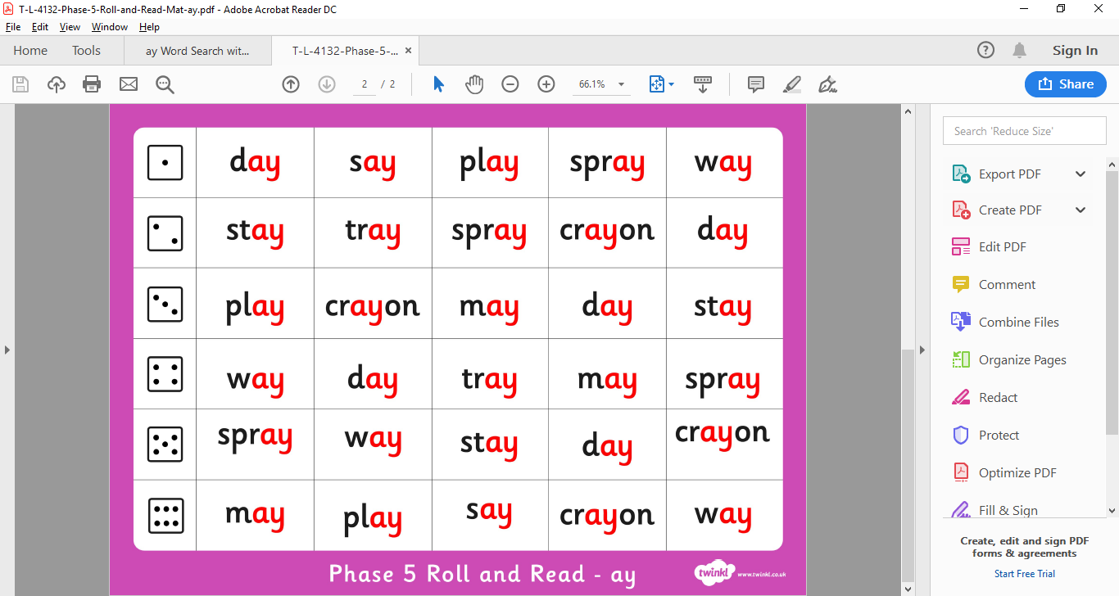
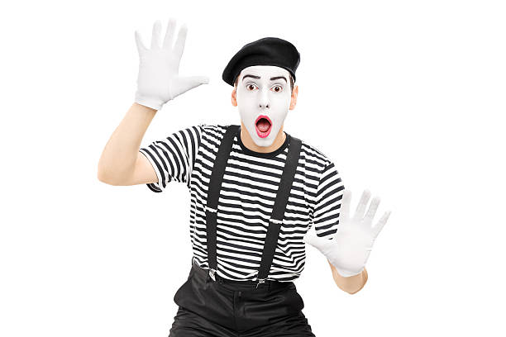
Plenary – Roll and Read Game
Act It Out!

Slide 18
Word Family ay video Read along with the ay words
https://www.youtube.com/watch?v=yOvPoxX7-P0

