Slide 1
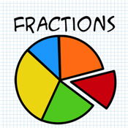
Identifying fifths

Slide 2
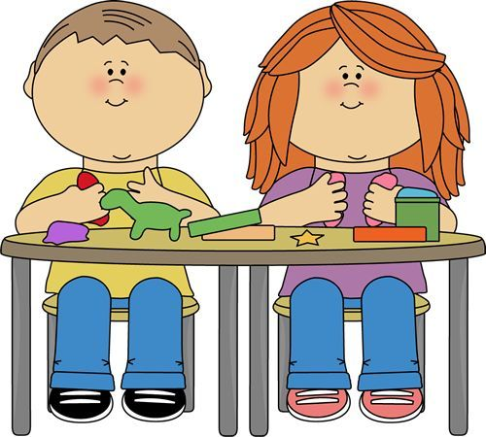
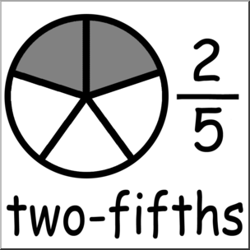
Getting organised
Resources: - playdough - Numeracy jotter
Today we are going to explore making, identifying and writing fifths of a shape.

Slide 3
Task 1
Make a circle with your playdough.
Split the playdough into 5 equal sections (there’s a hint on the previous slide).
You will use this to work through the next few tasks.
Question 1
If you gave one section of your circle to your friend, what fraction would you give them?
Write this in your numeracy jotter.

Slide 4
Questions 2 & 3
Question 2
Your friend was given 1/5. If you give two pieces of the circle to your mum, how many pieces do you have left for yourself?
Question 3
How many pieces of the circle have you given away in total?

Slide 5
Get creative!
In the next two slides make up 3 of your own questions using your circle.
This must still be split into fifths and your questions should give you practice of sharing fifths and writing fractions involving fifths.
Question 1

Slide 6
My own questions using fifths
Question 2
Question 3

Slide 7
Let’s Recap
Work through the power point about fractions here. You might want to make some notes and join in with the tasks in your blue Numeracy jotter.
https://www.khanacademy.org/math/arithmetic/fraction-arithmetic/arith-review-fractions-intro/v/fraction-basics

