Slide 1
Numeracy
Subtraction
L.I. to take away
S.C. I can use my counting backwards strategy
I can use a number line to help me take away
I can partition my numbers to take away bigger numbers

Slide 2
Warm up
Practise counting backwards 20 - 0 then 100 – 0
Watch this video
https://www.youtube.com/watch?v=8jMmZaFvRpE
Watch the subtraction video and say the answers.
https://www.youtube.com/watch?v=pwQKugrFmJQ

Slide 3
Counting Backwards strategy
8 - 3 =
The biggest number is always first in a take away sum. Put it in your head. Now count backwards tracking the number on your fingers.
5, 6, 7 8
Start at the 8 as that’s the biggest number.
Hold 3 fingers up and put them down as your count backwards. The last number you say is the answer!
Watch this video to get more help on number lines and counting backwards.
https://www.youtube.com/watch?v=c-vAOjeCUTI

Slide 4
Using friends of 10 to help
You can use your friends of 10 to help with subtraction too.
10 - 4 =
You might just know the answer because you recognise it being a friend of 10!
10 – 4 =
If you don’t recognise it. Think what does 4 need to make 10?
4 + = 10
4, 5, 6, 7, 8, 9, 10
Help: Count up from 4 up to 10 tracking how many or count backwards from 10 to 4.

Slide 5
Using friends of 10 with bigger numbers
You can use your friends of 10 to help do subtraction with larger numbers too
70 - 3 =
You might just know the answer because you recognise it being a friend of 10!
Think what does 3 need to make 10?
3 + = 10
Remember you are counting backwards so you are going into the decade before when counting backwards.
3 + 7 = 10
67, 68, 69 70

Slide 6
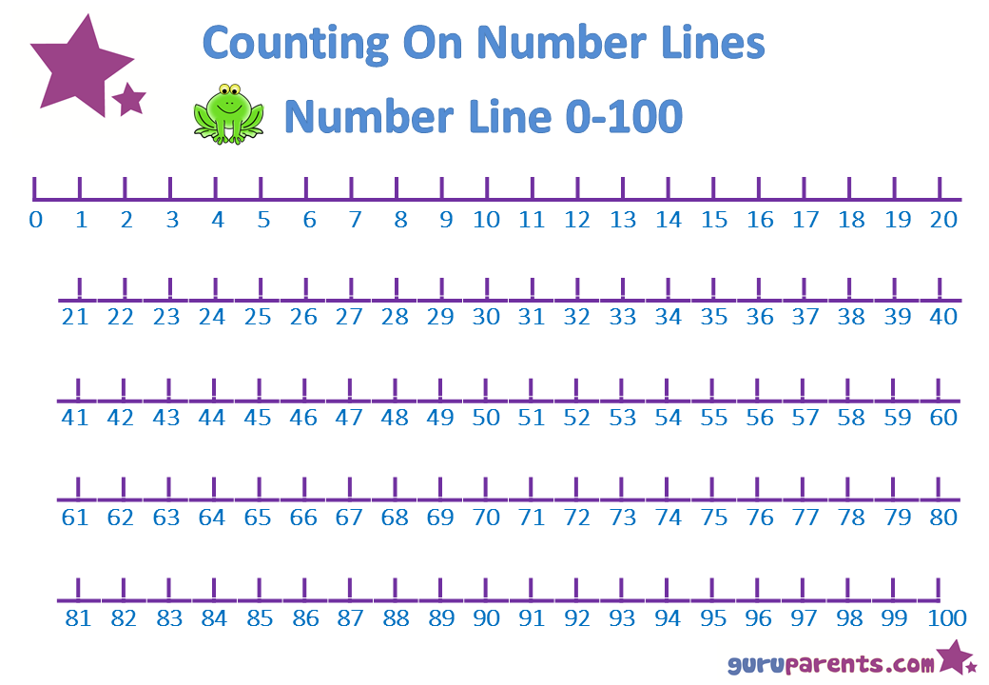
Subtraction with partioning
Watch this video first.
https://www.youtube.com/watch?v=quiZDDk5gYU

Slide 7
Daily tasks
Write the following sums in your jotter.
There are Mild, Hot and Spicy ones to choose from. If you complete a set and find it easy try the next one!
Remember to use the most efficient strategy to help you get the answer quickly.
If you get you stuck you can always use items to help you. For example you may use buttons, cheerios or bits of lego.

Slide 8
Mild
1. | 7 - 5 =
2. | 6 - 3 =
3. | 7 - 2 =
4. | 8 - 3 =
5. | 10 - 3 =
6. | 18 - 2 =
7. | 17 - 6 =
8. | 20 - 3 =
9. | 18 - 3 =
10. | 14 - 4 =

Slide 9
Spicy
1. | 48 - 8 =
2. | 24 - 4 =
3. | 55 - 5 =
4. | 47 - 7 =
5. | 19 - 9 =
6. | 38 - 9 =
7. | 44 - 7 =
8. | 53 - 8 =
9. | 37 - 9 =
10. | 43 - 5 =

Slide 10
Hot
1. | 98 - 10 =
2. | 34 – 20 =
3. | 45 – 20 =
4. | 67 - 30 =
5. | 79 – 30 =
6. | 97 – 23 =
7. | 48 - 34 =
8. | 75 – 32 =
9. | 46 – 25 =
10. | 55 – 42 =

Slide 11
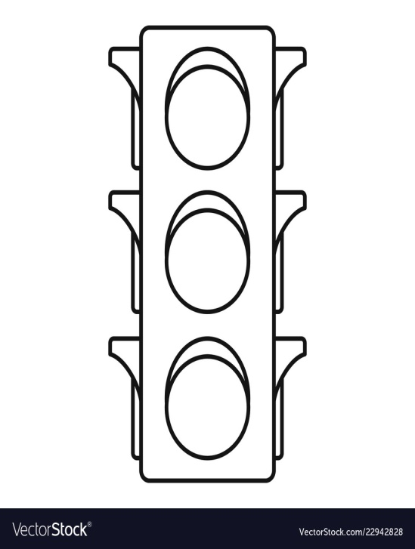
Assessment
How did you get on? Choose one way.
Tell me how you feel it went by leaving
a comment on the blog.
Draw one of the self assessment methods below next to your work.
Traffic light Fist of 5
1 – I struggled
Red – not there yet 2 – I found some difficult
Orange – getting there 3 – I think I’m getting it
Green – got it! 4 – I’m doing well
5 – I have got it!

Slide 12
Plenary
Play these games!
Use your efficient strategies to help you out!
Funky mummy take away up to 20
http://www.ictgames.com/funkyMummy/index.html
Subtraction grids – choose from the level of games to suit you.
https://www.topmarks.co.uk/maths-games/subtraction-grids

Slide 13
Good Job Everyone!

