Slide 1
Literacy
Home Learning recommendation for lots of free resources:
https://home.oxfordowl.co.uk/school-closure-resources/

Slide 2
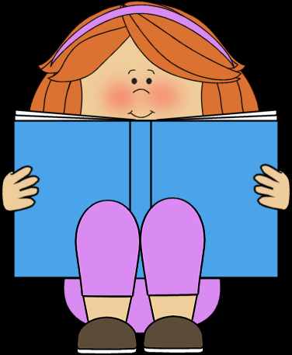
Literacy
Reading – Characters Part 3 (of 3)
You will need:
A comfy spot to work, a sharp pencil, plain paper, access to the internet and someone to help you with the lesson.
Follow the lesson plan or skip to slide 4.

Slide 3
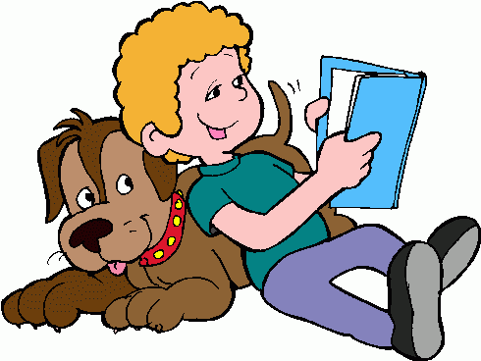
Literacy
Reading – Characters Part 3 (of 3)
Learning Intention (LI):
to show an understanding of what I’m reading
(or listening to ).
Success Criteria (SC):
I can describe the main character(s).
I can use amazing adjectives to describe characters.

Slide 4
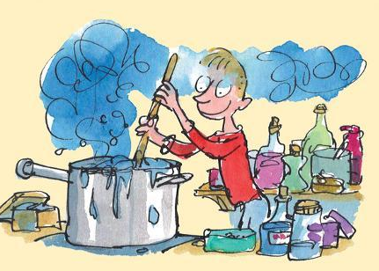
George’s Marvellous Medicine
Activity:
As you listen to the story, make a list or create a drawing for each main character (George and his Grandmother):
https://www.bbc.co.uk/programmes/p011nz7m

Slide 5
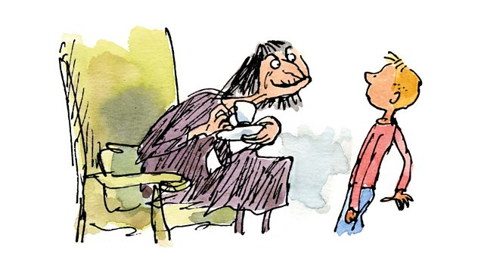
George’s Marvellous Medicine
Activity – As you listen to the story, make a list or create a drawing for each main character (George and his Grandmother):
Option 1 – Draw the main characters. Describe them (looks and personality) to someone at home.
Option 2 – Draw the main characters. Make lists of key words to describe them (looks and personality)
Option 3 – Draw the main characters. Make lists of key words to describe them (looks and personality). Write a short descriptive sentence using your key adjectives. Are the characters the same?

Slide 6
Assessment and Plenary
Think:
Did you successfully describe the main characters?
Choose an assessment method and draw it beside your work.
1 – I struggled 4 – I’m doing well
Red – not there yet 2 – I found some difficult
Orange – getting there 3 – I think I’m getting it 5 – I have got it!
Green – got it!
Next step:
Who is your favourite character – tell me in the blog comments.

Slide 7
Extension activities
Option 1:
Next time you read a story with someone else, describe a character to them
and see if they can guess from your description.
Option 2:
With permission, make your own potion. This can be a fun bath time
activity.
Option 3:
Play some music and dance away like Gerald the giraffe – have fun. Everyone can dance!

