Slide 1
Spelling/ Phonics/ Reading Activity Carousel
Monday 23rd- Thursday 26th do one of these activities each day.
Use your jotter to record your answers!
Recommended time: 30 mins

Slide 2
1. Spelling Activity
Here are the spellings for this week…
(Children will know which spellings they normally do)
pl and sl spellings: plan, plot, pluck, plug, plum, slack, slap, slick, slim, slip, slot, slum
-ft spellings: left, drift, gift, lift, swift, loft, soft
ear spellings: dear, ear, fear, hear, near, rear, spear, year
ed spellings: assorted, battled, crowded, disobeyed, displeased, disturbed, drowned, flawed, frightened, marked, murdered, powered, sorted
Click on the link below to find different ways of practising your spellings!
https://www.thoughtco.com/ways-to-practice-spelling-words-2086716

Slide 3
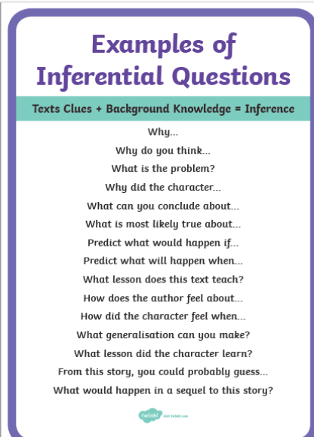
2. Reading activity
Following on from our reading lesson on Monday.
Read some of your book and get an adult to ask you some of these inference questions about what you have read.
.

Slide 4


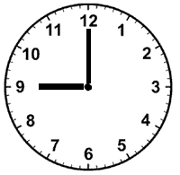
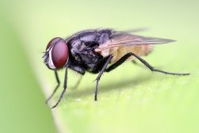


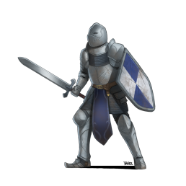

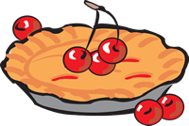
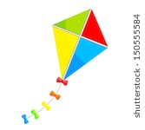
3. Phonics activity
The sound family we are looking at this week is the igh, ie, i_e, y family. They sound the same but are spelt differently.
Check out this video cliphttps://www.youtube.com/watch?v=2BCyvxdzWxE
Which igh/ie/i_e/y sound go in these words?
Bonus point- can you identify the homophone!?

Slide 5
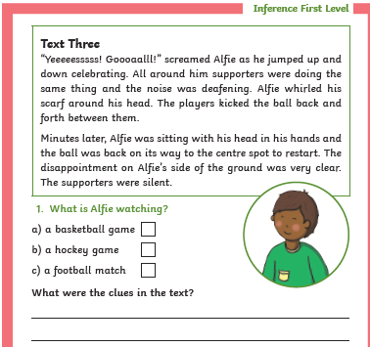
4. Reading activity

Slide 6
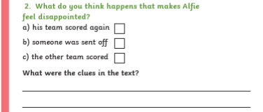
4. Reading activity

