Slide 1
Numeracy lesson. Thursday 26th March

Slide 2
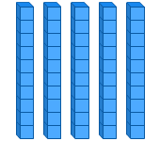
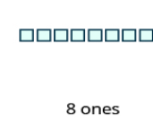
Mental Maths
Adding ones to multiples of ten
Multiples of ten are:
10,20,30,40,50,60,70,80,90,100
Remember multiples of ten have a zero in the ones.
e.g.
50
So if you’re adding ones it just slots straight into the ones position.
So 50 +8= 58 58
Therefore you shouldn’t need to count on your fingers etc. This is ‘quick maths’

Slide 3
Mental Maths
Your turn! This should take no longer than 3 mins! Challenge and time yourself! https://www.online-stopwatch.com/countdown-timer/
40+4=
30+7= 9) 8+100=
20+9= 10) 200+7=
10+3=
90+9=
70+4=
2+80=
6+60=

Slide 4
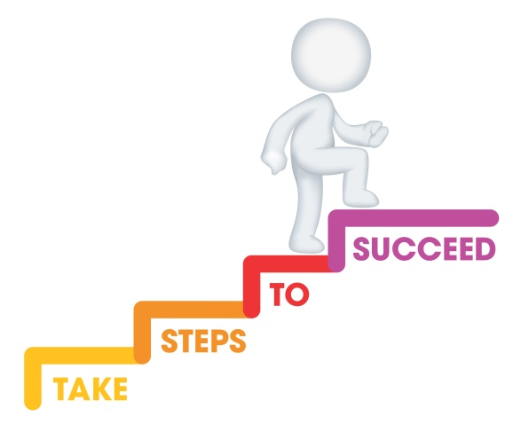
L.I. To answer addition word problems Recommended time approx 1 hour
Steps to success
- I can identify the key information from a worded problem.
I can add by drawing dienes or using the partitioning method.
I can make a sensible estimation to check whether my answer looks right.

Slide 5
Today you will be answering addition word problems. You can use the partition method or draw the dienes (Monday and Tuesday’s lesson). You can check whether your answer looks sensible my making a sensible guess (estimation)!

Slide 6
You can use the ‘RUCSAC’ method when tackling worded problems…

Slide 7
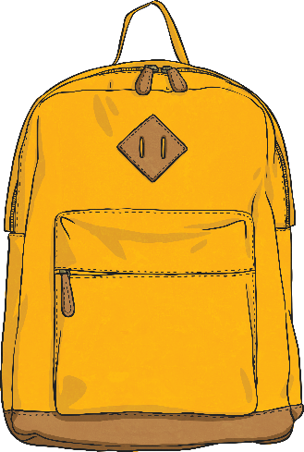
ead
R
Read the question.
What is the important information?

Slide 8
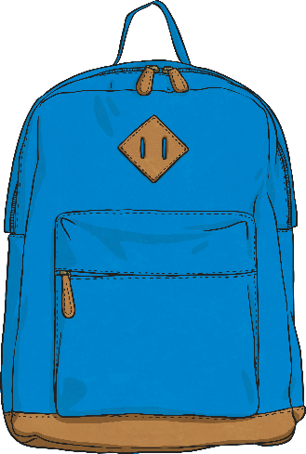
nderstand
U
Understand the question.
What do you need to find out?

Slide 9
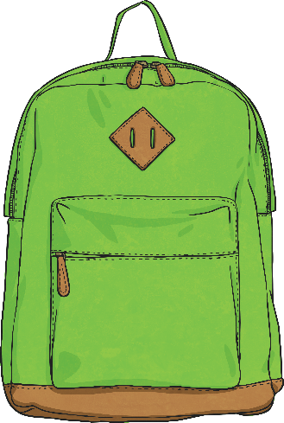
hoose
C
Choose the correct method of calculation and operation(s),
i.e. addition!

Slide 10
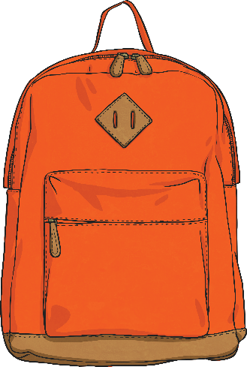
olve
S
Solve the problem. Use the partition method or draw the dienes.
Make sure you follow the steps.

Slide 11
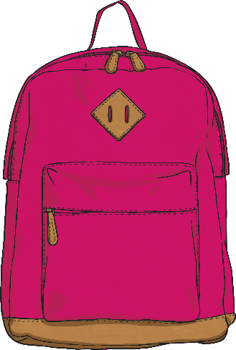
nswer
A
Answer the question.
What were you meant to find out?
Have you remember to write whatever you’ve been counting next to the answer? i.e. cm, counters, buttons etc

Slide 12
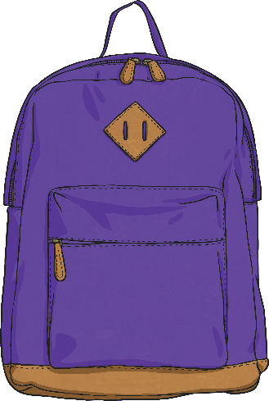
heck
C
Check your answer.
Use your sensible estimation to check if your answer looks sensible.

Slide 13
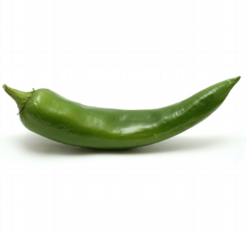
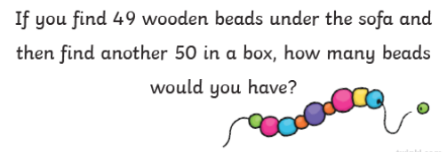
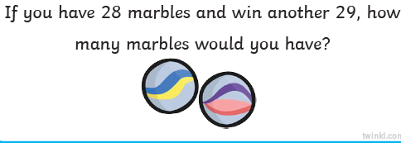
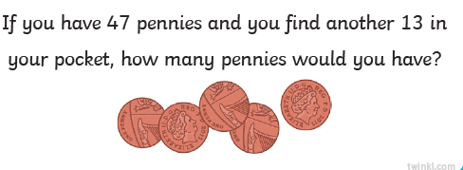
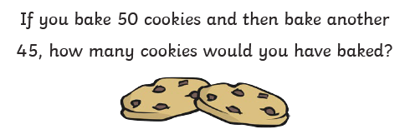
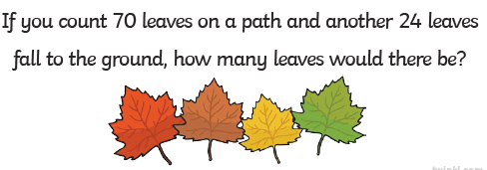
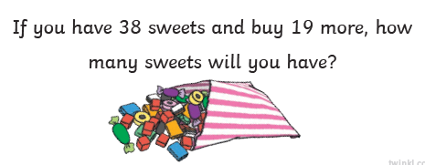
Your turn! You choose a sensible challenge for yourself!
Mild

Slide 14
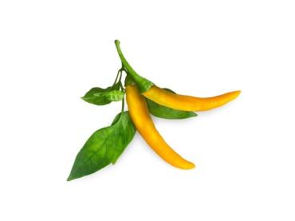
Your turn! (Ignore how they are numbered)
Spicy

Slide 15
Your turn! (Ignore how they are numbered)
Hot

Slide 16
Let’s reflect on our learning! Can you now… .. identify the key information from a worded problem? …add by drawing dienes or using the partitioning method? …make a sensible estimation to check whether my answer looks right?
Not achieved the learning intention- I’ve answered ‘no’ to all of the above.
Go through the slides again.
Partly achieved the learning intention- I’ve answered ‘yes’ to some of the above
Goo job! We’ll keep practising.
Achieved the learning intention- I’ve answered ‘yes’ to all of the above.
Well done!

