Slide 1
Literacy
Home Learning recommendation for lots of free resources:
https://home.oxfordowl.co.uk/school-closure-resources/

Slide 2
Literacy
Reading – Characters Part 2 (of 3)
You will need:
A comfy spot to work, a sharp pencil, plain paper, access to the internet and someone to help you with the lesson.
Follow the lesson plan or skip to slide 5.

Slide 3
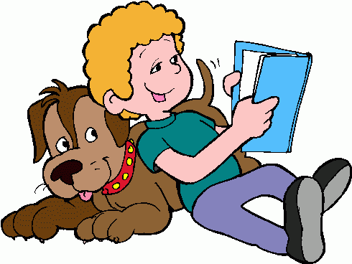
Literacy
Reading – Characters Part 1 (of 2)
Learning Intention (LI):
to show an understanding of what I’m reading
(or listening to ).
Success Criteria (SC):
I can describe the main character(s).
I can use amazing adjectives to describe characters.

Slide 4
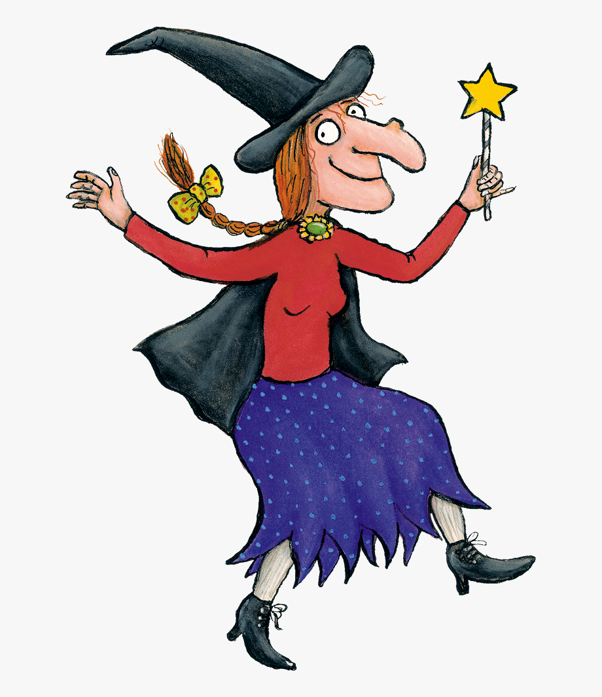
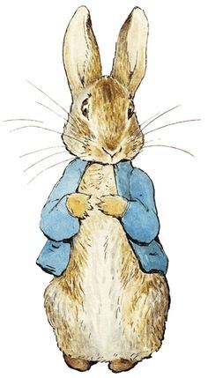
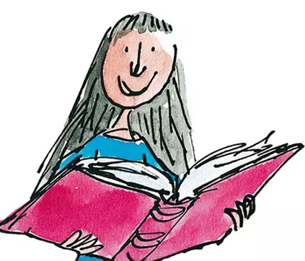
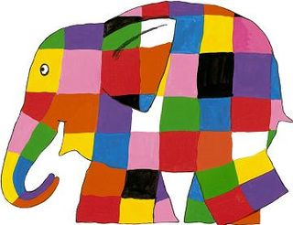
Warm Up – Guess the character
Activity:
Choose a character describe them without saying
their name.
Can someone at home guess your character?

Slide 5
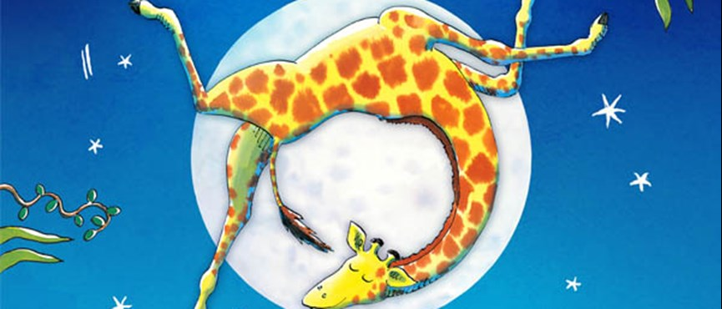
Giraffes Can’t Dance
Activity:
Listen to this story:
https://www.youtube.com/watch?v=0Bp2wiMu9xU

Slide 6
Giraffes Can’t Dance.
Activity:
Option 1 – Draw the main character. Describe them (looks and personality) to someone at home.
Option 2 – Draw the main character. Label your drawing with key words to describe them (looks and personality)
Option 3 – Draw the main character. Label your drawing with key words to describe them (looks and personality). Write a short descriptive sentence using your key adjectives.

Slide 7
Assessment and Plenary
Think:
Did you successfully describe the main character?
Choose an assessment method and draw it beside your work.
1 – I struggled 4 – I’m doing well
Red – not there yet 2 – I found some difficult
Orange – getting there 3 – I think I’m getting it 5 – I have got it!
Green – got it!
Next step:
Can you dance like Gerald the giraffe?

