Slide 1
Numeracy
Subtraction
L.I. to take away
S.C. I can use my counting backwards strategy
I can use my friends of 10 to help me take away

Slide 2
Warm up
Make a number line 0-20 or 0-100
Practise counting 100 - 0 Backwards watching the video
https://www.youtube.com/watch?v=8jMmZaFvRpE
Watch the subtraction video and singalong saying the answers as you go.
https://www.youtube.com/watch?v=QkPa9V2wtZs
Practise your friends of 10 with subtraction
https://www.youtube.com/watch?v=HvxSdytKqgg

Slide 3
Counting Backwards strategy
6 - 4 =
The biggest number is always first in a take away sum. Put it in your head. Now count backwards tracking the number on your fingers.
2,3,4,5 6
Start at the 6 as that’s the biggest number.
Hold 4 fingers up and put them down as your count backwards. The last number you say is the answer!

Slide 4
Using friends of 10 to help
You can use your friends of 10 to help with subtraction too.
10 - 2 =
You might just know the answer because you recognise it being a friend of 10!
10 – 2 =
If you don’t recognise it. Think what does 2 need to make 10? Count up from 2 to 10.
2 + = 10
2, 3, 4, 5, 6, 7, 8, 9, 10

Slide 5
Using friends of 10 with bigger numbers
You can use your friends of 10 to help do subtraction with larger numbers too
50 - 4 =
You might just know the answer because you recognise it being a friend of 10!
Think what does 4 need to make 10?
4 + = 10
Remember you are counting backwards so you are going into the decade before when counting backwards.
4 + 6 = 10
46, 47, 48, 49 50

Slide 6
Daily tasks
Write the following sums in your jotter.
There are Mild, Hot and Spicy ones to choose from. If you complete a set and find it easy try the next one!
Remember to use the most efficient strategy to help you get the answer quickly.
If you get you stuck you can always use items to help you. For example you may use buttons, cheerios or bits of lego.

Slide 7
Mild
1. | 8 - 5 =
2. | 4 - 3 =
3. | 5 - 2 =
4. | 7 - 3 =
5. | 9 - 3 =
6. | 17 - 2 =
7. | 18 - 6 =
8. | 15 - 3 =
9. | 16 - 3 =
10. | 15 - 4 =

Slide 8
Spicy
1. | 28 - 8 =
2. | 34 - 4 =
3. | 45 - 5 =
4. | 27 - 7 =
5. | 39 - 9 =
6. | 37 - 8 =
7. | 48 - 9 =
8. | 55 - 6 =
9. | 36 - 8 =
10. | 45 - 8 =

Slide 9
Hot
1. | 78 - 10 =
2. | 84 – 20 =
3. | 65 – 20 =
4. | 57 - 30 =
5. | 99 – 30 =
6. | 87 – 20 =
7. | 78 - 30 =
8. | 85 – 30 =
9. | 96 – 20 =
10. | 65 – 40 =

Slide 10
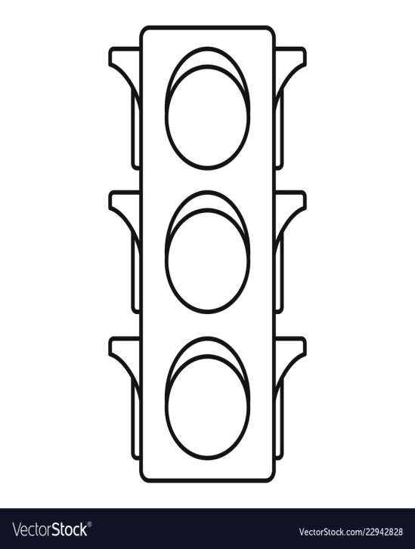
Assessment
How did you get on? Choose one way.
Tell me how you feel it went by leaving
a comment on the blog.
Draw one of the self assessment methods below next to your work.
Traffic light Fist of 5
1 – I struggled
Red – not there yet 2 – I found some difficult
Orange – getting there 3 – I think I’m getting it
Green – got it! 4 – I’m doing well
5 – I have got it!

Slide 11
Plenary
Play these games! Minus mission and Count Back
Use your efficient strategies to help you out!
https://www.arcademics.com/games/mission
https://www.topmarks.co.uk/learning-to-count/blast-off

Slide 12
Amazing Effort
Everyone!

