Slide 1
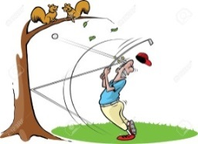
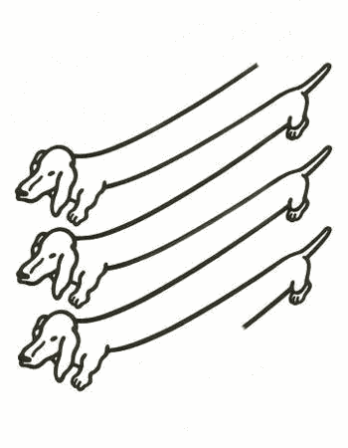
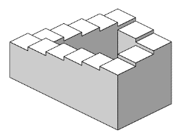
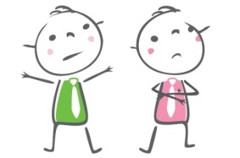

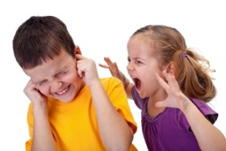

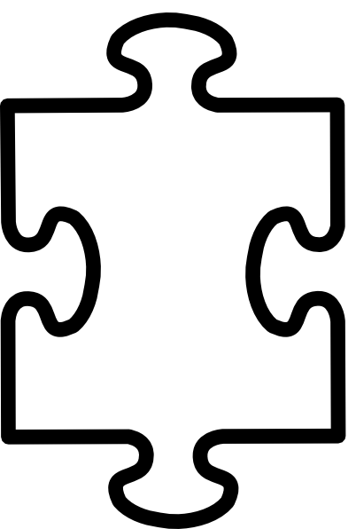

Prefixes – Primary 4
prefix un-
prefix il-
prefix im-
prefix dis-
prefix in-
prefix mis-
prefix ir-
prefix
root
word
D. Bryant 2016

Slide 2
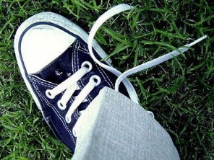

Prefix un-
By adding the ‘un-’ prefix, the meaning of the base word changes to the opposite - unwell is the opposite of well.
un-
untie
unlucky
Year 3

Slide 3
un
able
prefix un-

Slide 4
un
afraid
prefix un-

Slide 5
un
aided
prefix un-

Slide 6
un
aware
prefix un-

Slide 7
un
beaten
prefix un-

Slide 8
un
block
prefix un-

Slide 9
un
certain
prefix un-

Slide 10
un
clean
prefix un-

Slide 11
un
clear
prefix un-

Slide 12
un
clip
prefix un-

Slide 13
un
cover
prefix un-

Slide 14
un
cut
prefix un-

Slide 15
un
do
prefix un-

Slide 16
un
dress
prefix un-

Slide 17
un
even
prefix un-

Slide 18
un
equal
prefix un-

Slide 19
un
expected
prefix un-

Slide 20
un
fair
prefix un-

Slide 21
un
fasten
prefix un-

Slide 22
un
fit
prefix un-

Slide 23
un
fold
prefix un-

Slide 24
un
happy
prefix un-

Slide 25
un
helpful
prefix un-

Slide 26
un
kind
prefix un-

Slide 27
un
known
prefix un-

Slide 28
un
lace
prefix un-

Slide 29
un
like
prefix un-

Slide 30
un
load
prefix un-

Slide 31
un
lock
prefix un-

Slide 32
un
lucky
prefix un-

Slide 33
un
made
prefix un-

Slide 34
un
noticed
prefix un-

Slide 35
un
open
prefix un-

Slide 36
un
pack
prefix un-

Slide 37
un
paid
prefix un-

Slide 38
un
pick
prefix un-

Slide 39
un
plug
prefix un-

Slide 40
un
read
prefix un-

Slide 41
un
real
prefix un-

Slide 42
un
safe
prefix un-

Slide 43
un
seen
prefix un-

Slide 44
un
stuck
prefix un-

Slide 45
un
sure
prefix un-

Slide 46
un
tidy
prefix un-

Slide 47
un
tied
prefix un-

Slide 48
un
told
prefix un-

Slide 49
un
usual
prefix un-

Slide 50
un
wanted
prefix un-

Slide 51
un
well
prefix un-

Slide 52
un
wind
prefix un-

Slide 53
un
wrap
prefix un-

Slide 54
un
zip
prefix un-

Slide 55

Prefix dis-
By adding the ‘dis-’ prefix, the meaning of the base word often changes to the opposite – disagree is the opposite of agree.
dis-
disagree
Year 3 spellings

Slide 56
dis
agree
prefix dis-

Slide 57
dis
able
prefix dis-

Slide 58
dis
allow
prefix dis-

Slide 59
dis
cover
prefix dis-

Slide 60
dis
grace
prefix dis-

Slide 61
dis
like
prefix dis-

Slide 62
dis
loyal
prefix dis-

Slide 63
dis
obey
prefix dis-

Slide 64
dis
order
prefix dis-

Slide 65
dis
own
prefix dis-

Slide 66
dis
mount
prefix dis-

Slide 67
dis
please
prefix dis-

Slide 68
dis
repair
prefix dis-

Slide 69
dis
trust
prefix dis-

Slide 70
dis
appear
prefix dis-

Slide 71
dis
appoint
prefix dis-

Slide 72
dis
approve
prefix dis-

Slide 73
dis
belief
prefix dis-

Slide 74
dis
believe
prefix dis-

Slide 75
dis
comfort
prefix dis-

Slide 76
dis
honest
prefix dis-

Slide 77
dis
continue
prefix dis-

Slide 78

Prefix mis-
By adding the ‘mis-’ prefix, the meaning of the base word often changes to the opposite – misbehave is the opposite of behave.
mis-
misbehave
Year 3 spellings

Slide 79
mis
lead

Slide 80
mis
behave

Slide 81
mis
lay

Slide 82
mis
calculate

Slide 83
mis
conduct

Slide 84
mis
guide

Slide 85
mis
fire

Slide 86
mis
fit

Slide 87
mis
hap

Slide 88
mis
hear

Slide 89
mis
fortune

Slide 90
mis
heard

Slide 91
mis
lead

Slide 92
mis
inform

Slide 93
mis
judge

Slide 94
mis
place

Slide 95
take
mis

Slide 96
time
mis

Slide 97
mis
treat

Slide 98
mis
pronounce

Slide 99
mis
took

Slide 100
read
mis

Slide 101
mis
understand

Slide 102
spell
mis

Slide 103
mis
use

Slide 104
Prefix il-
By adding this prefix, the meaning of the base word often changes to the opposite, or ‘not’ something – illegal is the opposite of legal.
il-
Use when base word begins with ‘l’.
illogical

Slide 105
il
legal

Slide 106
il
logical

Slide 107
il
legible

Slide 108

Prefix im-
By adding this prefix, the meaning of the base word often changes to the opposite, or ‘not’ something – impatient is the opposite of patient.
im-
Use when base word begins with ‘m’ or ‘p’.
impossible

Slide 109
im
mature

Slide 110
im
mobile

Slide 111
im
modest

Slide 112
im
moral

Slide 113
im
mortal

Slide 114
im
movable

Slide 115
im
measurable

Slide 116
im
partial

Slide 117
im
patient

Slide 118
im
perfect

Slide 119
im
personal

Slide 120
im
polite

Slide 121
im
possible

Slide 122
im
practical

Slide 123
im
precise

Slide 124
im
probable

Slide 125
im
proper

Slide 126
im
pure

Slide 127
im
balance

Slide 128
im
mortal

Slide 129
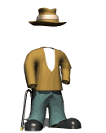
Prefix in-
By adding this prefix, the meaning of the base word often changes to the opposite, or ‘not’ something – inactive is the opposite of active.
in-
invisible

Slide 130
in
active

Slide 131
in
accurate

Slide 132
in
appropriate

Slide 133
in
capable

Slide 134
in
correct

Slide 135
in
credible

Slide 136
in
sincere

Slide 137
in
visible

Slide 138
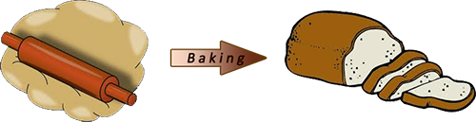
Prefix ir-
By adding this prefix, the meaning of the base word often changes to the opposite, or ‘not’ something – irregular is the opposite of regular.
ir-
Use when base word begins with ‘r’.
irreversible

Slide 139
ir
rational

Slide 140
ir
regular

Slide 141
ir
relevant

Slide 142
ir
replaceable

Slide 143
ir
resistible

Slide 144
ir
respective

Slide 145
ir
responsible

Slide 146
ir
reversible

