Slide 1
Numeracy lesson. Wednesday 25th March

Slide 2
Mental Maths Recommended time 15 mins
Adding multiples of ten
Multiples of ten are:
10,20,30,40,50,60,70,80,90,100
The easiest way to do this is to think about them as ten sticks so…
30+40=
3 ten sticks + 4 ten sticks= 7 tens and 7 tens are 70!

Slide 3
Mental Maths
Your turn!
10+20=
30+50=
50+40=
30+70=
60+50=
70+50=
40+40=
90+80=
70+70=
100+50=

Slide 4
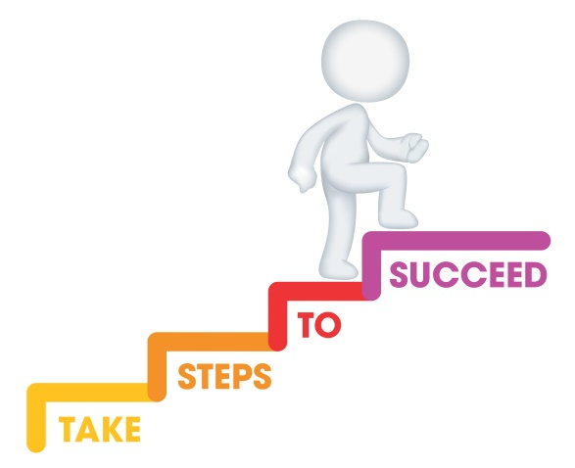
L.I. To estimate and then add Recommended time approx 1 hour
Steps to success
I can make a sensible estimation by rounding to the nearest 10.
I can add by drawing dienes or using the partitioning method.
I can check if my answer is sensible by comparing it with my
estimation.

Slide 5
Can you remember what estimation means?

Slide 6
Yes, it means to have a sensible guess! This is useful for checking our answers look sensible. It’s useful in the real world when you go to pay for items at the till. If you have a rough estimate at how much you owe then you’ll know if you have enough money!

Slide 7
One way we can have a sensible guess it to round to the nearest 10. Watch this video clip to remind yourself how to do this! https://www.youtube.com/watch?v=CMdck80SHnw

Slide 8
Your task, to estimate the answer to an addition sum, calculate the exact answer and then compare it to see if you’re answer looks correct!

Slide 9
Here is an example… 33+ 59= Step 1: Round both numbers… 33 rounds to 30 59 rounds to 60

Slide 10
Here is an example… 33+ 59= Step 2: Add the rounded numbers to calculate your estimate. 30+60=90 So my estimate is that the answer to 33+59 will be around 90.

Slide 11
Here is an example… 33+ 59= Step 3:Calculate the actual sum. Use either partition method or draw the dienes (Monday and Tuesday’s lesson). 33 30 and 3 +59 50 and 9 92 80 + 12
Answer=92

Slide 12
Here is an example… 33+ 59= Step 4:Compare with your estimate, is it a sensible answer? If not, check your calculation.. So my estimate was 90 and my actual answer was 92 so yes I can feel confident I’ve got it right!

Slide 13
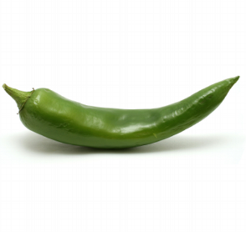
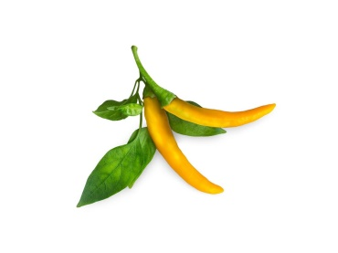
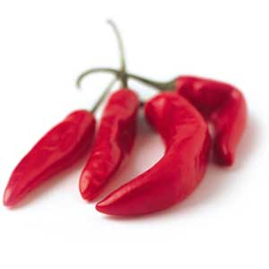
Your turn! In your jotter round these numbers first, make and estimation. Then calculate the actual answer. Check it against your estimation.
Mild
Spicy
Hot
23+ 12=
17+14=
30+ 41=
45+27=
13+ 48=
87+23=
65+ 17=
98+24=
43+ 15=
68+34=
132+ 81=
123+23=
101+ 111=
130+127=
233+ 23=
832+128=
423+ 15=
682+34=
132+ 181=
123+223=
221+ 327=
453+127=
827+ 323=
801+401=

Slide 14
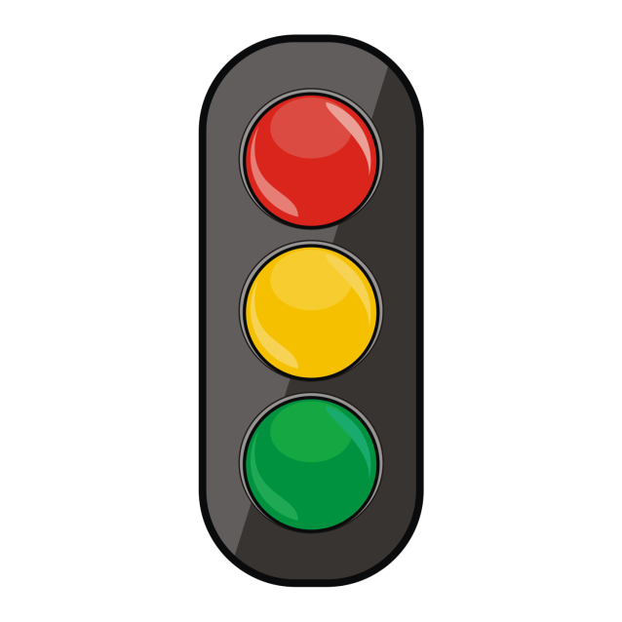
Let’s reflect on our learning! Can you now… ..make a sensible estimation by rounding to the nearest 10? …add by drawing dienes or using the partitioning method? …check if my answer is sensible by comparing it with my estimation?
Not achieved the learning intention- I’ve answered ‘no’ to all of the above.
Go through the slides again.
Partly achieved the learning intention- I’ve answered ‘yes’ to some of the above
Goo job! We’ll keep practising.
Achieved the learning intention- I’ve answered ‘yes’ to all of the above.
Well done!

