Slide 1
Literacy
Home Learning recommendation for lots of free resources:
https://home.oxfordowl.co.uk/school-closure-resources/

Slide 2
Literacy
Reading – Characters Part 1 (of 3)
You will need:
A comfy spot to work and someone to help you with the lesson.

Slide 3
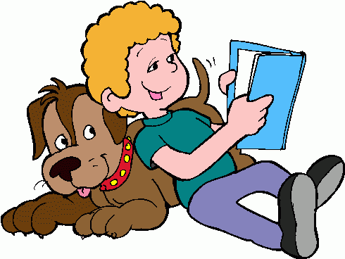
Literacy
Reading – Characters Part 1 (of 2)
Learning Intention (LI):
to show an understanding of what I’m reading
(or listening to).
Success Criteria (SC):
I can match adjectives to characters.

Slide 4
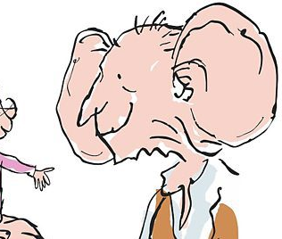
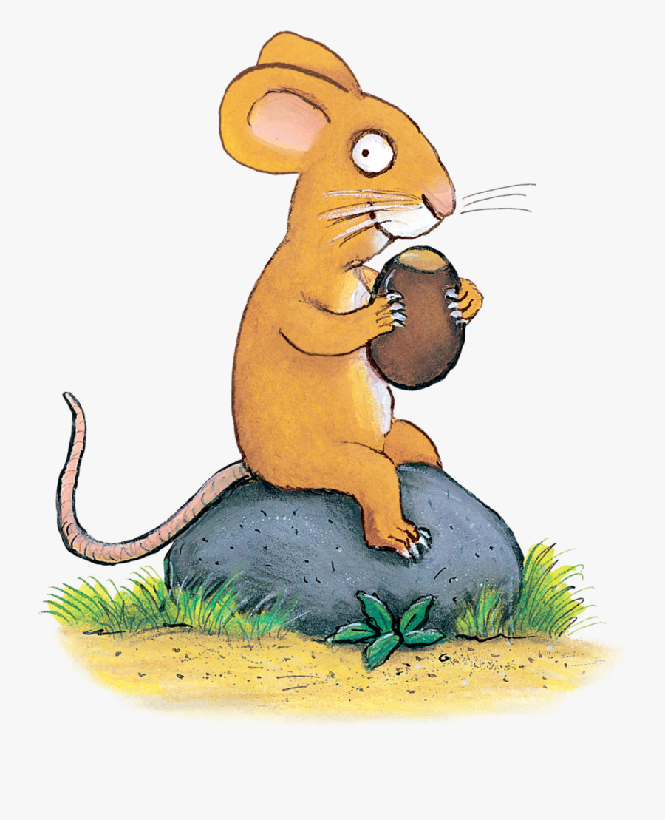
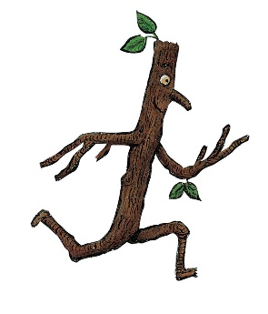
Amazing Adjectives
Activity 1:
Match the sentences to each character
to describe how they look (their appearance).
Long whiskers and a red and white striped hat.
Big ears and a long tail.
Brown and bumpy skin.
Enormous ears and a big smile.

Slide 5
Amazing Adjectives
Activity 2:
Match the sentences to each character
to describe what they are like (their personality).
Clever and sneaky .
Friendly and kind.
Brave and determined.
Mischievous and funny.

Slide 6
Assessment and Plenary
Think:
Did you successfully describe the characters?
Choose an assessment method and draw it beside your work.
1 – I struggled 4 – I’m doing well
Red – not there yet 2 – I found some difficult
Orange – getting there 3 – I think I’m getting it 5 – I have got it!
Green – got it!
Next step:
Are there other words you would use to describe these characters?
Do you have books with these characters in them?
If so, tell me in the blog comments. Well done!

