Slide 1
Literacy
Writing – Imaginative, part 3 (of 3)
You will need:
Sharp pencil, our writing from yesterday, he VCOP sheet from your Home Learning booklet (given home in your pack/collected from school) and someone to help you read through your work and the lesson.
Follow the lesson plan or skip to slide 4.

Slide 2
Literacy
Writing – Imaginative, part 3 (of 3)
Learning Intention (LI):
to develop my own ideas for imaginative writing.
Success Criteria (SC):
I can describe a setting using amazing adjectives.
I can use The Descriptive Bubble to describe what I
can see, hear and feel in a picture prompt.
I can check and up-level my work.

Slide 3
Warm Up
Activity:
Do these descriptions match the pictures?
True or false?
The blossom tree has ten pink flowers.
The three orange daffodils have a yellow
trumpet.
The butterfly is symmetrical.

Slide 4
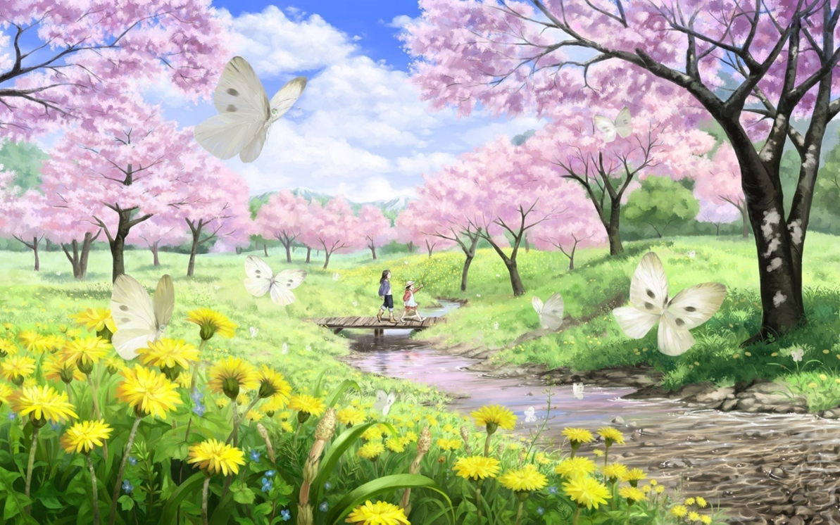
Activity:
Read your title and story with someone and
up-level your work. Use the VCOP sheet in your Home Learning pack.
(VCOP = vocabulary, connectives, openers and punctuation).
Think:
Does your title and descriptions match the image?
Do you need to up-level your work?
Have you included a character?
Have you used amazing adjectives?
Could you add joining words?

Slide 5
Assessment and Plenary
Activity:
With permission, post a photo of your Imaginative Writing work to the school blog or Twitter page.
Think:
Did you successfully up-level your writing?
Choose an assessment method and draw it beside your work. 1 – I struggled 4 – I’m doing well
Red – not there yet 2 – I found some difficult
Orange – getting there 3 – I think I’m getting it 5 – I have got it!
Green – got it!
Next step:
Keep on writing! You can use this lesson to write similar imaginative stories using your own settings, views or images. Well done

Slide 6
Extension activities
Option 1:
Write a spring senses poem
Option 2:
Draw or paint some spring flowers.
Option 3:
Count how many butterflies visit your garden.

