Slide 1
Grammar
LI. To use conjunctions
SC. I can identify conjunctions
I can use conjunctions to join two short sentences together.

Slide 2
Warm Up
Watched the video and learn about conjunctions.
https://www.youtube.com/watch?v=psjd5w125Ac

Slide 3
Conjunctions
Conjunctions are joining words.
We use them to join sentences.
Give me the bag. I will unpack it.
Give me the bag and I will unpack it.
I want a plum. There are none left.
I want a plum but there are none left.

Slide 4
Read the sentences.
Say the conjunction in each sentence.
We got there on time but we missed the bus.
Sam likes oranges and he likes apples.
The birds made a nest but they did not lay any eggs.
We played well and won the match.

Slide 5
Copy the sentences and join the sentences with and or but.
1. I dropped the glass.
It didn’t smash.
2. There was a knock at the door.
Mum opened it.
3. I like football.
I don’t like swimming.

Slide 6
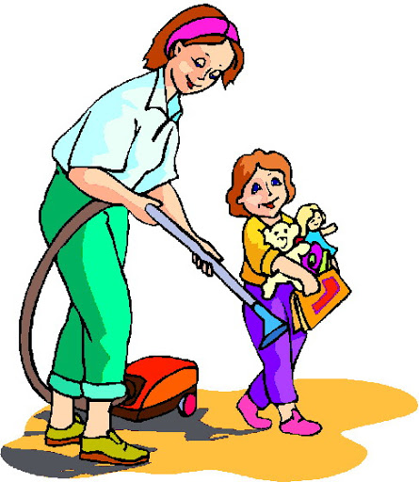
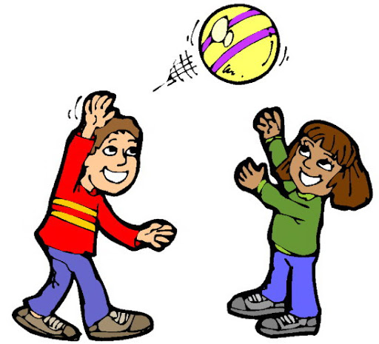
1. Write two sentences about this picture.
Join the two sentences with and or but.
2. Write two sentences about this picture.
Join the two sentences with and or but.

Slide 7
Assessment Time
How did you get on? Choose one way.
Tell me how you feel it went by leaving
a comment on the blog.
Draw one of the self assessment methods below next to your work.
Traffic light Fist of 5
1 – I struggled
Red – not there yet 2 – I found some difficult
Orange – getting there 3 – I think I’m getting it
Green – got it! 4 – I’m doing well
5 - I’ve got it!

