Slide 1
Numeracy lesson. Tuesday 24th March

Slide 2
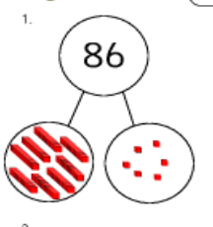
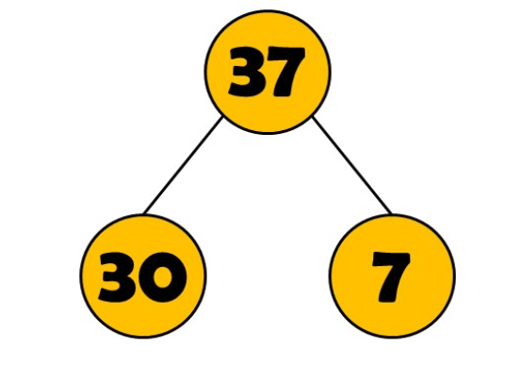
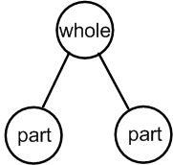
Mental Maths Recommended time 15 mins
Partitioning numbers- remember this just means to break them up into hundreds, tens and ones. Here is an example…

Slide 3
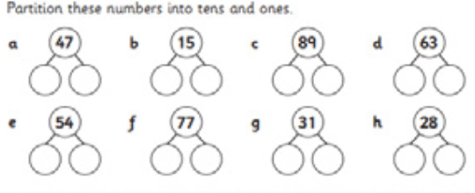
Mental Maths Recommended time 15 mins
Partition these numbers…
Extra challenge…
173

Slide 4
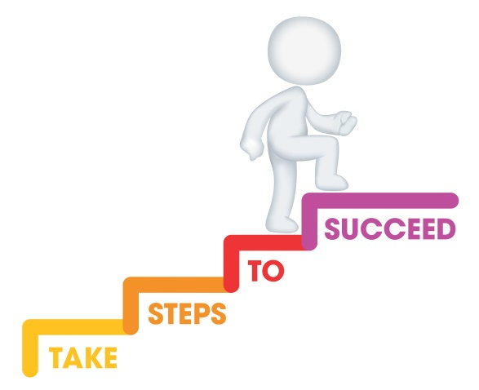
L.I. To add using expanded addition method. Recommended time approx 1 hour
Steps to success
I can partition numbers into hundreds, tens and ones.
I can add the ones.
I can add the tens/hundreds.
I can combine these to find the answer.

Slide 5
Parents/Carers please note this is the step before regular column addition. The reason we do it this way is so pupils have a good understanding of the value of the of the digits and so they don’t get confused with ‘carrying’ digits into the tens/hundreds column.

Slide 6
Step 1- write down your sum and ensure digits are on top of each other..
Tens sit above each other
Ones sit above each other
45
+39

Slide 7
Step 2- partition each number to the side.
Ensure the tens and ones are lined up again.
45 40 and 5
+39 30 and 9

Slide 8
Step 3- add vertically the ones.
5 + 9.
45 40 and 5
+39 30 and 9
and 14

Slide 9
Step 4- add vertically the tens.
40+30.
45 40 and 5
+39 30 and 9
70 and 14

Slide 10
Step 4- add the tens and ones together.
70+14=84.
45 40 and 5
+39 30 and 9
84 70 and 14

Slide 11
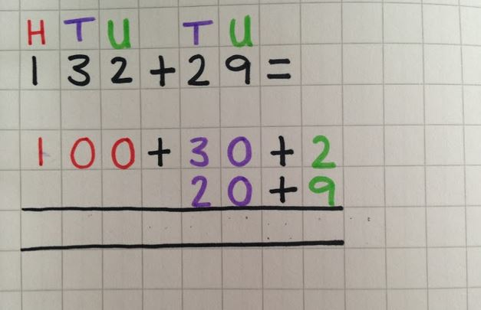
Here is an example with a bigger number
Can you work out the answer?
Look how this is carefully lined up!

Slide 12
Here is an example with a bigger number
Can you work out the answer?

Slide 13
Your turn! In your jotter calculate the following by drawing the dienes. You choose which chilli challenge suits your level of understanding!
Mild
Spicy
Hot
43+ 12=
15+14=
33+ 31=
41+23=
17+ 42=
84+27=
75+ 13=
92+24=
49+ 18=
78+29=
123+ 51=
201+23=
125+ 129=
381+127=
727+ 23=
943+128=
78+29=
123+ 51=
381+127=
727+ 23=
943+128=
1234+123=
2314+3021=
4920+329=

Slide 14
Let’s reflect on our learning! Can you now… Partition numbers into hundreds, tens and ones? Add the ones? Add the tens/hundreds? Combine these to find the answer?
Not achieved the learning intention- I’ve answered ‘no’ to all of the above.
Go through the slides again.
Partly achieved the learning intention- I’ve answered ‘yes’ to some of the above
Goo job! We’ll keep practising.
Achieved the learning intention- I’ve answered ‘yes’ to all of the above.
Well done!

