Slide 1
Literacy
Writing – Imaginative, part 2 (of 3)
You will need:
Sharp pencil, plain and lined paper, access to You tube and someone to help you read through the lesson.
Follow the lesson plan or skip to
slides 4 and 7.

Slide 2
Literacy
Writing – Imaginative, part 2 (of 3)
Learning Intention (LI):
to develop my own ideas for imaginative writing.
Success Criteria (SC):
I can describe a setting using amazing adjectives.
I can use The Descriptive Bubble to describe what I
can see, hear and feel in a picture prompt.
I can include a characters thoughts and feelings.

Slide 3
Warm Up
Activity:
Use the link to listen to the music (2 minutes is enough).
https://www.youtube.com/watch?v=WyVf0tMsIk0
Sit or lie in a quiet spot. RELAX.
What can you hear? How would you describe the sounds?
Discuss with someone. Do they hear anything else?

Slide 4
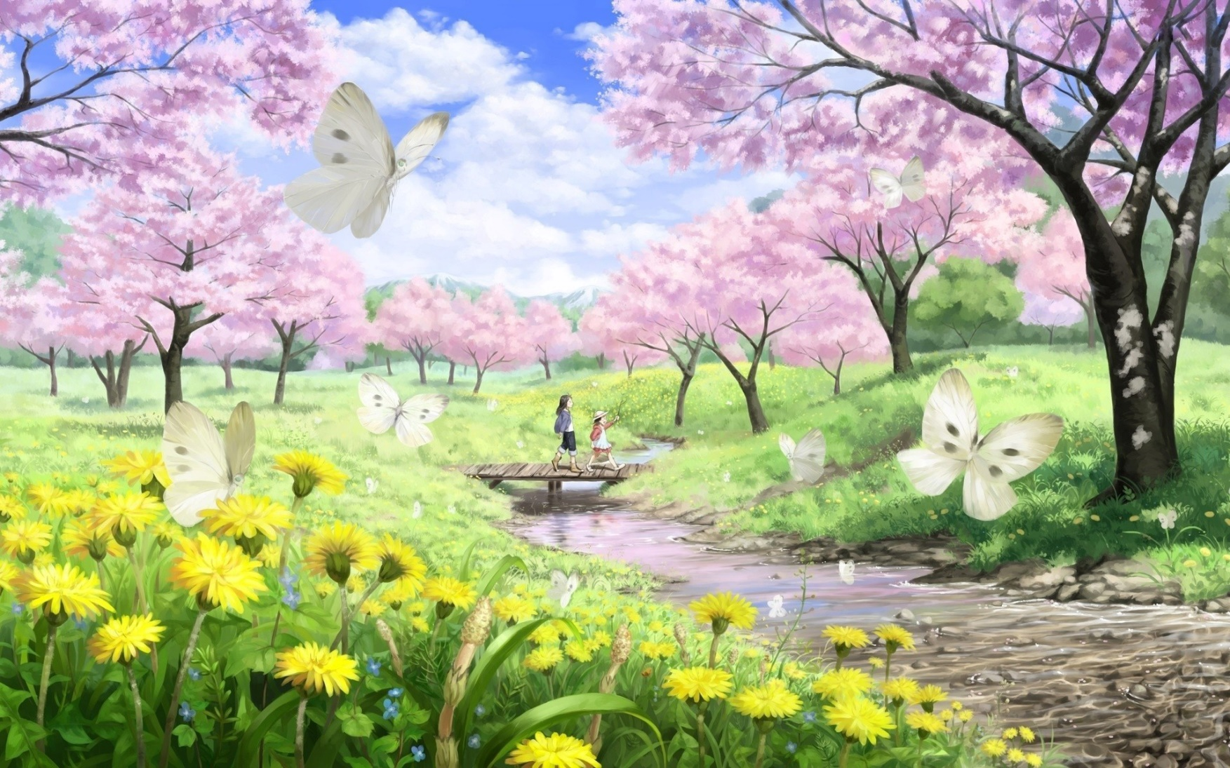
Activity: Describe the scene to someone. What can you see, hear and feel?

Slide 5
Example 1
Pink Trees
There is a bridge. It is hot. Butterflies are flying.
Discuss:
What is wrong with this example?
What would make it better?
Is it interesting?

Slide 6
Example 2 (up-level)
Sunny Spring Day
As Chloe and her big cousin skipped across the wooden bridge a butterfly flew by, fluttering from one soft pink blossom tree to another. Chloe felt the warm sunshine on her face and was looking forward to sitting in the shade to share a picnic with her cousin. The stream gently bubbled under the bridge and the sound made Chloe feel relaxed. She picked up a smooth round pebble and dropped it in the water where it made a small splash before sinking to the bottom. Chloe and her cousin skipped down the path and into the shade to enjoy their picnic.
Discuss:
Could this be a WAGOLL? (What A Good One Looks Like) Why?
Has the setting been described using amazing adjectives?
Can you find what can bee seen, heard and felt?

Slide 7
Descriptive Bubble
size
shape
Activity:
Option 1 – Write a title and at least three sentences (what can you see, hear and feel).
Option 2 – Write a title and at least three sentences (what can you see, hear and feel). Use a joining words for each sentence (and, but, because, so).
Option 3 – Write a title and one sentence for each part of the Descriptive Bubble to describe what can you see, hear and feel.
number
doing
texture
colour

Slide 8
Assessment and Plenary
Activity:
Sit or lie in a quiet spot. Read over your title or story and look at your drawing. RELAX
Think:
Did you successfully describe the image using amazing adjectives and the Descriptive Bubble?
Choose an assessment method and draw it beside your work. 1 – I struggled 4 – I’m doing well
Red – not there yet 2 – I found some difficult
Orange – getting there 3 – I think I’m getting it 5 – I have got it!
Green – got it!
Next step:
Will you make any changes?

