Slide 1
Numeracy
Addition
L.I. to add two numbers together
S.C. I can use my counting on strategy
I can add using my friends of ten.

Slide 2
Warm up
Practise counting 0-100 forwards watching the video
https://www.youtube.com/watch?v=1dkPouLWCyc
Watch the addition video and singalong saying the answers as you go.
https://www.youtube.com/watch?v=uRoJ5E-Xx9s
Singalong learning your friends of 10
https://www.youtube.com/watch?v=QS5w8LRnnp0
Write down all the friends of 10 as fast as you can.
1_9 2_8 3_7 etc

Slide 3
Counting on strategy
4 + 7 =
Put the biggest number in your head. Now count on the rest on your fingers.
7 8,9,10,11,
Start at the 7 as that’s the biggest number.

Slide 4
Using friends of 10
You can use your friends of 10 to help with addition.
8 + 2 =
You might just know the answer because you recognise it being a friend of 10!
8 + 6 =
Think what does 8 need to make 10? Split the 6 into this number and what’s left.
8 + 6 =
2 4
8 +2 =10 10 + 4 = 14

Slide 5
Using friends of 10 with bigger numbers
You can use your friends of 10 to help with addition with larger numbers too
46 + 4 =
You might just know the answer because you recognise it being a friend of 10!
46 + 6 =
Think what does 6 need to make 10? Split the 6 into this number and what’s left.
46 + 6 =
4 2
46 +4 =50 50 + 2 = 52

Slide 6
Daily tasks
Write the following sums in your jotter.
There are Mild, Hot and Spicy ones to choose from. If you complete a set and find it easy try the next one!
Remember to use the most efficient strategy to help you get the answer quickly.
If you get you stuck you can always use items to help you. For example you may use buttons, cheerios or bits of lego.

Slide 7
Mild
1. | 3 + 5 =
2. | 4 + 3 =
3. | 5 + 2 =
4. | 7 + 3 =
5. | 5 + 3 =
6. | 11 + 2 =
7. | 13 + 6 =
8. | 14 + 3 =
9. | 15 + 3 =
10. | 16 + 4 =

Slide 8
Hot
1. | 36 + 4 =
2. | 45 + 5 =
3. | 16 + 4 =
4. | 53 + 7 =
5. | 74 + 6 =
6. | 79 + 5 =
7. | 87 + 7 =
8. | 47 + 8 =
9. | 85 + 7 =
10. | 69 + 6 =

Slide 9
Spicy
1. | 48 + 12 =
2. | 56 + 14 =
3. | 37 + 23 =
4. | 49 + 21=
5. | 58 + 22 =
6. | 52 + 34 =
7. | 61 + 33 =
8. | 44 + 42 =
9. | 35 + 42 =
10. | 53 + 23 =

Slide 10
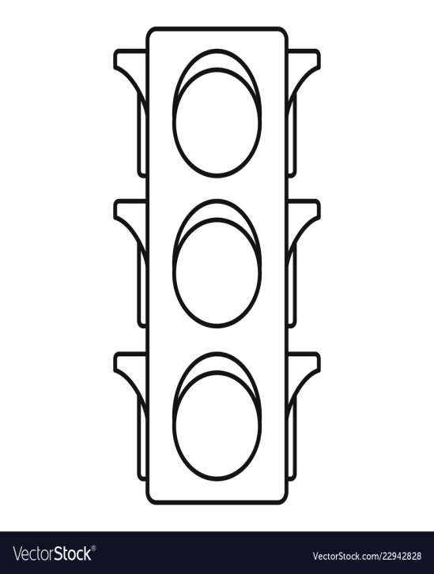
Assessment
How did you get on? Choose one way.
Tell me how you feel it went by leaving
a comment on the blog.
Draw one of the self assessment methods below.
Traffic light Fist of 5
1 – I struggled
Red – not there yet 2 – I found some difficult
Orange – getting there 3 – I think I’m getting it
Green – got it! 4 – I’m doing well
5 – I have got it!

Slide 11
Plenary
Play these games!
Use your efficient strategies to help you out!
https://pbskids.org/curiousgeorge/busyday/ten/
https://www.arcademics.com/games/alien

Slide 12
Well Done Everyone!

