Slide 1
Literacy Tuesday 24th March Part 1
L.I. to read words using our phonics sounds
S.C. I can read ed words.

Slide 2
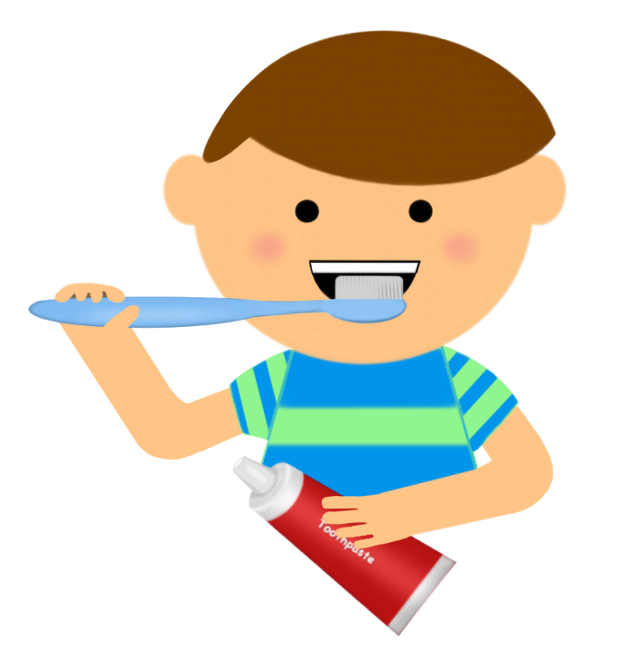
Verbs
Verbs are doing words.
If the word has an ed on the end it tells us the action/verb that has happened in the past.
Its called the past tense.
brush brushed

Slide 3
Watch the links below
https://www.youtube.com/watch?v=0b4rsDuzThE
https://www.youtube.com/watch?v=msJIy_f_Xsw

Slide 4
Warm Up Game!
Can you read what the verb is and act it out?
Let’s have a go!

Slide 5
jumped rolled
Licked dressed
painted washed
Looked opened
Pushed played

Slide 6
Part 2
L.I. to make sentences make sense.
S.C. I can complete the sentences using ed words to make them make sense.
Activity – Build a Sentence.
Write the sentences and fill in the missing words from the choice at the bottom of the page.
Choose from Mild, Spicy or Hot

Slide 7
Mild
Build a sentence – ed
Biff__________ the rug.
Chip _____________ the box.
Floppy___________ into the pond.
Mum___________ her hair.
jumped | pulled
opened | brushed

Slide 8
Spicy
Build a sentence – ed
Dad______________ football with his friends.
The children__________ their hands.
The man ___________ his car in the drive.
Kipper____________ his books into his school bag.
Everyone___________ at home.
Mum and Dad __________ from home.
The children all ____________school.
Dad __________ the light.
washed | played
stayed | fixed
parked | packed
worked | missed

Slide 9
Hot
Build a sentence – ed
He was___________ there were toilet rolls in the shop.
The boy got _______________ into his Pj’s because it was bedtime.
The parents ____________ after a busy day home schooling.
The children _______________ rainbows to put in their windows.
People ___________ food online but there was a huge waiting time.
Mum____________ the shelf and found some coins for the piggy bank.
The pupils ____________ at home for a while and enjoyed it.
The boys_______________ a game onto the computer to play.
learned | surprised
ordered | dusted
relaxed | painted
changed | loaded

Slide 10
Assessment Time
How did you get on? Choose one way.
Tell me how you feel it went by leaving
a comment on the blog.
Draw one of the self assessment methods below next to your work.
Traffic light Fist of 5
1 – I struggled
Red – not there yet 2 – I found some difficult
Orange – getting there 3 – I think I’m getting it
Green – got it! 4 – I’m doing well
5 – I have got it!

Slide 11
Plenary
Ask an someone in your family to act out some of the ed words. Try to spell them on paper to guess what they are doing!

Slide 12
A song to finish up! This has some more spelling rules for adding ed.
https://www.youtube.com/watch?v=u1lZ9-81MOo

