Slide 1
Literacy
L.I. to spell words using our phonics sounds
S.C. I can spell ed words.

Slide 2
Verbs
Verbs are doing words.
If the word has an ed on the end it tells us the action/verb that has happened in the past.
Its called the past tense.
cook cooked

Slide 3
Watch the link below
https://www.youtube.com/watch?v=jxl28KQOHy4

Slide 4
Warm Up Game!
Can you say what the verb is in each picture and try to spell it in your jotter?
Remember to add ed
Let’s have a go!

Slide 9
Reading ed words Read each word out loud Draw a picture for each verb and colour it in.
1. helped 2. packed
3. punched 4. brushed

Slide 10
Part 2
L.I. to write a sentence with a verb
S.C. I can use the descriptive bubble to make
sentences more interesting.

Slide 11
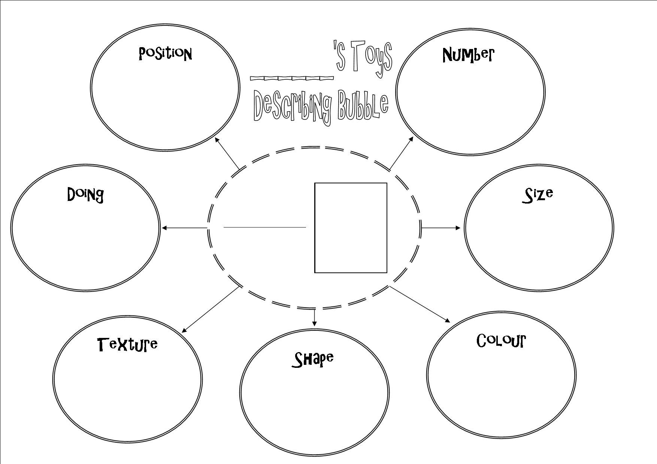
Up Level
I pushed the baby in the pram.
This sentence is boring. Let’s up level it using the descriptive bubble!

Slide 12
I pushed the baby in the pram.
First what are the nouns? (The name of things)
I pushed the baby in the pram.
These are the things I can describe.
I pushed the cute little baby in the pink frilly pram.
Now its more interesting!

Slide 13
Your Turn!
Write a sentence for each verb.
Make sure you use your basic writing targets.
Capital letters finger spaces full stops
Try to up level your sentences using the descriptive bubble.
1. helped 2. packed
3. punched 4. brushed

Slide 14
Assessment Time
How did you get on? Choose one way.
Tell me how you feel it went by leaving
a comment on the blog.
Draw one of the self assessment methods below next to your work.
Traffic light Fist of 5
1 – I struggled
Red – not there yet 2 – I found some difficult
Orange – getting there 3 – I think I’m getting it
Green – got it! 4 – I’m doing well
5 – I have got it!

Slide 15
Plenary
Act It Out!

Slide 16
Mime!
Act out a verb for your family to guess!
A song to finish up!
https://www.youtube.com/watch?v=w1tDY0pPq3w

