Slide 1
Numeracy lesson. Monday 23rd March

Slide 2
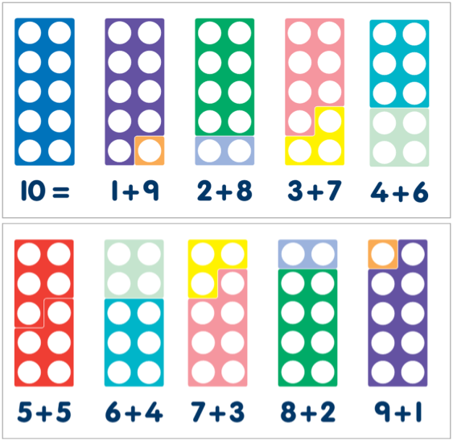
Mental Maths Recommended time 15 mins
Step 1: Make sure you can recall all your number bonds to ten (off by heart)

Slide 3
Mental Maths Recommended time 15 mins
Step 2 (if you can confidently do step 1): Change your number bonds to ten into number bonds to 100 by multiplying by ten. Then recall these off by heart.
1+9=10 so 10+90=100
2+8=10 so 20 +80=100
Extension: Can you work out a whole number family? i.e. 10+90=100 so 90+10=100
so 100-10=90 so 100-90=10

Slide 4
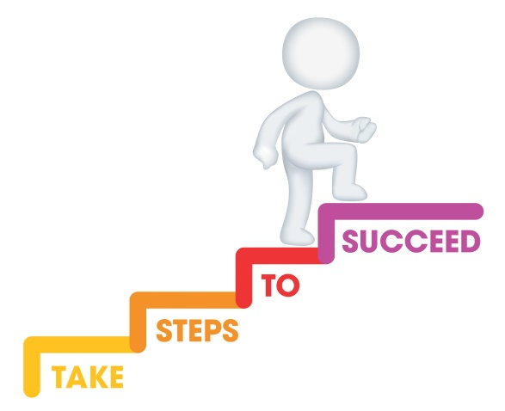
L.I. To add by drawing dienes. Recommended time approx 1 hour
Steps to success
I know how to represent a number using dienes.
I know how to draw the dienes.
I can add by drawing the dienes.
I know that it doesn’t matter what order I add in- you get the same answer.

Slide 5
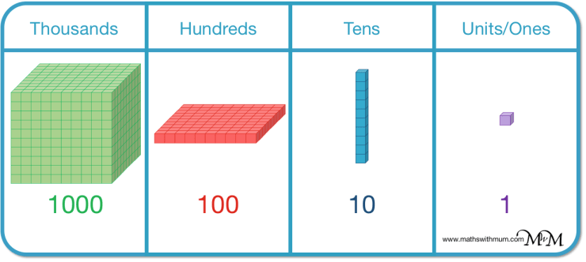
These are dienes.

Slide 6
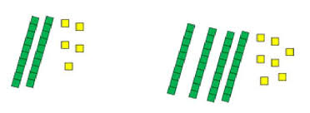
We can use dienes to represent numbers.
This represents 25 because 25 is made of 2 tens and 5 ones.
What number does this represent?

Slide 7
I can draw dienes like this

Slide 8
Now I can add numbers by drawing the dienes!
33
21

Slide 9
Now count the tens and then the ones to find the total
54
33
21
54

Slide 10
What calculation is represented by my drawing here?

Slide 11
Did you get it right?
53
34
Count the tens and then ones to find the answer!

Slide 12
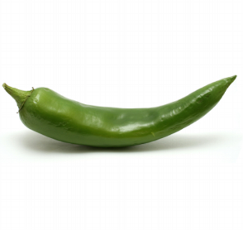
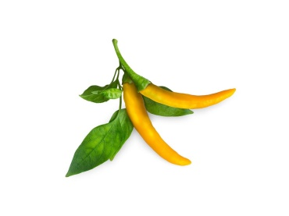
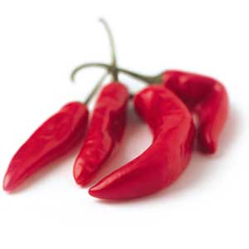
Your turn! In your jotter calculate the following by drawing the dienes. You choose which chilli challenge suits your level of understanding!
Mild
Spicy
Hot
23+ 13=
45+24=
33+ 51=
44+23=
16+ 42=
81+27=
77+ 13=
94+28=
93+ 18=
78+24=
133+ 51=
214+23=
316+ 342=
81+127=
727+ 13=
942+28=
316+ 342=
81+127=
727+ 13=
942+28=
____+ 31=102
782+___= 800
873+___=2010
____+12=3000

Slide 13
Let’s reflect on our learning! Do you now… Know how to represent a number using dienes? Know how to draw the dienes? Add by drawing the dienes? Know that it doesn’t matter what order I add in- you get the same answer?
Not achieved the learning intention- I’ve answered ‘no’ to all of the above.
Go through the slides again.
Partly achieved the learning intention- I’ve answered ‘yes’ to some of the above
Goo job! We’ll keep practising.
Achieved the learning intention- I’ve answered ‘yes’ to all of the above.
Well done!

