Slide 1
Reading lesson Monday 23rd March Either discuss these slides with an adult or write a response in your jotter (in sentences) on the ‘Your Turn’ slides. Recommended time: 30 mins

Slide 2
L.I. To infer meaning.
Steps to success
I know what inference means.
I can infer meaning from a picture.
I can infer meaning from piece of writing (text).
I can explain my thinking.

Slide 3
To infer meaning means to ‘read between the lines’ or to work out what’s going on without actually been told. It’s like been a text detective!
Okay P3 remember we’ve been working on this for the last few weeks! Although ‘inference’ sounds hard it’s really just common sense! it’s really just common sense! e!

Slide 4
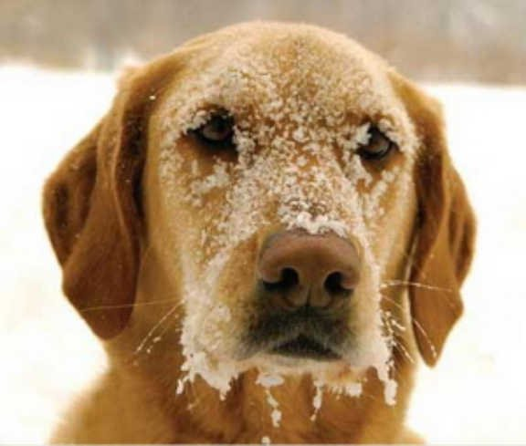
From this picture I may infer that the dog is cold and not very happy. I am inferring in this way because there is frost on his face, snow on the ground and his expression looks sad.

Slide 5
From this picture I may infer that the baby is sad and thoughtful. I am inferring in this way because her bottom lip is out, her eyes look watery and she is looking into the distance.

Slide 6
Your turn! What do you infer from this picture? Can you explain your thinking?

Slide 7
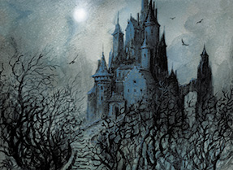
What can you infer from this picture? How do you feel about the castle? Where do you think the castle is? Who do you think lives there?
Your turn!

Slide 8
We can also infer from text (a piece of writing). He stood there shaking, his feet seemingly glued to the spot. A shudder ran down his spine. I can infer from this text that the boy is frightened perhaps he is stood somewhere scary!?

Slide 9
Without a seconds thought she jumped up and lifted Benny off the precarious ledge. I can infer from this text that she is caring towards Benny and perhaps a bit brave too!

Slide 10
Your turn! The witch cackled with delight, her plan to take over the kingdom was occurring before her eyes! What can you infer from this text? Can you explain your thinking?

Slide 11
Your turn! Ms Smith scrunched her eyebrows, “I am not going to repeat myself again P6!” What can you infer from this text? Can you explain your thinking?

Slide 12
Let’s reflect on our learning! Do you now… Know what inference means? Infer meaning from a picture? Infer meaning from piece of writing (text)? Explain your thinking?
Not achieved the learning intention- I’ve answered ‘no’ to all of the above.
Go through the slides again.
Partly achieved the learning intention- I’ve answered ‘yes’ to some of the above
Goo job! We’ll keep practising.
Achieved the learning intention- I’ve answered ‘yes’ to all of the above.
Well done!

