Slide 1
The Victorians
I P6H we have been learning about the Victorians

Slide 2
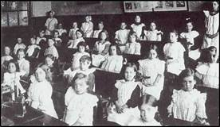
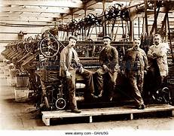
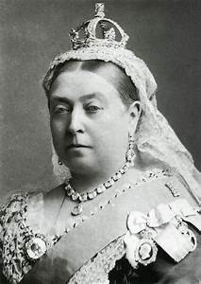
Contents
Facts about a school day
Facts about working in the Victorian times
Queen Victoria

Slide 3
Facts about a school day
In 1880 a law was passed making it compulsory for every child in Britain between the ages of 5 and 10 to attend school.
In the first half of the 1800s, classes were massive. Sometimes there were more than 100 pupils in every class.
Victorian pupils sat at iron-framed desks. These were usually bolted to the floor in rows facing the front of the classroom.
The floor of the schoolrooms were tiered (a bit like in a cinema). The children sitting at the back of the room were higher up than those sitting at the front. This meant that all of the children had a good view of the teacher and the blackboard, but it also meant that the teacher had a good view of them.
The windows in a Victorian classroom were high up (to stop pupils looking out of the window) and the rooms were lit by gaslights. As a result, the schoolrooms were gloomy and often stuffy.
Although lots of schools were built during the Victorian era, not a great deal of money was spent on taking care of the buildings. Victorian schools were often quite shabby and in need of repair.
The Victorian classroom was often referred to as the schoolroom.

Slide 4
Facts about working in the Victorian times
Children had to start working at age 10 girls would work as a maid or mill girl and boys would work as a mill boy.
The Victorians saw child labour as a normal part of working life. Most children started work underground when they were around eight years old, but some were as young as five. They would work the same hours as adults, sometimes longer, at jobs that paid far less.
The older children and women were employed as hurriers, pulling and pushing tubs full of coal along roadways from the coal face to the pit-bottom. The younger children worked in pairs, one as a hurrier, the other as a thruster, but the older children and women worked alone.
Getters were the oldest and strongest members of the family, almost always grown men or strong youths. Their job was to work at the coal face cutting the coal from the seam with a pickaxe. Getters were the only members of the family who would work continually with a candle or safety lamp, as they needed the light to see the coal face.
On 4 August 1842, a law was passed that stopped women and children under ten years from working underground in mines in Britain.

Slide 5
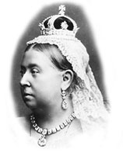
Queen Victoria
Queen Victoria was only 18 when she came to the throne and she had a lot to learn. Her reign had a rocky start. She thought that, as queen, she could do as she liked, and she quickly had to learn that she couldn’t.
Victoria was Queen of the United Kingdom of Great Britain and Ireland (1837-1901) and empress of India (1876-1901). Her reign was the longest of any monarch in British history and came to be known as the Victorian era.
Queen Victoria was born on the 24 May in 1819.
Her father died eight months after she was born.
At the age of 21, Victoria married her cousin, Albert of Saxe-Coburg Gotha, a German Prince. They married on the 10th February 1840 at the Chapel Royal in St. James's Palace.

